Slide 1
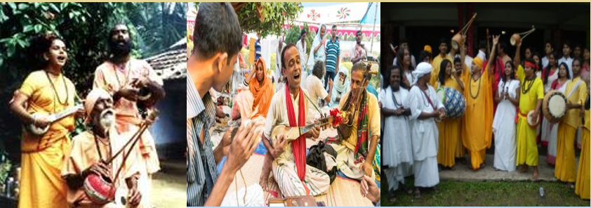
Welcome to English class.

Slide 2
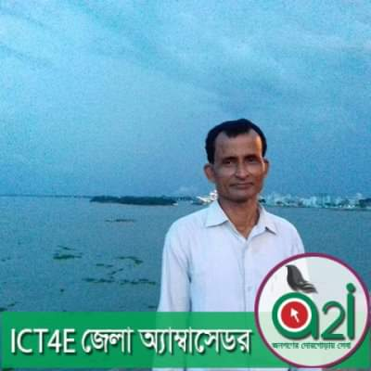
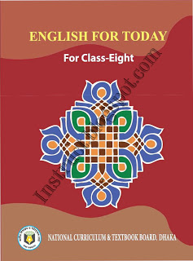
IDENTITY
Manik Chandra Majumder
Senior Teacher (English)
Gazirhat High School
Senbag, Noakhali
Mobile No: 01717155169
Email: manikmajumder01@gmail.com
Class : Eight
Subject : English 1st paper
Time : 50 Minutes
Date : 00/00/2019

Slide 3
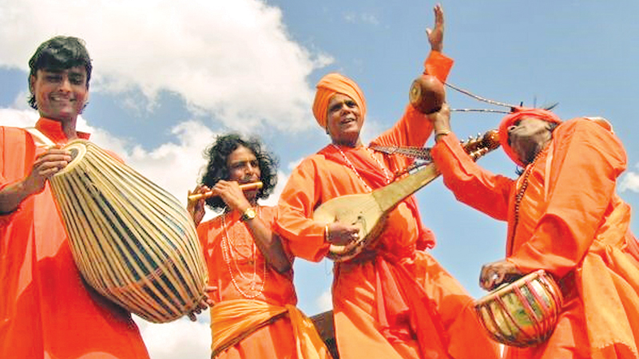
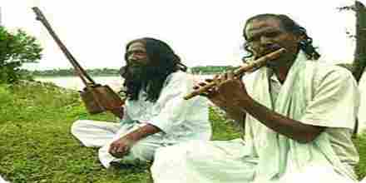
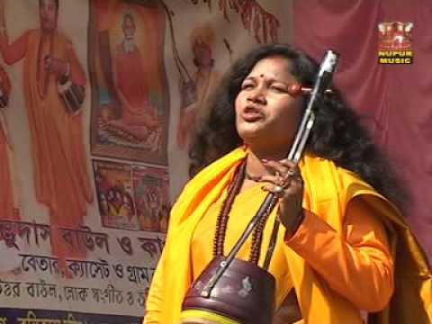
What kinds of song do you think they are performing ?
What are the men performing?

Slide 4
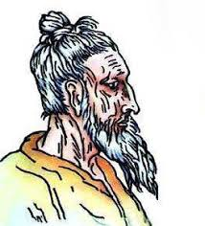
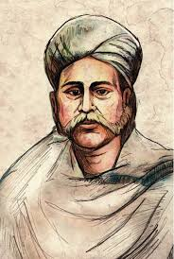
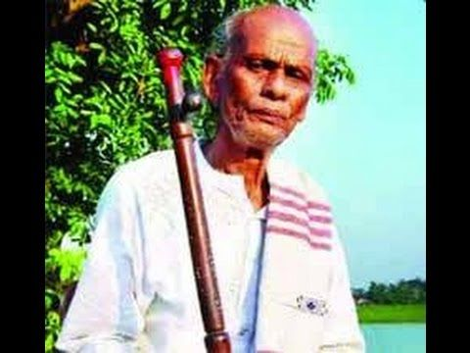
Who are they?
Are you familiar with them ?
Lalon Shah
Hason Raja
Shah Abdul Karim

Slide 5
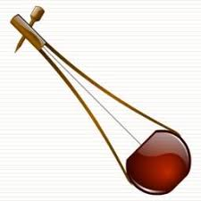
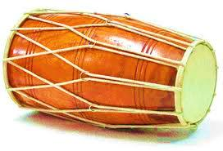
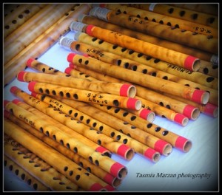
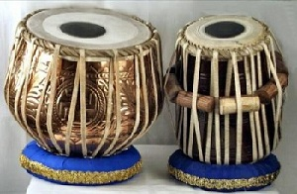
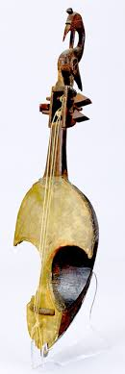
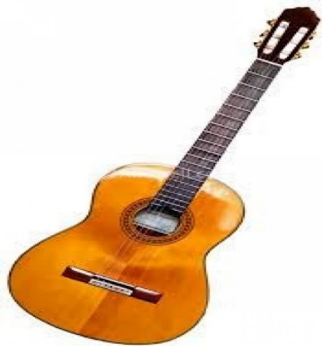
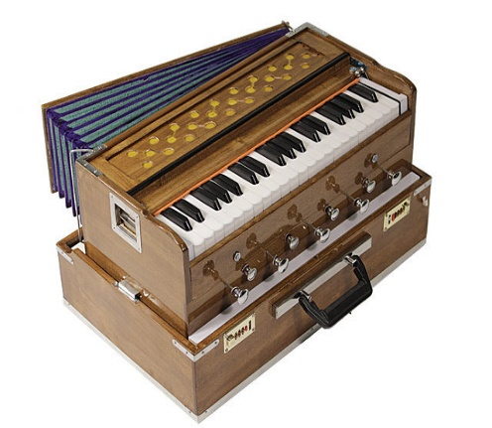
2. Have you seen them before?
3. Are you familiar with them?
4. What are their names?
5. What are their uses?
Look & Ask the questions to your partners.
1. What can you see in the pictures?
Ek-tara
Dotara
Drum
Flute
Sarinda
Guitar
Harmonium
Tabla

Slide 6
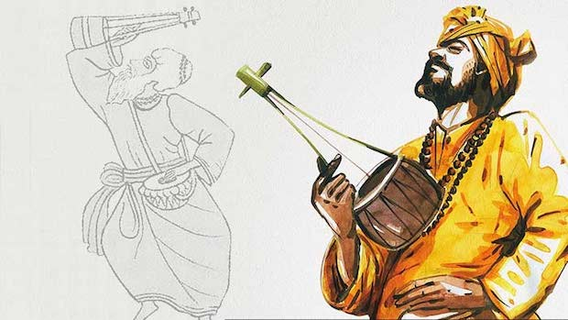
Our today’s topic is…
OUR FOLK SONGS
Unit-One
Lesson-0ne

Slide 7
Learning Outcomes
After the end of the lesson, the learners will be able to…
ask and answer questions,
tell the name of musical instruments,
read and understand through silent reading,
write the answers of the comprehensive questions,
write a paragraph.

Slide 8
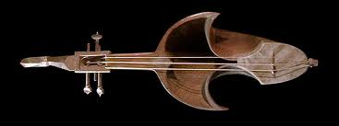
Look
1.Can you sing a song?
2.Can you play any of these musical instruments?
3. Which instruments go well with the folk songs?

Slide 9
Observe the video.
https://www.youtube.com/watch?v=tpJOG64d0SI
Individual work
What kind of song is sung in the video and what musical instruments are displayed?

Slide 10
Folk song are songs sung in the traditional style of a community or country. Here the traditional style includes the theme, words and tunes of the songs that have existed for a long time among the common people.
We have a rich history and collection of folk songs in Bangladesh. Of them Bhatiali,Bhawaiya,Jari, Sari,Gambhira, Lalongiti, Palagaan and songs of Hason Raja are very popular. The Traditional musical Instruments are usually played with these songs.

Slide 11
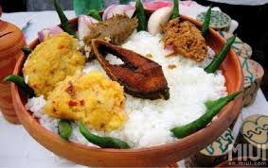
Word meaning and sentence making
Word : Traditional
Meaning : Conventional/Customary
Sentence : People like to eat traditional food on Pahela Boishakh.

Slide 12
Word : Common people
Meaning: People of different classes and occupations/ civil people
Sentence : Common people love folk songs.

Slide 13
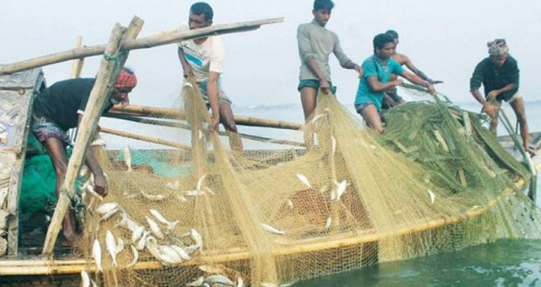
Word : Community
Meaning: A particular classes of people
Sentence : People of certain community live and work together.

Slide 14
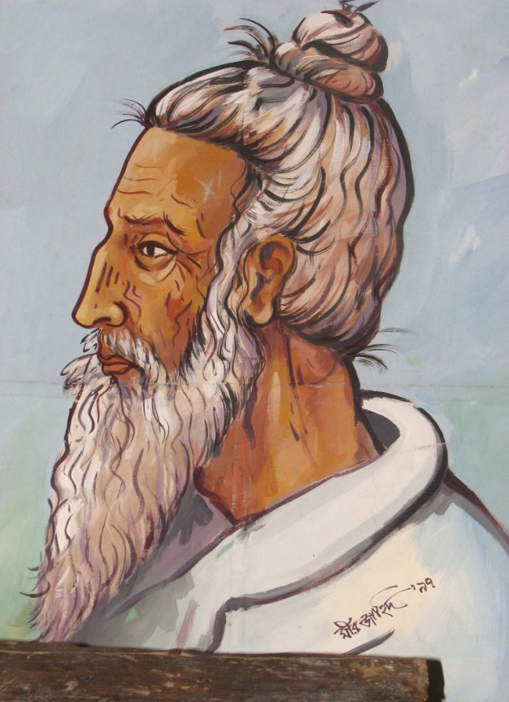
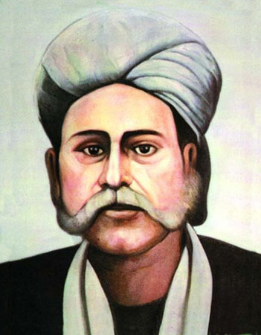
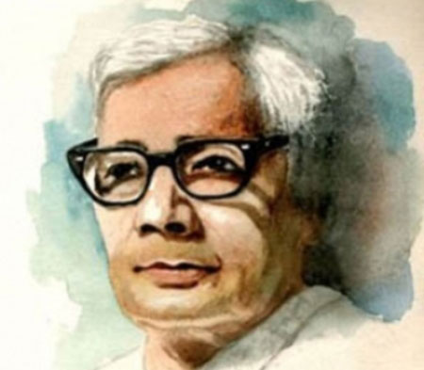
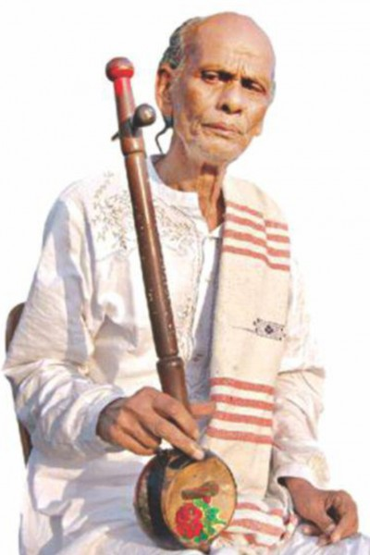
There are many popular folk song composers in Bangladesh. Among them Lalon Shah, Hason Raja, Polli kobi Jasimuddin, Shas Abdul Karim are very famous.
Lalon Shah
Pollikobi
Jasimuddin
Shah Abdul
Karim
Hason Raja
Notes:
Teacher will give short notes about them

Slide 15
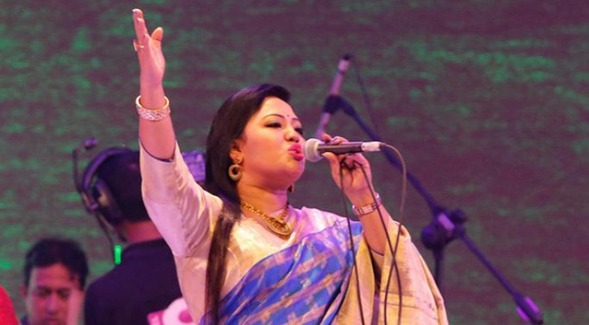
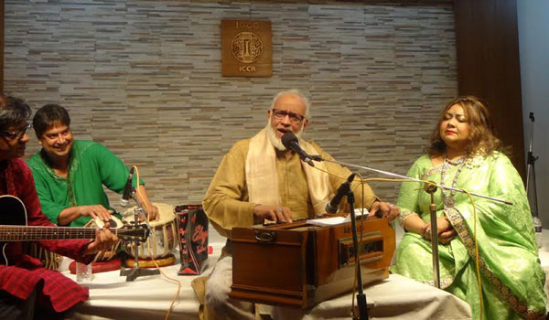
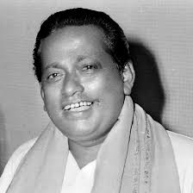
There are many popular folk singers in Bangladesh who make the folk songs famous.
Group work
Group-A
Group-B
Group-C
Each group will write a short description of a singer.
Notes:
Teacher will give short note about them.

Slide 16
Work in pair
Ask the following questions to your partner.
1. Who usually likes our folk songs?
2. Can you name some well known folk singers?
3. Do you like folk songs?
4. Who is your favorites singers?
5. Which song or songs do you like most?

Slide 17
Evaluation
Choose the best answer from the alternatives.
a) The word ‘traditional’ stands for-----------.
Ans :
iii. new
iv. rare
Ans :
ii. conventional
i. modern
ii. conventional
b) Folk songs are usually sung by the……
Ans :
i. common mass
iii. foreigners
Ans :
i. common mass
ii. intellectuals
iv. students
C. Exist refers to……..
i. remove
ii. remain
iii. reduce
iv. emit
Ans :
Ans :
ii. remain

Slide 18
d) What does the word ‘theme’ refer to ?
ii. subject
iv. grade
Ans :
ii. subject
iii. value
Ans :
i. price
e) The word ‘tune’ means--------
i. melody
ii. word
Ans :
i. melody
iii. style
iv. lyric
Ans :
f ). Folk songs are------- much by the common people
ii. liked
iv. disliked
Ans :
i. hated
ii. liked
iii. neglected
Ans :

Slide 19
Home work
Write a paragraph on “Our folk song.”

Slide 20
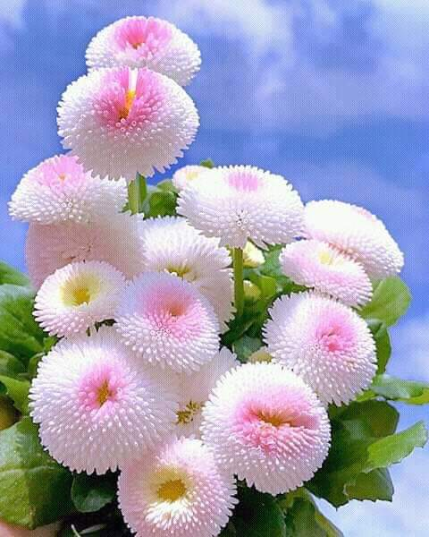
Good bye

