Slide 1

GOOD MORNING
STUDENTS

Slide 2
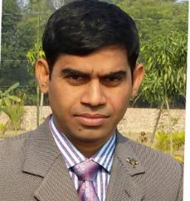
Teacher`s Information
1
2
Abul Kalam Azad
Assist. Teacher
3
Nasirabad Dulahar GPS.
4
Nachole, Chapainabawganj. Email: azad548020@gmail.com
5

Slide 3

Lesson`s Information
1
2
Class: One
Subject: English for today
3
Unit: 27 A ( Rhyme )
4
Lesson: ( Listen and say)
5

Slide 4
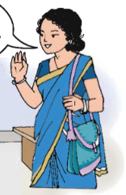
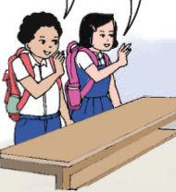
GREETINGS
Good morning, students.
Good morning, teacher.
TEACHER
How are you today?
STUDENTS
Fine. and you?
Fine, thank you.

Slide 5
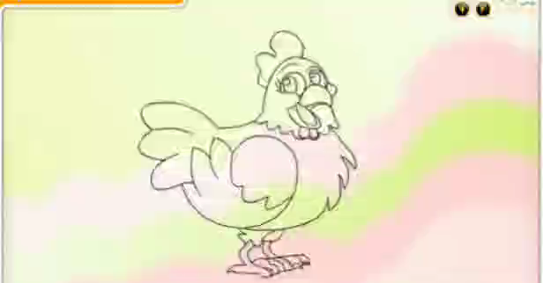
Now enjoy a video

Slide 6
Lesson Declaration
Rhyme (Unit: 27)
Listen and say.

Slide 7

Learning Outcomes:
1
Students will be able to:
2
3
Listening:
1.1.1: become familiar with English & sounds by listening to common English words.
4
Speaking:
1.1.1: repeat after the teacher simple words and phrases.
1.1.2: say simple words & phrases.

Slide 8
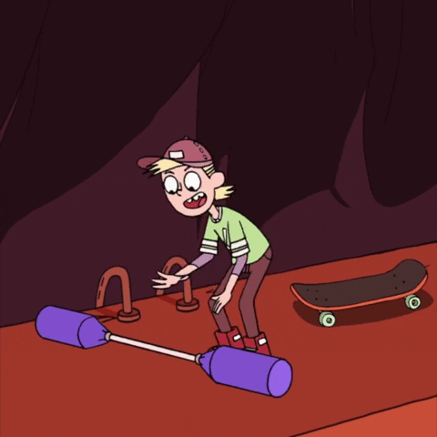
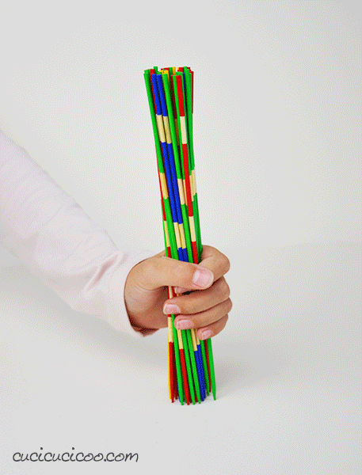
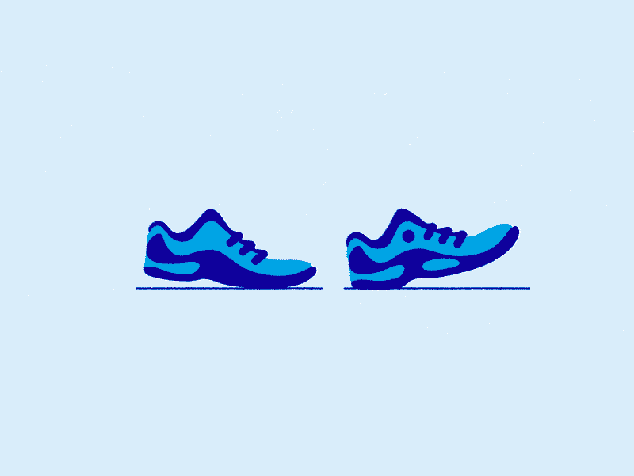

What is this?
Look at the picture.
Look at the picture.
Look at the picture.
Look at the picture.
Pick up
Shoe
Cap
Sticks

Slide 9
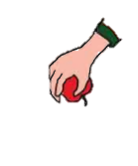
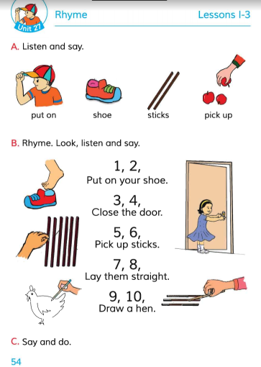
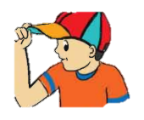




Today we will read ‘Rhyme’ at page 54.

Slide 10
Look, listen and say after me
Put on
Sticks
Shoe
Pick up

Slide 11
New Words
Put on --------
পরিধান করা
Shoe ----------
জুতা
Stick ---------
লাঠি
Pick up --------
উঠান

Slide 12
Group work
?
Put on
?
Sticks
?
Pick up
?
Shoe

Slide 13


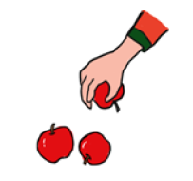
Let`s see some picture and try to say
Cap
Shoe
Stick
Pick up

Slide 14

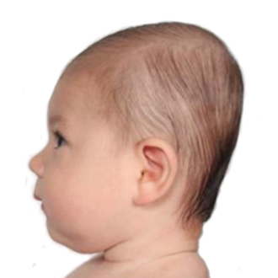
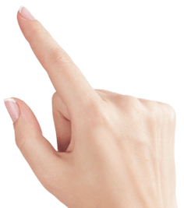



Try to say
Stick
Pick up
Shoe
Put on

Slide 15
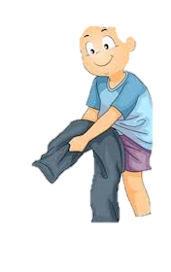
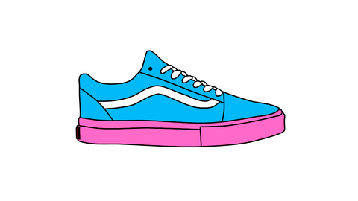
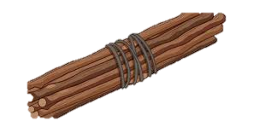
Pair work
Match the words with the pictures
Sticks
Pick up
Put on
Shoe

Slide 16
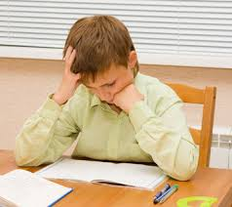
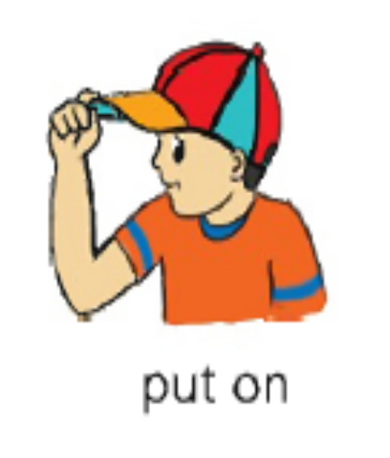
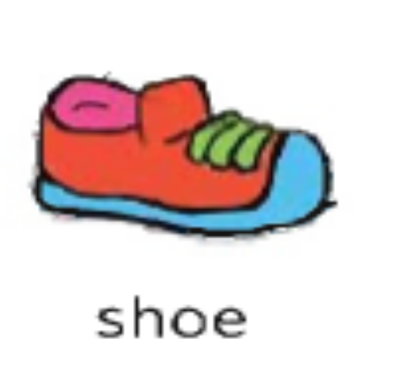

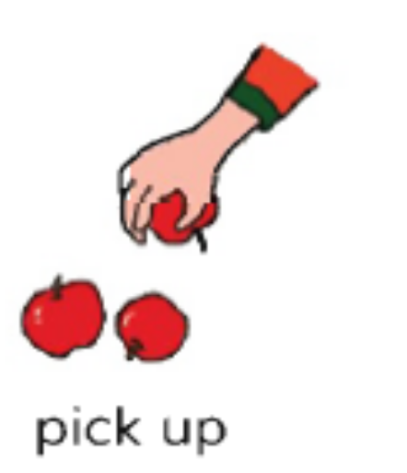
Individual work
Look , listen and say
Put on
Shoe
Stick
Pick up
What is this?
What is this?
What is this?
What is this?

Slide 17
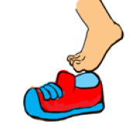
Evaluation
Pick up
Match the picture
Put on

Slide 18
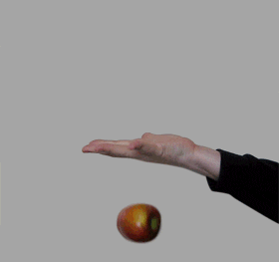


Evaluation
What are you see in the picture?
Listen to me and say the word.
Stick
Pick up
Put on
Shoe

Slide 19

Home work
Name the things outside your house.

Slide 20

Thank you
See you tomorrow

