Slide 1
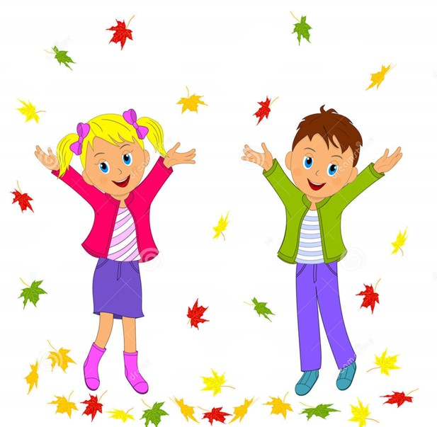


Slide 2
MD. KOWSER ALI
ASISSTANT TEACHER
DURLOVPUR GOVT. PRIMARY SCHOOL
HORINAKUNDU, JHENIDAH.
kowser.gps@gmail.com
Sub: English
Class: Two
Lesson : Greetings and introductions
Parts of the lesson: Activity-C
Page No-2

Slide 3
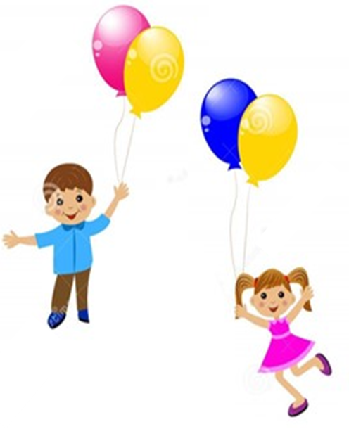
Safety environment by greetings song.
Hello! Hello! How are you?
I’m well, I’m good.
I’m great, I’m wonderful.
Hello! Hello! How are you?
I’m fine! I’m great today.

Slide 4
Checking homework and justify the previous lesson.

Slide 5
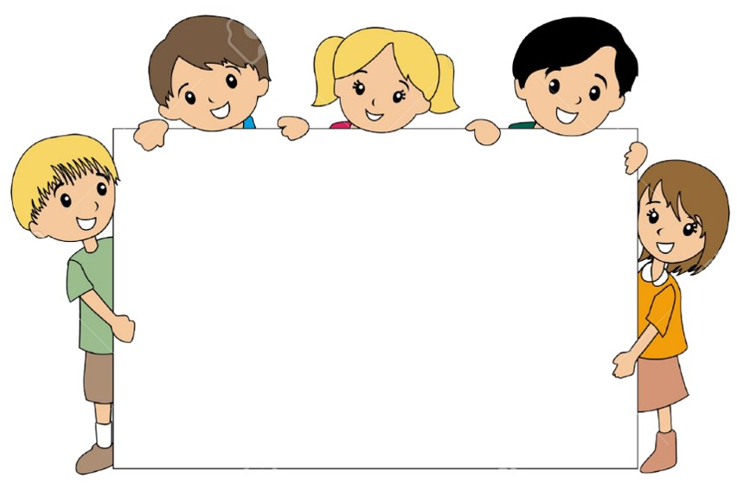
Our today’s lesson is too--
Greetings and Introductions
Activity-C

Slide 6
LEARNING OUTCOMES
By end of the lesson students will be able to-------
Listening: 1.1.1 become familiar with English sounds by listening to common
English words
3.1.1 understand simple questions and statements about them.
3.1.2 understand simple questions and statements about familiar objects.
Speaking: 1.1.1 repeat after the teacher simple words and phrases with proper sounds
and stress.
1.1.2 say simple words and phrases with proper sounds and stress.
2.1.2 say Good morning, Hi, Hello.
3.1.1 ask and answer questions about themselves.

Slide 7
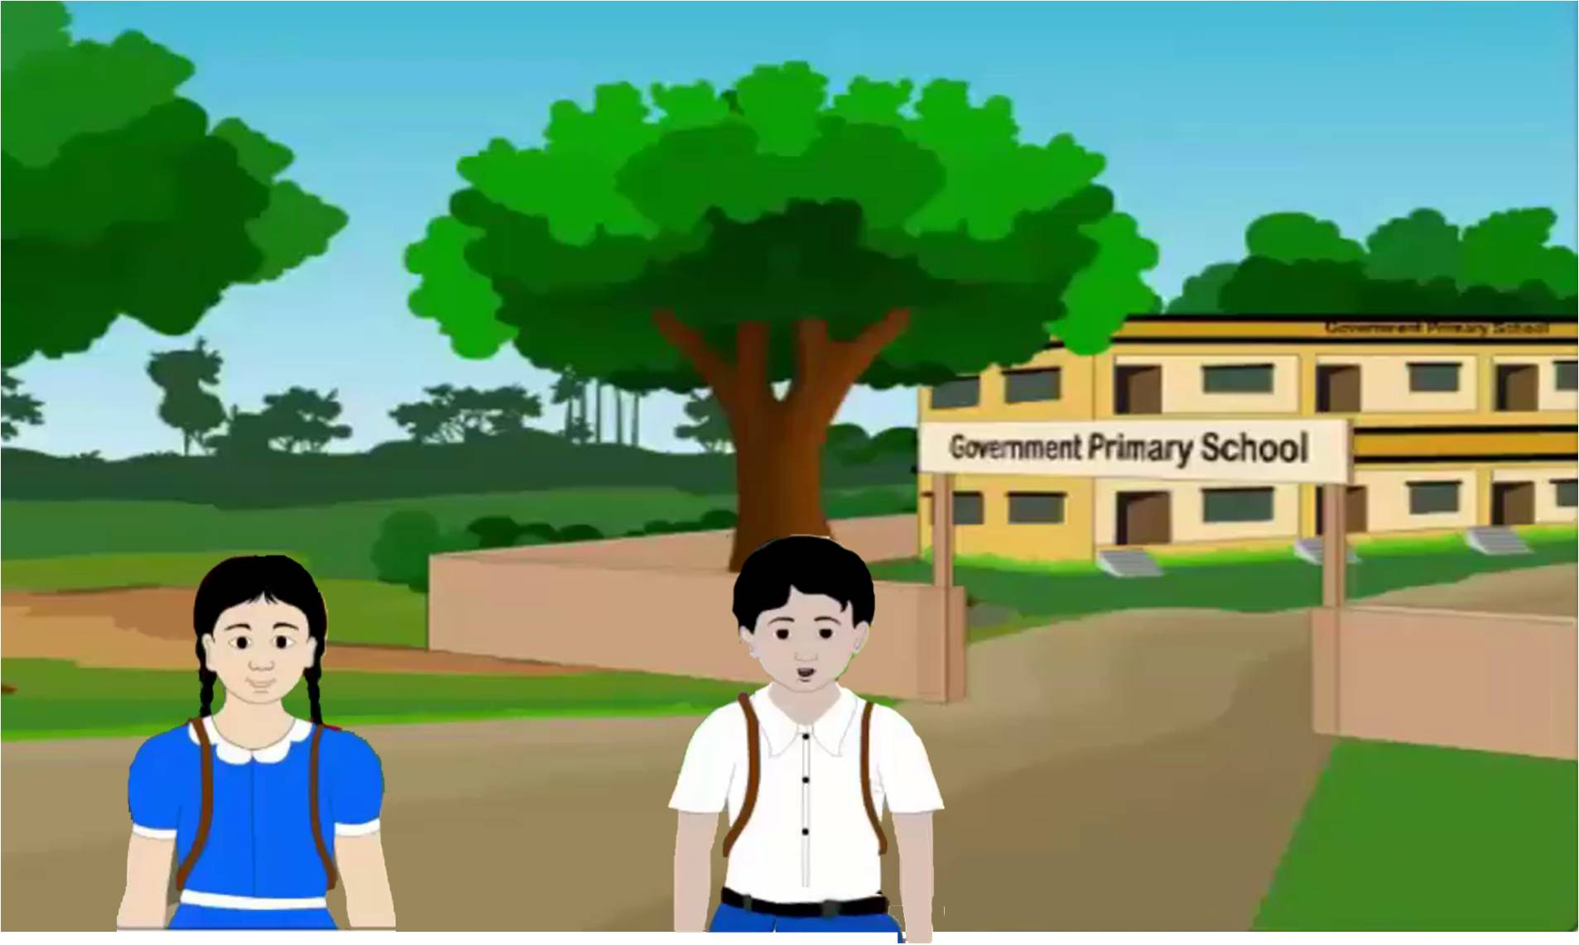
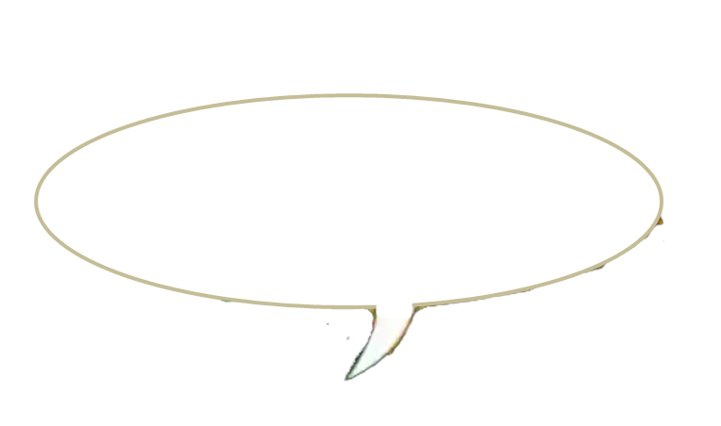
Look, listen and say.
Hello, friends.
I’m Rafi.
Hello. Friends.
What’s your name?
I’m Shuva.
What’s your name?

Slide 8
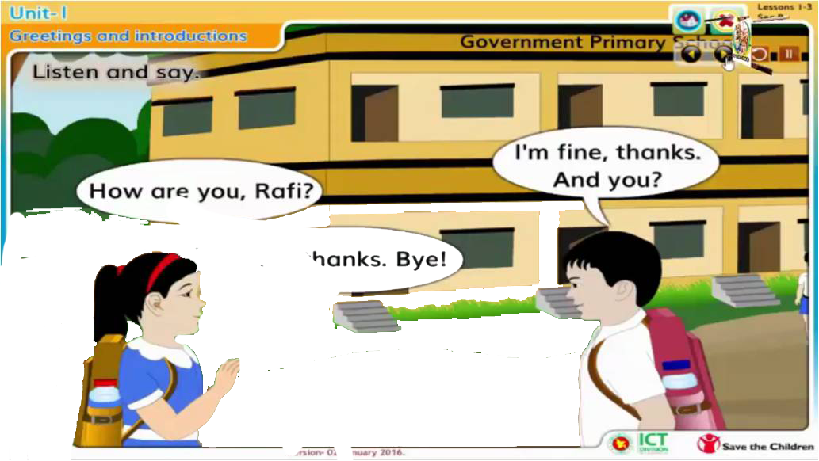
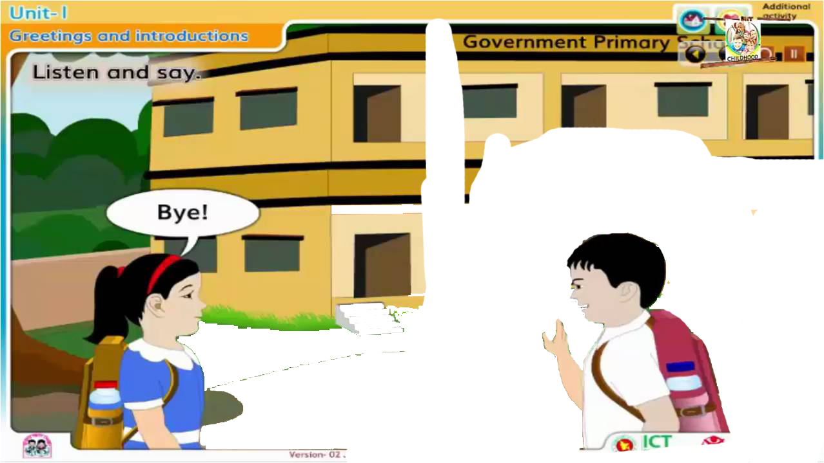
Pair work according to Activity-A and B.
Say and do.
Shuva
Rafi

Slide 9
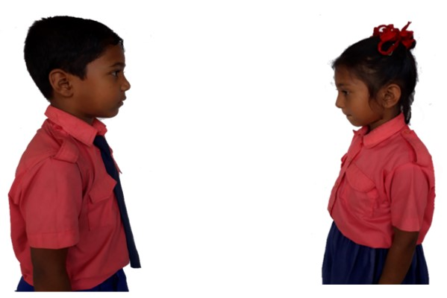
Pair work.
Say about themselves.
One more

Slide 10
Checking learning
What’s your name?
How are you?

Slide 11
Read and say.
Hello, I’m Shuva.
What’s your name?
Hi, Shuva, I’m Rafi.
How are you, Rafi?
I’m fine, thanks.
And you?
Fine, thanks. Bye!
Bye!
Identifying weak students and taking to cure.

Slide 12
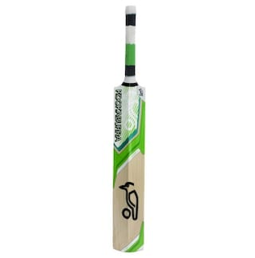
One day one word
What is this?
bat
খেলার হাতল
Spell out the word - SGW

Slide 13
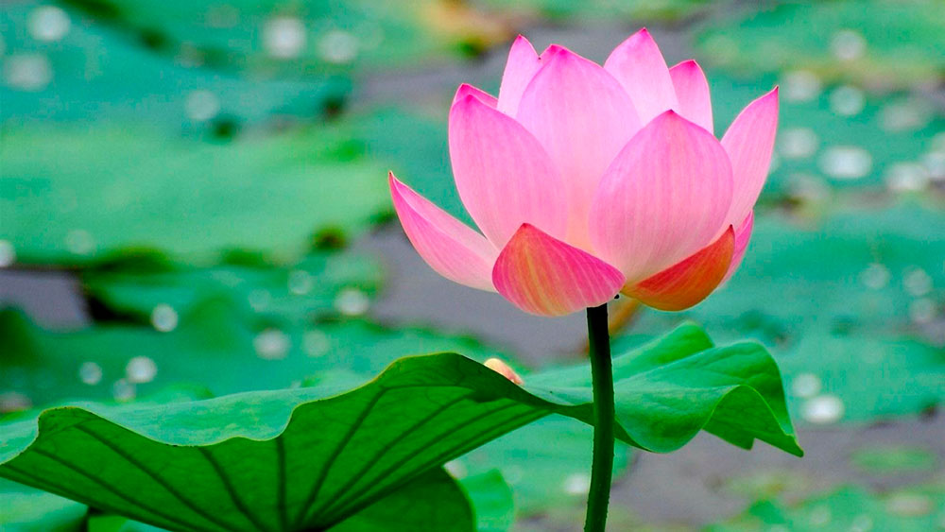
Find out the letters that are made by the word-----.
h
b
d
u
a
s
t
k
x
i
Find out the right word-------.
bag
ball
big
beg
bat

Slide 14
Say the missing letter.
̶ at
b ̶ t
ba ­̶
Write the word to your notebook.
Date-
/ /20
bat
ব্যাট
খেলার হাতল

Slide 15
Home work
Activity –A and B will be well read and written.

Slide 16

That’s all for today. Goodbye. See you tomorrow.

