Slide 1
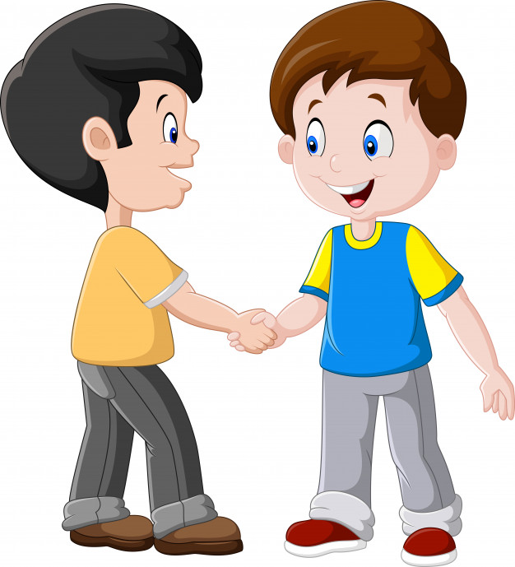


Slide 2
MD. KOWSER ALI
ASISSTANT TEACHER
DURLOVPUR GOVT. PRIMARY SCHOOL
HORINAKUNDU, JHENIDAH.
kowser.gps@gmail.com
Sub: English
Class: Two
Lesson : Greetings and Introductions
Parts of the lesson: Activity-B
Page No-2

Slide 3
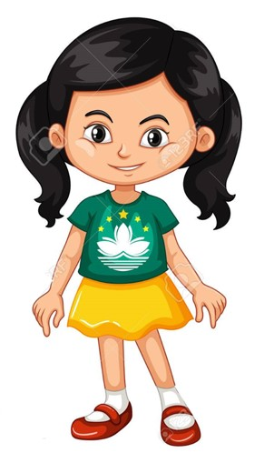
Safety environment by greetings song.
Hello! Hello! How are you?
I’m well, I’m good.
I’m great, I’m wonderful.
Hello! Hello! How are you?
I’m fine! I’m great today.

Slide 4
Checking homework and justify the previous lesson.

Slide 5
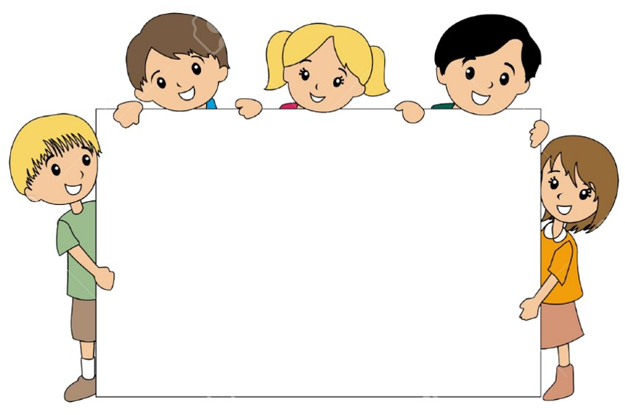
Our today’s lesson is too--
Greetings and Introductions
Activity-B

Slide 6
LEARNING OUTCOMES
By end of the lesson students will be able to-------
Listening: 1.1.1 become familiar with English sounds by listening to
common English words.
3.1.1 understand simple questions and statements about them.
3.1.2 understand simple questions and statements about familiar objects.
Speaking: 1.1.1 repeat after the teacher simple words and phrases with proper sounds
and stress.
1.1.2 say simple words and phrases with proper sounds and stress.
2.1.2 say Good morning, Hi, Hello.

Slide 7
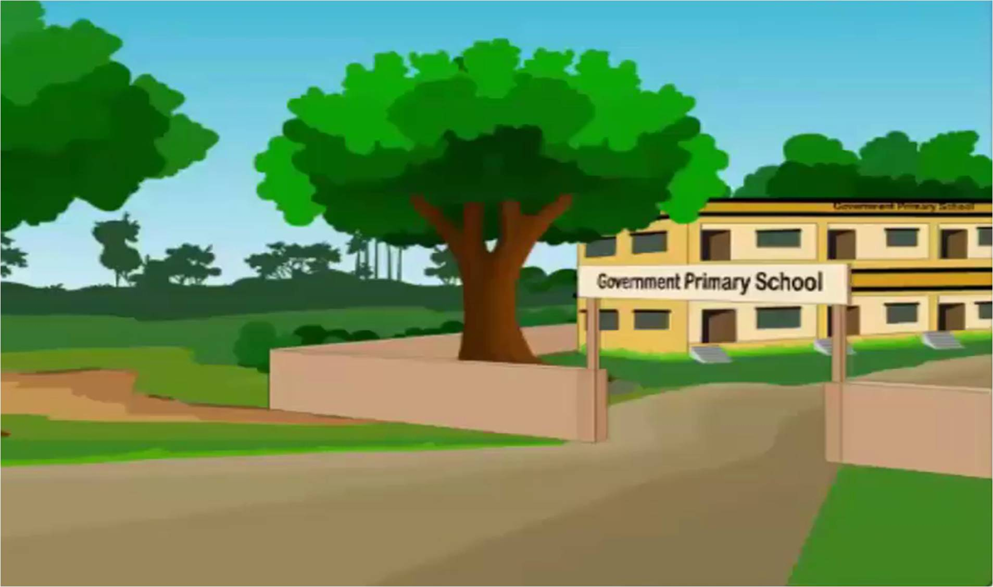
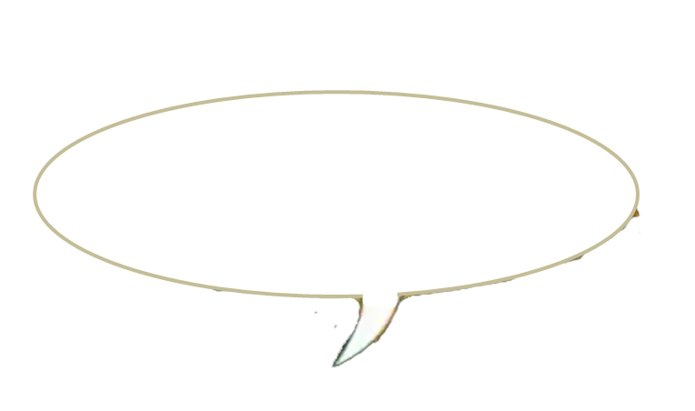
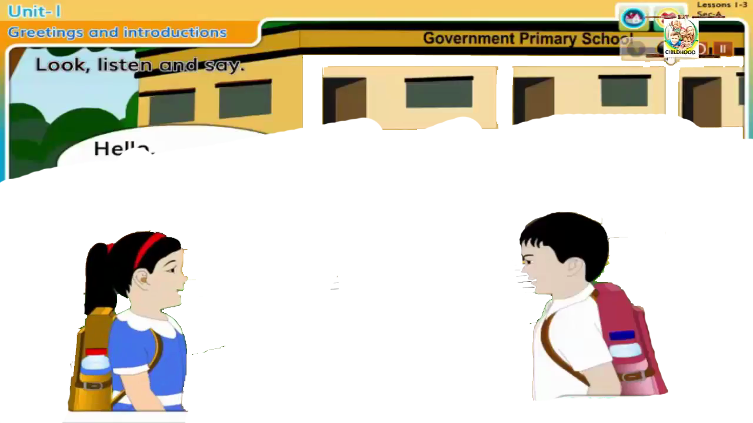
Open your English book at page-2 and see the Activity- B
Look, listen and say.
How are you, Rafi?
I’m fine, Thanks
Fine, Thanks?
And you?
Reading- SGW

Slide 8
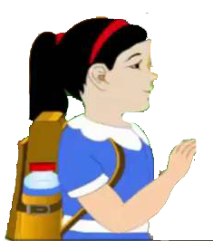
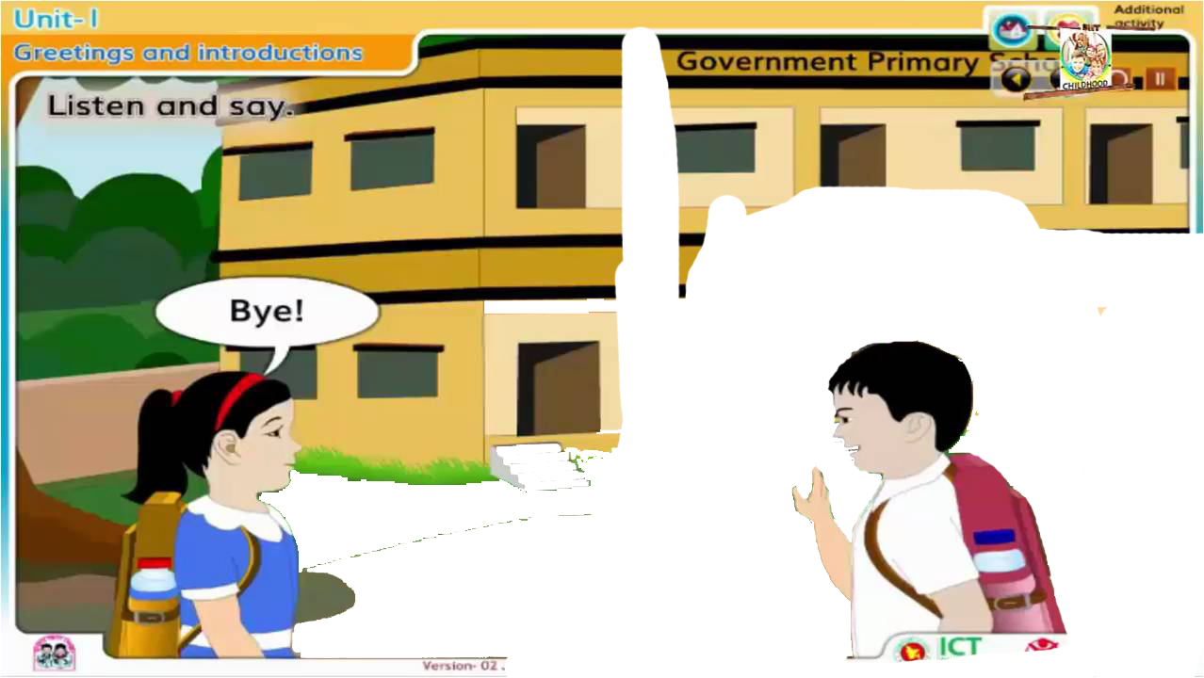
Bye!
Bye!

Slide 9
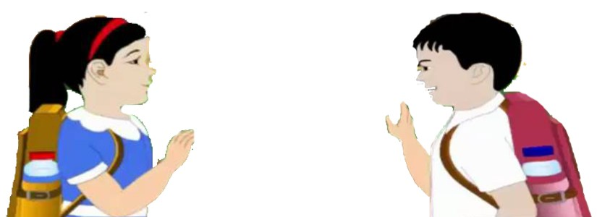
Pair work
Shuva
Rafi
One more

Slide 10
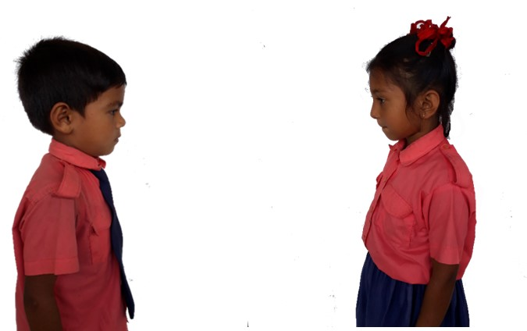
Pair work.
Say about themselves.
One more

Slide 11
Checking learning
What’s your name?
How are you?

Slide 12
Read and say.
How are you, Rafi?
I’m fine, thanks.
And you?
Fine, thanks. Bye!
Bye!
Identifying weak students and taking to cure.

Slide 13

One day one word
Do you understand the picture?
one
এক
Spell out the word - SGW

Slide 14

Find out the letters that are made by the word------.
p
o
u
c
n
m
e
k
x
i
Find out the right word-------.
orange
ox
one
on
onion

Slide 15
Say the missing letter.
o--e
on--
--ne
Write the word to your notebook.
Date-
/ /20
one
ওয়ান
এক

Slide 16
Home work
Activity-A will be well read and written.

Slide 17

That’s all for today. Goodbye. See you tomorrow.

