Slide 1
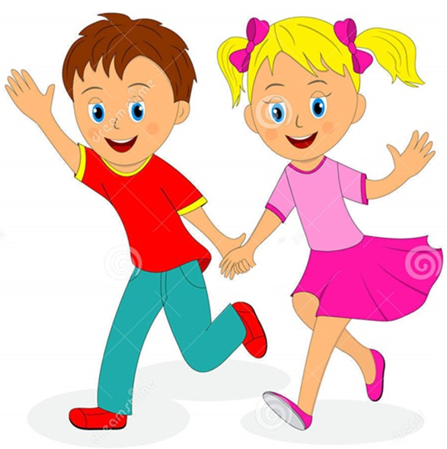


Slide 2
MD. KOWSER ALI
ASISSTANT TEACHER
DURLOVPUR GOVT. PRIMARY SCHOOL
HORINAKUNDU, JHENIDAH.
kowser.gps@gmail.com
Sub: English
Class: Two
Lesson : Numbers (1,2,3,4)
Parts of the lesson: Activity-B
Page No-4

Slide 3

Safety environment by greetings song.
Hello! Hello! How are you?
I’m well, I’m good.
I’m great, I’m wonderful.
Hello! Hello! How are you?
I’m fine! I’m great today.

Slide 4
Checking homework and justify the previous lesson.

Slide 5
Our today’s lesson is too--
Numbers-1,2,3,4
Activity-B

Slide 6
LEARNING OUTCOMES
By end of the lesson students will be able to-------
Listening: 1.1.1 become familiar with English sounds by listening to common
English words.
Speaking: 1.1.1 repeat after the teacher simple words and phrases with proper
sounds and stress.
1.1.2 say simple words and phrases with proper sounds and stress.
Reading: 1.2.1 recognize and read cardinal numbers up to 30.
Writing: 1.2.1 write cardinal numbers up to 30 in figures.
1.2.1 copy numbers up to 10 in figures and in words.
1.2.1 write numbers up to 10 in figures and in words.

Slide 7
Teacher showing real objects.
Look, listen and say.
How many stick?
How many sticks?
Now repeat after me.

Slide 8

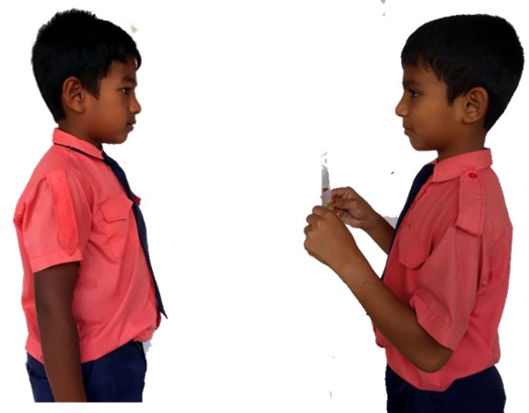
Pair work
How many ----------?
One more.

Slide 9
Open your English book at page-4 and see the Activity- B
Say, trace and write.
1
2
3
4
one
two
three
four
Exchange your book and check the text of other.
Let’s practice on the board

Slide 10






Let’s click on the right number.
two

Slide 11
Let’s click on the right number.
three

Slide 12
Let’s click on the right number.
one

Slide 13
Let’s click on the right number.
four

Slide 14
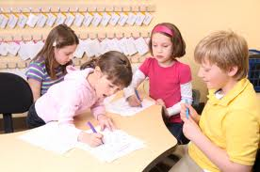
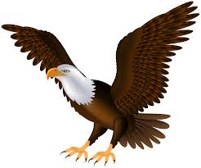
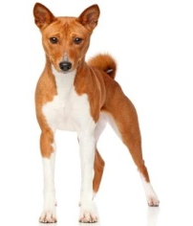

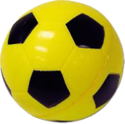
Count and write in words.
Group work.
Let’s see the right answers.
four
two
one
three
------ dogs.
------ balls.
------ bird.
------- cups .

Slide 15
Read and say.
three
one
four
two
four
two
three
one
three
one
four
two
four
two
three
one
Identifying weak students and taking to cure.

Slide 16
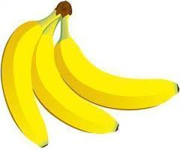
One day one word
How many bananas?
three
তিন
Spell out the word - SGW

Slide 17

Find out the letters that are made by the word------.
t
n
h
r
a
z
e
k
e
u
Find out the right word--------.
threes
thirteen
three
third

Slide 18
Say the missing letter.
thr-e
-hree
thre-
t-ree
Write the word to your notebook.
Date-
/ /20
three
থ্রি
তিন

Slide 19
Home work
Page 2 will be well read and written.

Slide 20

That’s all for today. Goodbye. See you tomorrow.

