Slide 1



Slide 2
MD. KOWSER ALI
ASISSTANT TEACHER
DURLOVPUR GOVT. PRIMARY SCHOOL
HORINAKUNDU, JHENIDAH.
kowser.gps@gmail.com
Sub: English
Class: Two
Lesson : Numbers (1,2,3,4)
Parts of the lesson: Activity-A
Page No-4

Slide 3

Safety environment by greetings song.
Hello! Hello! How are you?
I’m well, I’m good.
I’m great, I’m wonderful.
Hello! Hello! How are you?
I’m fine! I’m great today.

Slide 4
Checking homework and justify the previous lesson.

Slide 5

Dear students, see the picture and try to say-
What can be the topic of our today’s lesson?

Slide 6
Our today’s lesson is--
Numbers-1,2,3,4
Activity-A

Slide 7
LEARNING OUTCOMES
By end of the lesson students will be able to-------
Listening: 1.1.1 become familiar with English sounds by listening to
common English words
Speaking: 1.1.1 repeat after the teacher simple words and phrases with
proper sounds and stress.
1.1.2 say simple words and phrases with proper sounds and stress.
Reading: 1.2.1 recognize and read cardinal numbers up to 30.

Slide 8

Look, listen and say.
What is this?
How many marbles are there?
How many marble is there?
1
o
e
n
2
t
w
o
3
t
e
h
e
r
4
u
r
o
f
Notes:
Repeat 2/3/4

Slide 9
What is this?
How many fingers?
How many finger?
Now we practice ourselves

Slide 10

Open your English book at page-4 and see the Activity-A
Look, listen and say.
How many ball?
How many balls?
1
2
3
4
one
two
three
four
Repeat after me.
Spell out the words. (SGW)

Slide 11

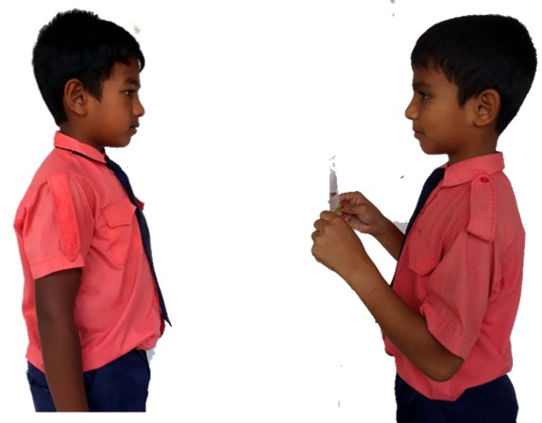
Pair work.
How many ----------?
One more.

Slide 12
Look, listen and say
1. How many chalk board is in your class room?
2. How many duster is in your class room?
3. How many fans are in your class room?
4. How many windows are in your class room?

Slide 13

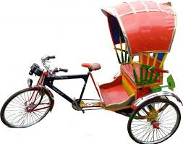





Let’s click on the right number.

Slide 14
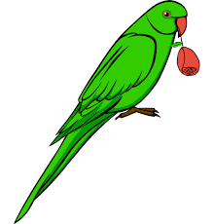
Let’s click on the right number.

Slide 15

Let’s click on the right number.

Slide 16

Let’s click on the right number.

Slide 17
Read and say.
three
one
four
two
four
two
three
one
three
one
four
two
four
two
three
one
Identifying weak students and taking to cure.

Slide 18

One day one word
How many ice-cream?
two
দুই
Spell out the word - SGW

Slide 19

Find out the letters that are made by the word-----.
p
t
d
u
w
m
o
k
o
i
Find out the right word------.
twoe
tew
two
tow
twi

Slide 20
Say the missing letter.
t-o
tw-
-wo
Write the word to your notebook.
Date-
/ /20
two
টু
দুই

Slide 21
Home work
Page 3 will be well read and written.

Slide 22

That’s all for today. Goodbye. See you tomorrow.

