Slide 1
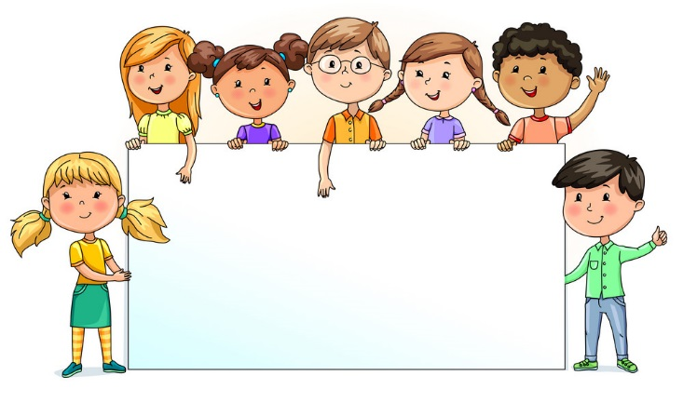


Slide 2
MD. KOWSER ALI
ASISSTANT TEACHER
DURLOVPUR GOVT. PRIMARY SCHOOL
HORINAKUNDU, JHENIDAH.
kowser.gps@gmail.com
Sub: English
Class: Two
Lesson : Commands
Parts of the lesson: (Activity-C)
Page No-6

Slide 3
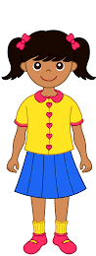
Safety environment by greetings song.
Hello! Hello! How are you?
I’m well, I’m good.
I’m great, I’m wonderful.
Hello! Hello! How are you?
I’m fine! I’m great today.

Slide 4
Checking homework and justify the previous lesson.

Slide 5
Our today’s lesson is too--
Commands-Unite-3
Activity-C

Slide 6
LEARNING OUTCOMES
By end of the lesson students will be able to-------
Listening: 2.1.1 follow simple commands and instructions.
Speaking: 1.1.1 repeat after the teacher simple words and phrases with proper
sounds and stress.
1.1.2 say simple words and phrases with proper sounds and stress.

Slide 7
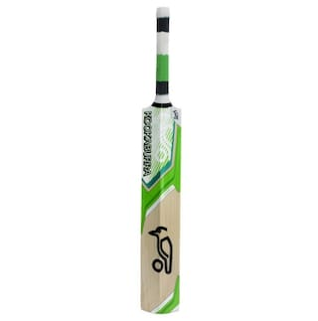

What can you see?
bat
ball

Slide 8
What is this?
underline
circle

Slide 9
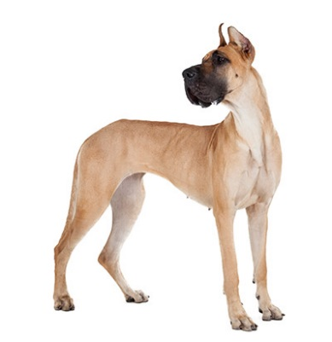

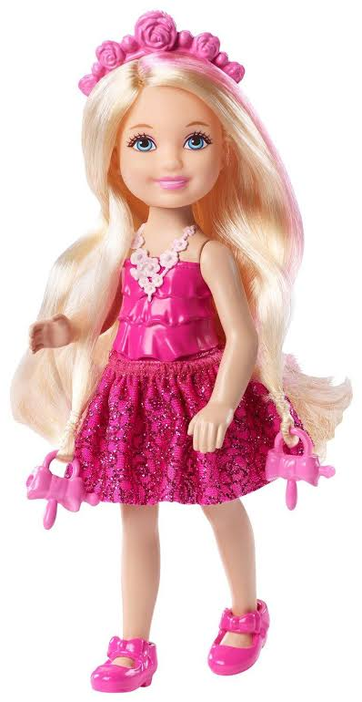
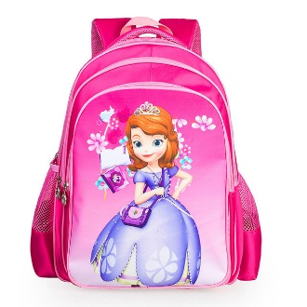

Open your English book at page-6 and see the Activity-C
What can you see?
Circle the things beginning with b and underline the things beginning with d.
Exchange your book and check the text of other.
See again.

Slide 10
Say other words that beginning with b and d.
Say name of the boy/girl in your class that beginning with b and d.
Notes:
students will say, teacher will write on the board

Slide 11
Read and say.
Show me your book.
Color it.
Close your book.
Look at the board.
Open the door.
Draw a flower.
Stand up. Come here.
Go to your seat.
Identifying weak students and taking to cure.

Slide 12
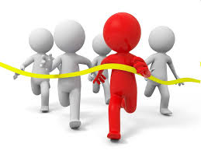
One day one word
What is this?
end
শেষ
Spell out the word - SGW

Slide 13

Find out the letters that are made by the word hut.
p
e
d
u
n
s
d
k
x
i
Find out the word.
end
and
ende
ennd
emd

Slide 14
Say the missing letter.
e--d
--nd
en--
Write the word to your notebook.
Date-
/ /20
end
ইন্ড
শেষ

Slide 15
Home work
Page 2 will be well read and written.

Slide 16

That’s all for today. Goodbye. See you tomorrow.

