Slide 1



Slide 2
MD. KOWSER ALI
ASISSTANT TEACHER
DURLOVPUR GOVT. PRIMARY SCHOOL
HORINAKUNDU, JHENIDAH.
kowser.gps@gmail.com
Sub: English
Class: Two
Lesson : Alphabet
Parts of the lesson: K-O(Activity-C)
Page No-7

Slide 3

Safety environment by greetings song.
Hello! Hello! How are you?
I’m well, I’m good.
I’m great, I’m wonderful.
Hello! Hello! How are you?
I’m fine! I’m great today.

Slide 4
Checking homework and justify the previous lesson.

Slide 5
Our today’s lesson is too--
Alphabet (K-O)
Activity-C

Slide 6
LEARNING OUTCOMES
By end of the lesson students will be able to-------
Speaking: 1.1.2 say simple words and phrases with proper sounds and stress.
Reading: 1.4.1 read words and phrases with the help visual clues and simple
sentences.
Writing: 1.2.1 write non-cursive small letter.

Slide 7
Spell the words we learned the previous class.
kite
lion
mango
net
orange

Slide 8
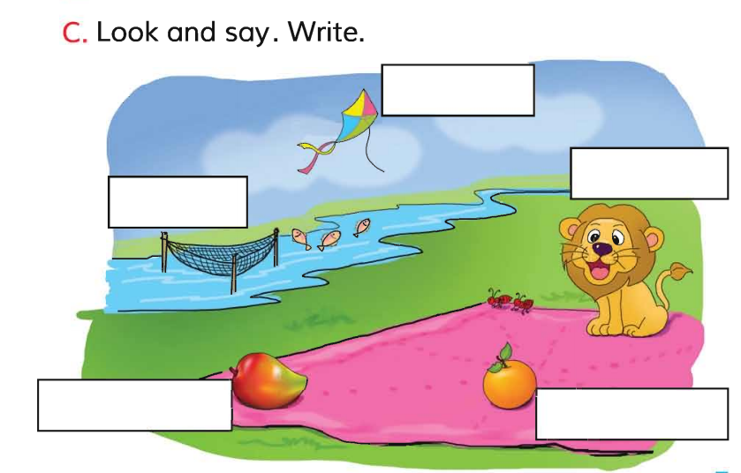
Open your English book at page-7 and see the Activity-C
What can you see in the picture?
kite
lion
net
mango
orange
Where is the net?
What can you see in the sky?
Exchange your book and check the text of other.
Match your answers.

Slide 9
SGW
Say and write the small letter.
K---
L---
M---
N---
O---

Slide 10
Read and say.
lion
net
mango
orange
kite
orange
kite
net
lion
mango
lion
net
mango
orange
kite
orange
kite
net
lion
mango
Identifying weak students and taking to cure.

Slide 11
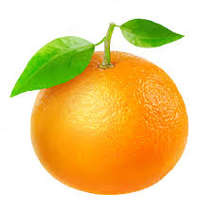
One day one word
What is this?
orange
কমলা
Spell out the word - SGW

Slide 12

Find out the letters that are made by the word.
o
w
r
b
a
t
n
k
g
e
Find out the correct word.
orange
arange
oarange
orenge

Slide 13
Say the missing letter.
o--ange
oran--e
or--nge
ora--ge
Write the word to your notebook.
Date-
/ /20
orange
অরেঞ্জ
কমলা

Slide 14
Home work
Page 2 will be well read and written.

Slide 15

That’s all for today. Goodbye. See you tomorrow.

