Slide 1



Slide 2
MD. KOWSER ALI
ASISSTANT TEACHER
DURLOVPUR GOVT. PRIMARY SCHOOL
HORINAKUNDU, JHENIDAH.
kowser.gps@gmail.com
Sub: English
Class: Two
Lesson : Alphabet
Parts of the lesson: K-O(Activity-A)
Page No-7

Slide 3

Safety environment by greetings song.
Hello! Hello! How are you?
I’m well, I’m good.
I’m great, I’m wonderful.
Hello! Hello! How are you?
I’m fine! I’m great today.

Slide 4
Checking homework and justify the previous lesson.
What’s the name of the letter?
Aa
Hh
Cc
Ff
Ee
Dd
Gg
Bb
Jj
Ii
Now try to say-
What can be the topic of our today’s lesson?

Slide 5
Our today’s lesson is--
Alphabet (K-O)
Activity-A

Slide 6
LEARNING OUTCOMES
By end of the lesson students will be able to-------
Listening:1.1.1 become familiar with English sounds by listening to common
English words.
Speaking: 1.1.1 repeat after the teacher simple words and phrases with proper sounds
and stress.
1.1.2 say simple words and phrases with proper sounds and stress.
Reading: 1.2.1 recognize and read the alphabet both small and
capital (non-cursive)
1.3.1 recognize and read the names of objects having the same initial and
final sounds

Slide 7
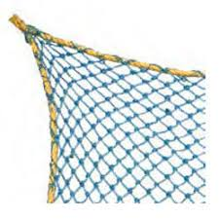



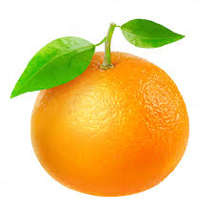
Look, listen and say.
What is this?

Slide 8


Open your English book at page-7 and see the Activity-A
Look, listen and say.
K k
L l
M m
N n
O o
kite
lion
mango
net
orange
Now repeat after me.
Spell out the words. (SGW)

Slide 9
Capital letters
L
O
o
l
M
m
N
K
k
n
Small letters

Slide 10
Letter’s sound video

Slide 11
What is this?
kite
What is the letter’s name?
What is the letter’s sound?

Slide 12
What is this?
lion
What is the letter’s name?
What is the letter’s sound?

Slide 13
What is this?
mango
What is the letter’s name?
What is the letter’s sound?

Slide 14
What is this?
net
What is the letter’s name?
What is the letter’s sound?

Slide 15
What is this?
orange
What is the letter’s name?
What is the letter’s sound?

Slide 16
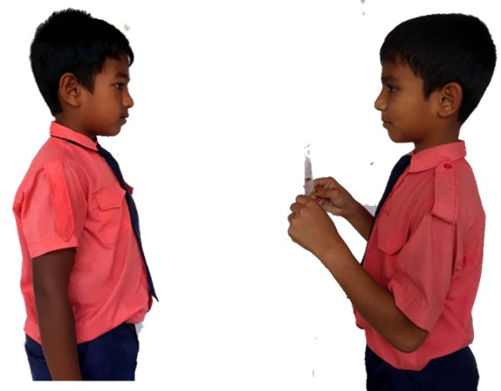
Pair work
m
What’s the letter’s name/sound?
One more

Slide 17

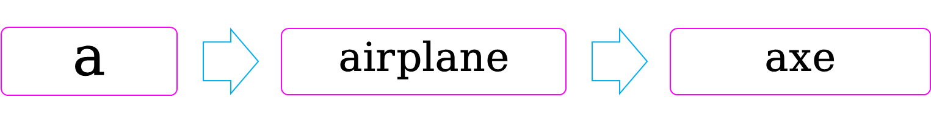
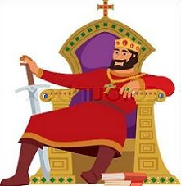



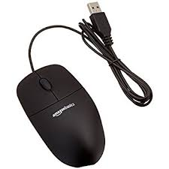
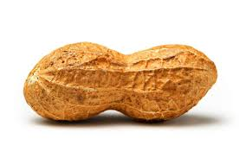

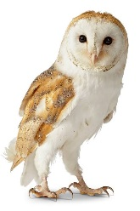
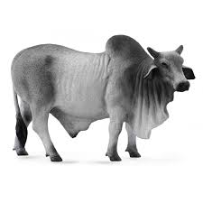
Say 2/more other words for each letter.
key
king
k
leaf
l
ladder
mug
m
mouse
nut
n
nest
owl
o
ox
Let’s see.

Slide 18
Read and say.
lion
net
mango
orange
kite
orange
kite
net
lion
mango
lion
net
mango
orange
kite
orange
kite
net
lion
mango
Identifying weak students and taking to cure.

Slide 19
One day one word
What is this?
lion
সিংহ
Spell out the word - SGW

Slide 20
Find out the letters that are made by the word lion.
h
i
d
a
o
t
l
k
c
n
Find out the correct word.
loin
lion
lione
lino
loni

Slide 21
Say the missing letter.
li--n
l--on
--ion
lio--
Write the word to your notebook.
Date-
/ /20
lion
লাইয়ন
সিংহ

Slide 22
Home work
Page 6 will be well read and written.

Slide 23

That’s all for today. Goodbye. See you tomorrow.

