Slide 1

Welcome
Everybody

Slide 2
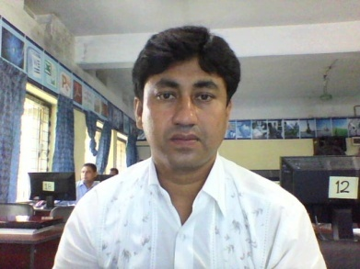
Edited by:
Md.Abdullah Al Masum Billah
Head Teacher
Ramchandrapur Govt. primary school.
Moheshpur, jhinaidah.

Slide 3
Class -One
Sub : English

Slide 4
Lesson—2o
Lesson Unit:
Rain, rain,---------------another day.

Slide 5
Learning Outcome:
SS will be able to -----
Recite the Rhyme will proper rhythm.

Slide 6
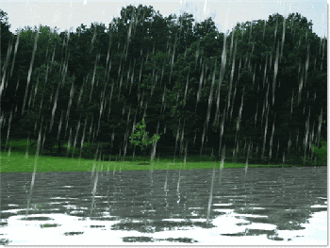
Scenary of Rain

Slide 7
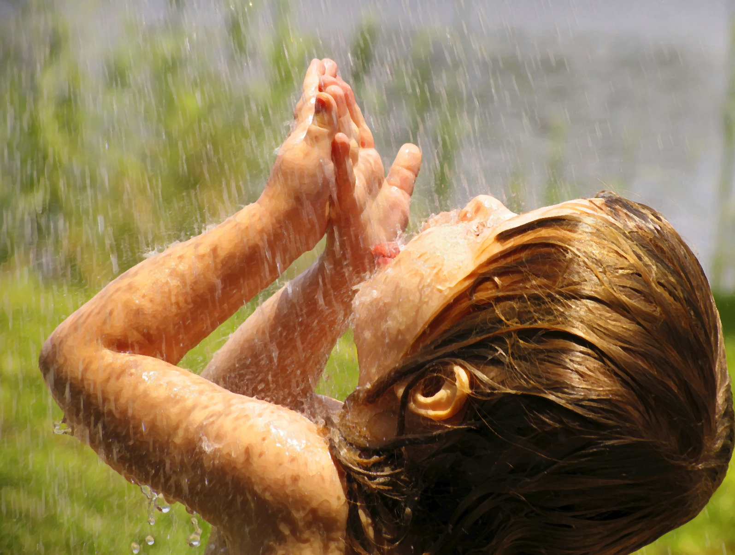
Rain, rain, go away,

Slide 8
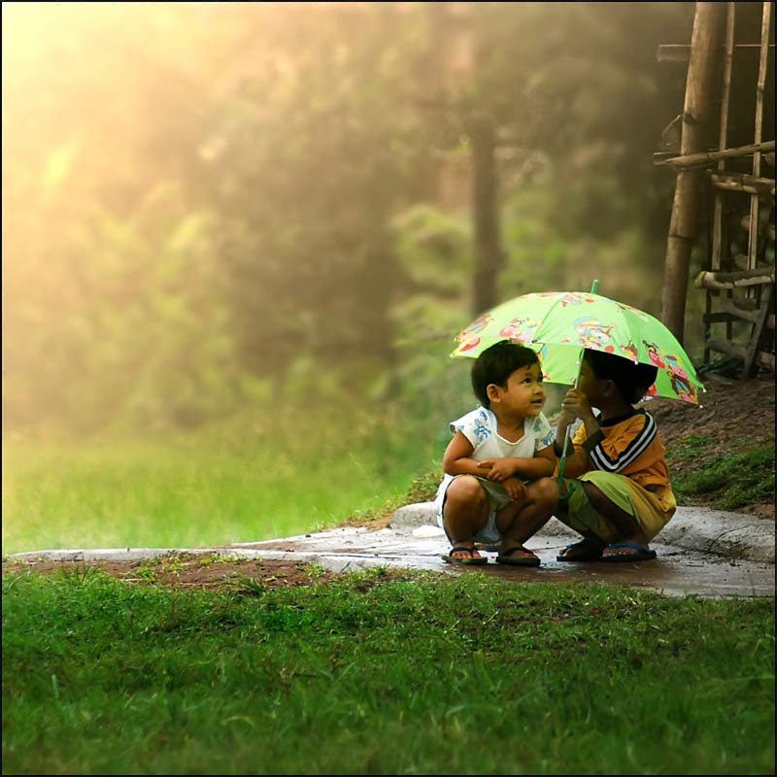

Come again another day.

Slide 9


Rain, rain, go away
Come again another day.
--------------------- ------------------ ------------ ---------------------------

Slide 10

Recite with picture .(w.c.w)
Recite with body language .
Recitate with clapping .(w.c.w)

Slide 11


Evaluation :
Recite the Rhyme .

Slide 12


Thanks
Every body.

