Slide 1

Welcome

Slide 2

Introducing:
Md. Saiful Islam
Assistant Teacher (English)
Bagbari Chowbaria High School,
Tangail Sadar, Tangail
E-mail: hridoy9555@gmail.com
Class: Eight
Subject: English for today
Unit: 09
Lesson: 03
Time: 50 Minutes
Date: 12-10-2019

Slide 3
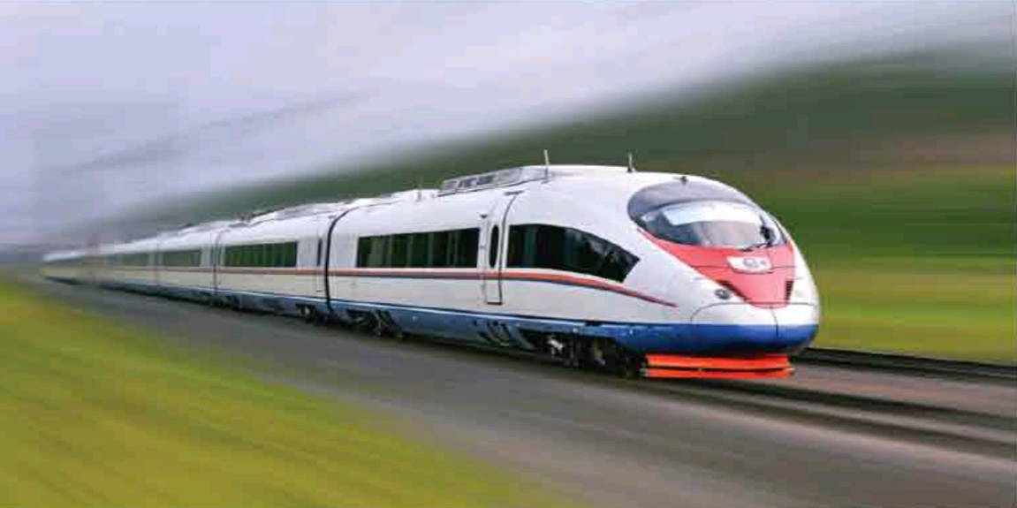
What is the picture about?
The TGV of France’s high speed rail service.

Slide 4
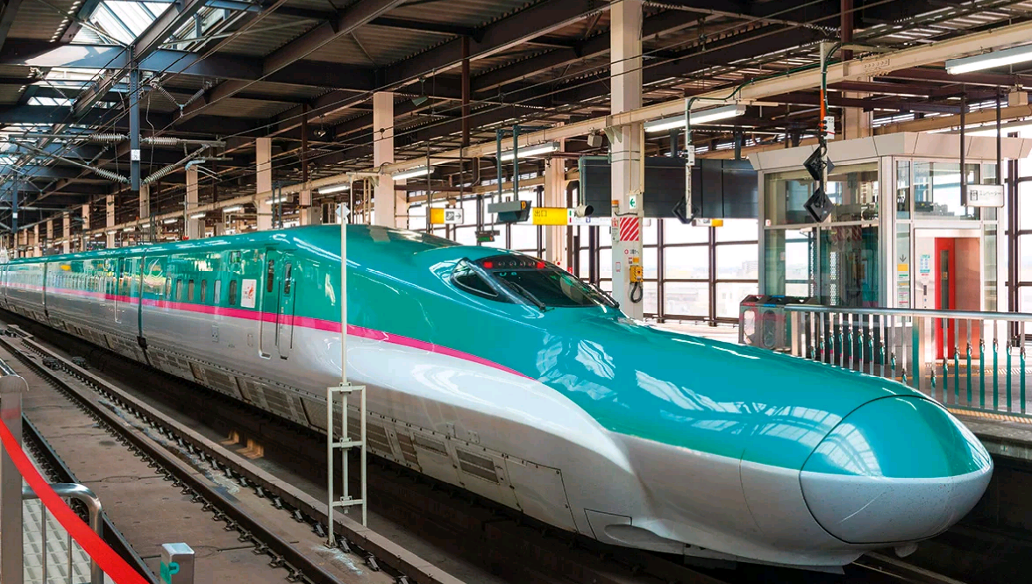
What is the picture about?
The Bullet Train of Japan.

Slide 5

Let’s enjoy the video

Slide 6
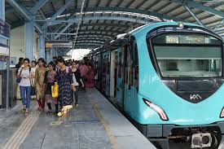
Lesson declaration:
The fastest Wheel on earth.

Slide 7
Learning outcomes:
After finishing the lesson learners will be able to-
1. Answer the questions.
2. Write a paragraph.
3. Information transfer.
Say true or false.
Write a letter about train journey.

Slide 8
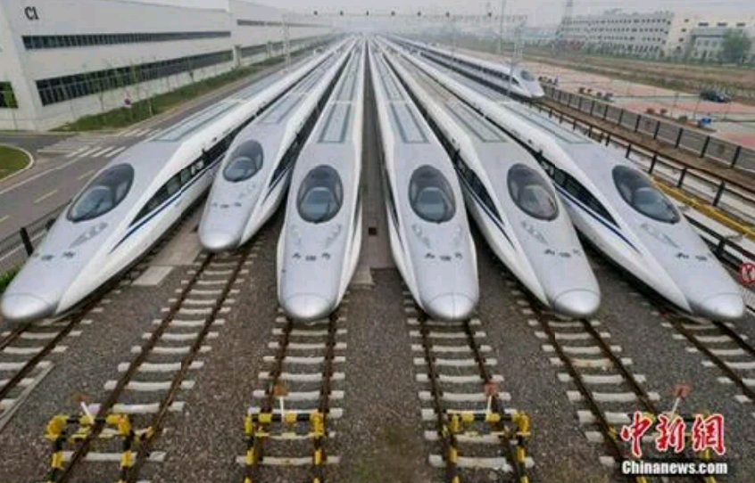
What is the picture about?
The High- speed Rail service of China

Slide 9
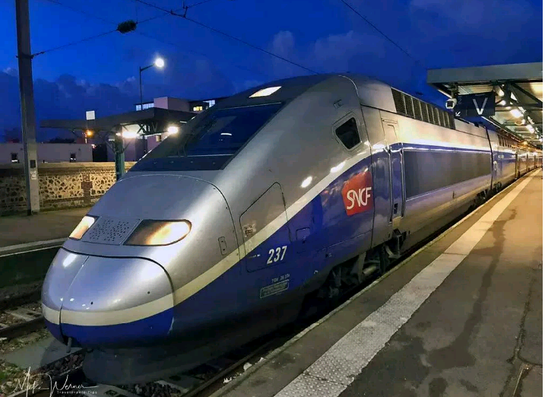
Look at the picture.

Slide 10

Standard reading

Slide 11
Individual work:
What is TGV?
When did the Bullet Train start her operation?
What is the fastest conventional wheeled train?
Answers:
(1) The TGV is the high speed train service of France.
(2) The Bullet Train started her operation in 1964.
(3) A TGV is the fastest conventional wheeled train.

Slide 12
Peer work
Write a letter to your friend abut the first experience of your train journey.

Slide 13
Group Work
C. Read the above text in section B again. Now, discuss with your partner to fill the blank slots in the following grid with the information about high-speed trains.
Name of the country | Name of the train/ train network | Year of introduction/ start | Top speed of conventional train | Top speed of unconventional train | Holds world record for
France | The TGV | 1970 | 320 km/h (200 m/h) | 574.8 km/h (357.2 m/h) | The fasted conventional wheeled train
Japan | The Bullet train | 1964 | 300 km/h (186 m/h) | 581 km/h (361 mph) | Unconventional magnetic trainsets
China | The High speed rail / Harmony Express | 2007 | 300 km/h (186 m/h) | 487.3 km/h (303 mph) | Unconventional magnetic trainsets

Slide 14
Evaluation
Say whether the following sentences are true or false. If false give the right answer.
The normal speed of TGV is 200 m/h.
The Bullet Train is an unconventional magnetic trainsets.
.The High-speed Rail Service is the train service of China.
(d) The highest speed of TGV is 520k/h.
(e) China has set the world record of a speed 847 k/h.
True
True
True
False. 574.8
False. 487.3

Slide 15

Home work
Write a paragraph about journey by train.

Slide 16

Thank you very much

