Slide 1
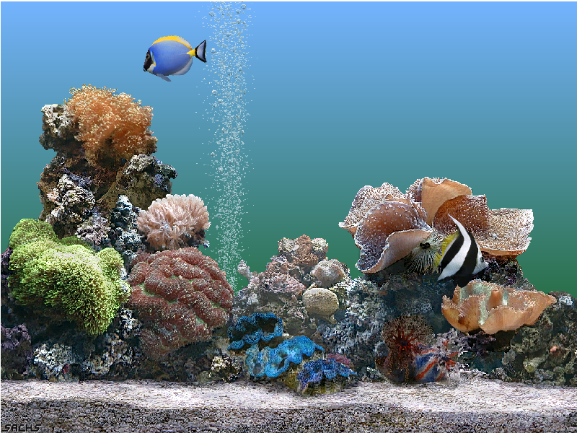

Welcome Students

Slide 2
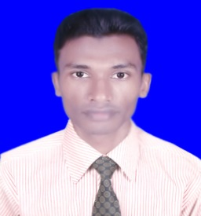

Introduction
English First Paper
Class Nine, Section A
Duration-35 mnts
Md. Ali Zinnah (M.A (Eng.)
Lecturer Of English
Agdighal Gram Senior Alim Madrasah
Udhunia, Ullapara, Sirajgonj

Slide 3
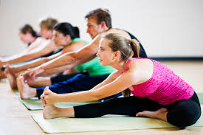
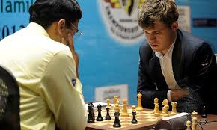
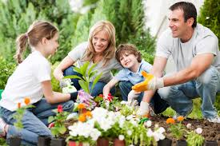
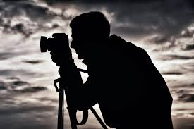
Look at the pictures
* What are the people doing here?
* When do people do this kinds of work?
Notes:
Teacher can describe the pictures if he supposes to do it.

Slide 4
Have you any favorite Pastime
Learning Outcome
Students will be able to-
* Narrate incidents and events
* Participate in conversation, discussion and debate etc.
* Read maps, charts, graphs etc.

Slide 5

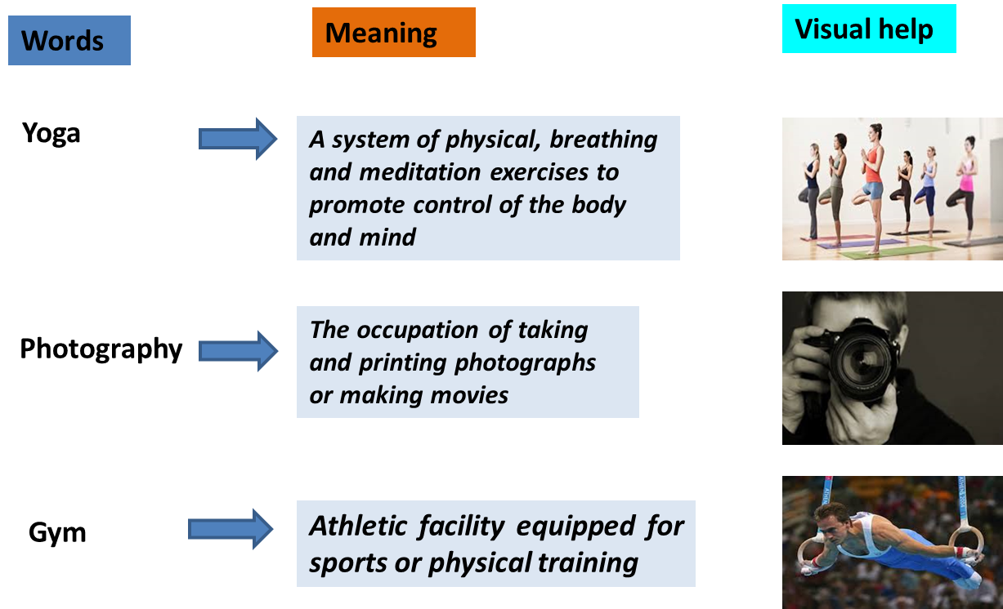

Slide 6
Students, now read the dialogue and try to answer the following questions in pairs.
Why does Anusha like going to the gym?
What are her pastimes?
Make a list of Tiya’s pastimes.

Slide 7
Evaluation
Match the information from column A with B
Column A | Column B
1. I like to keep | a. gardening.
2. Tiya likes | b. twice a week.
3. Anusha goes to gym | C. in shape.

Slide 8
Write true or false. If false give correct answer.
1. Anusha likes to go to the skiing.
2. Reading books is her favorite pastime.
3. Tiya has sufficient space for gardening.

Slide 9
Individual work
Complete the sentence individually
Anusha was looking ------
I do like-------but don’t have sufficient-------
I’m just from--------

Slide 10
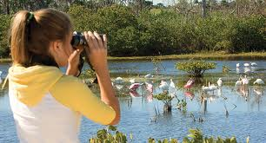
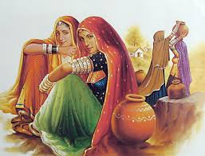
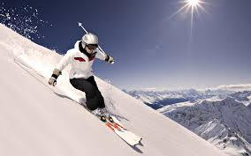



More pictures of favorite pastimes

Slide 11
Group work
There is a passage on yoga. Now write a paragraph based on it.

Slide 12


Slide 13

Thanks

