Slide 1
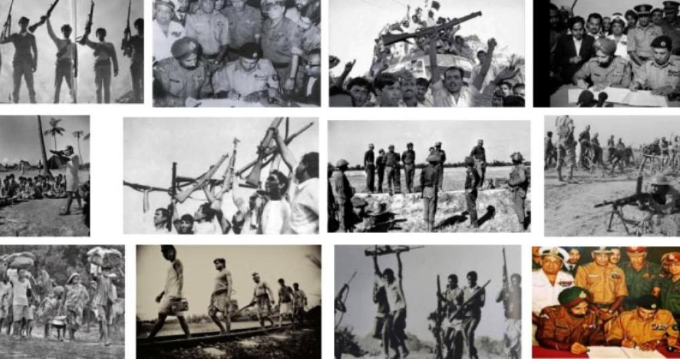
WELCOME

Slide 2
Identity
Mst.Hosneara Parvin
Head Teacher
Sholotaka Govt.Primary School.
Gangni, Meherpur.
Class: Five
Sub: English
Caption:The Liberation War Museum
Part of Lesson: A. (On 14……independence)
Unit: 19
Time: 55 Min
Date:

Slide 3
Learning Outcomes: Students will be able to
Listening:4.2.1 understand and enjoy simple stories.
Speaking: 1.1.1 say words, phrases and sentences with proper sounds and stress.
6.2.1 talk about people, objects, events etc.
Reading:1.5.1 read words, phrases and sentences in the text with proper pronunciation, stress and intonation.

Slide 4
Previous Lesson discuss
What does liberation war?
Can you tell what is the Bangla meaning of Liberation War Museum?

Slide 5
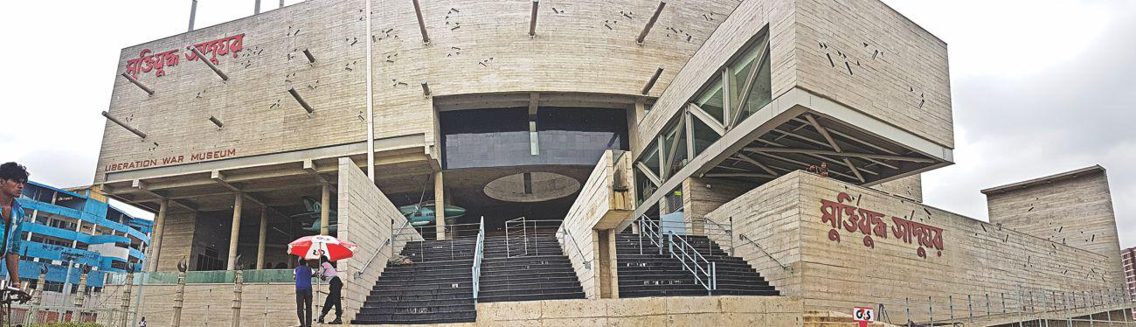
Let’s see the picture.
Today’s Lesson
The Liberation War Museum

Slide 6

Do you know? What is Magazine?
Look at the picture.
This is a Magazine
Magazine is a large thin book with a paper cover that is published every week or monthly containing article, photographs etc. on a particular topic.

Slide 7

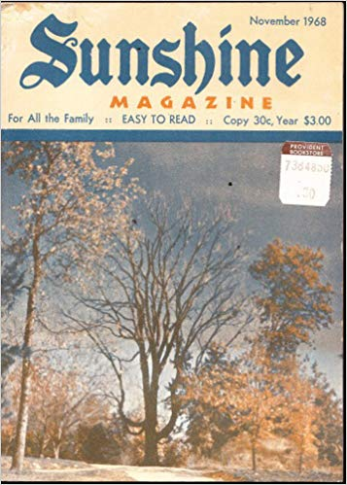
Let’s see the following pictures.
Sunshine Magazine
The Sunshine is a wall magazine. A wall magazine is a hand writing magazine posted on a wall.People can read standing before wall.

Slide 8

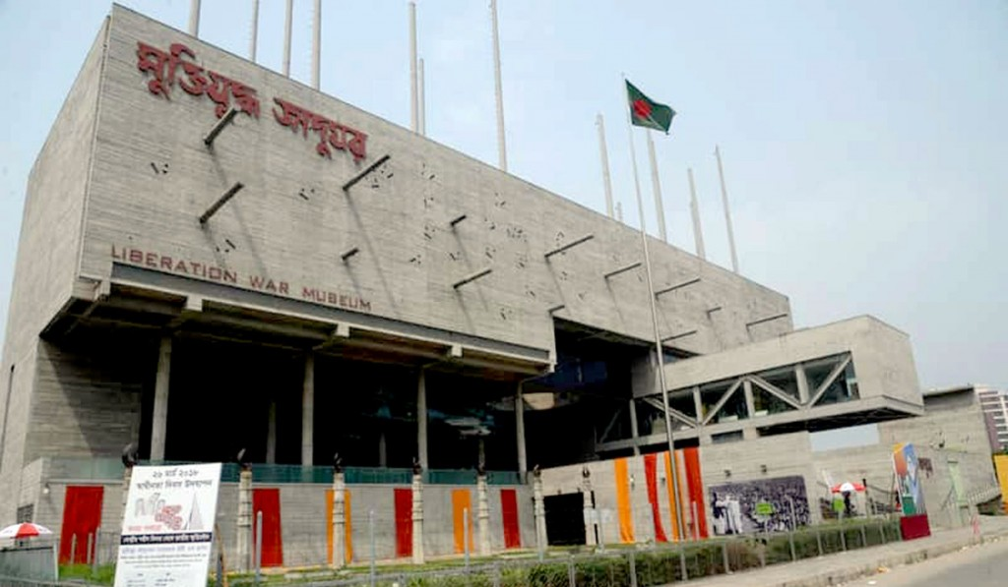
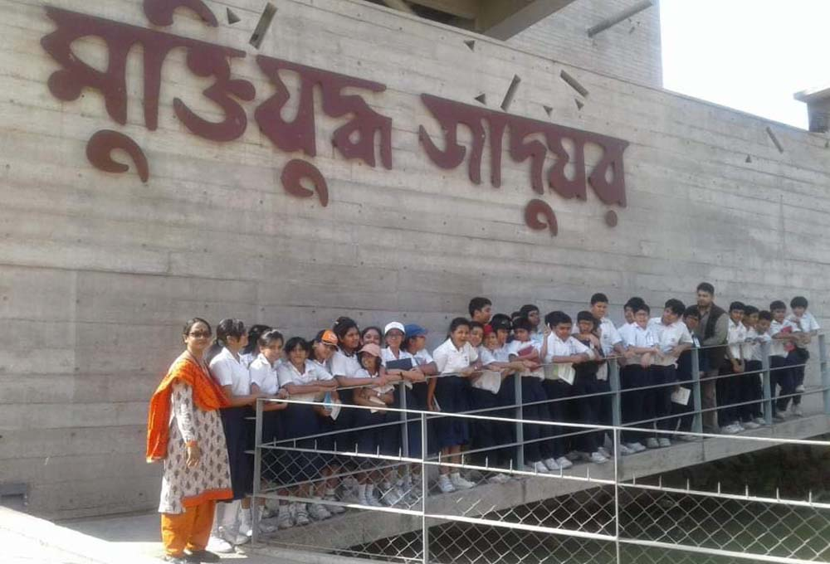
See the pictures attendtively
On 14 December, our class went on a field trip to the liberation war museum at Agargaon, Dhaka.

Slide 9
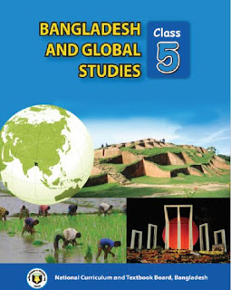
What is the picture?
The the trip was planned as part of our Bangladesh and Global studies course.
A book

Slide 10
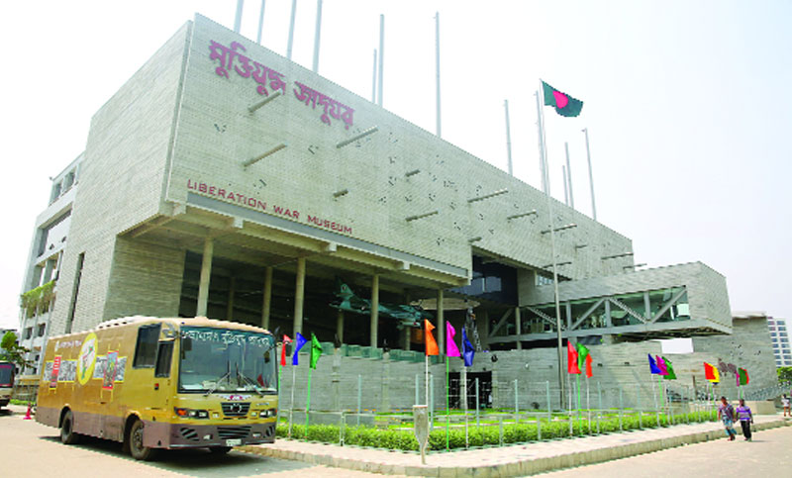

What can you see in the pictures?
Bus and watch
Our bus reached the museum at 10 a.m.

Slide 11
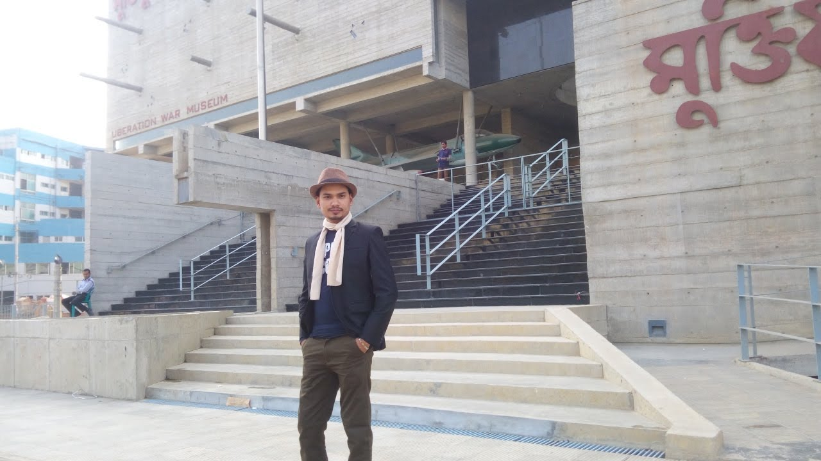
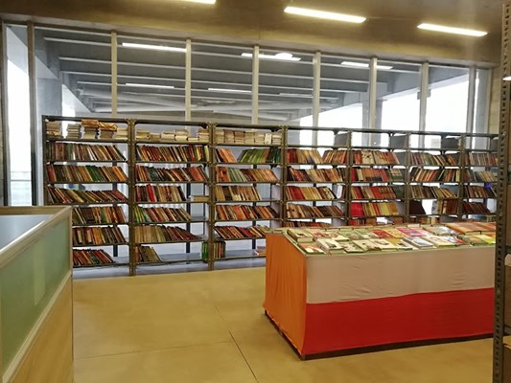
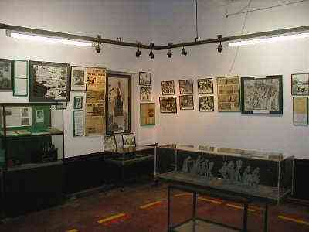
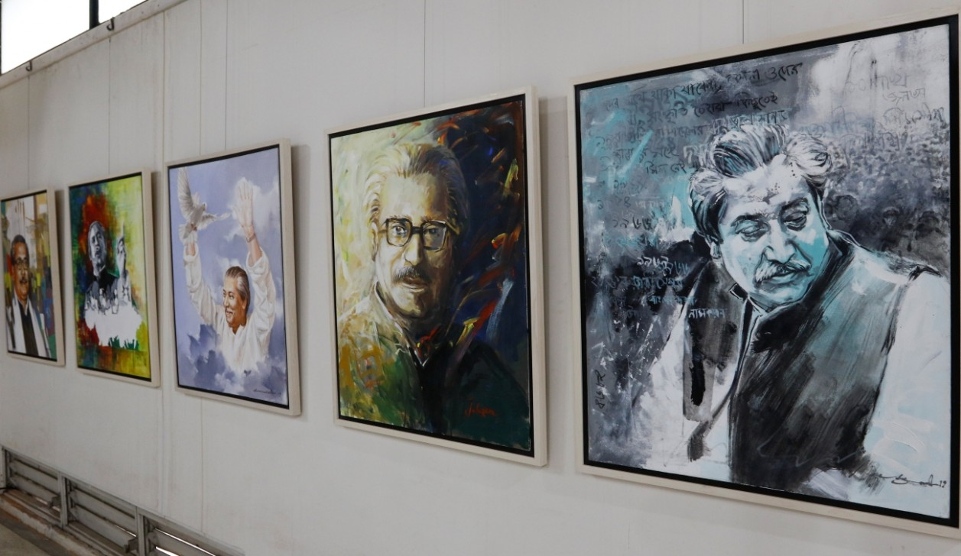
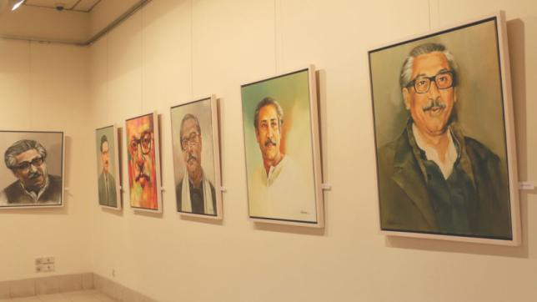
Watch the following pictures and think about these.
A guide was waiting for us. He welcomed us warmly and took us on a quick tour of the different galleries and exhibits of the museum.

Slide 12

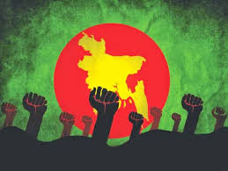
What do you see in the pictures?
We watched a video clip on our liberation war and our independence.

Slide 13
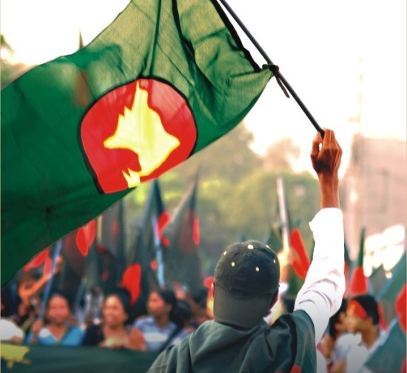
Exhibit
Independence
To show something publicly
Freedom from being ruled by another country.

Slide 14
Indivisual work:
What is the name of the wall magazine?
When did the class go to liberation war museum?
Where did the class go to?
When did they reach there?

Slide 15
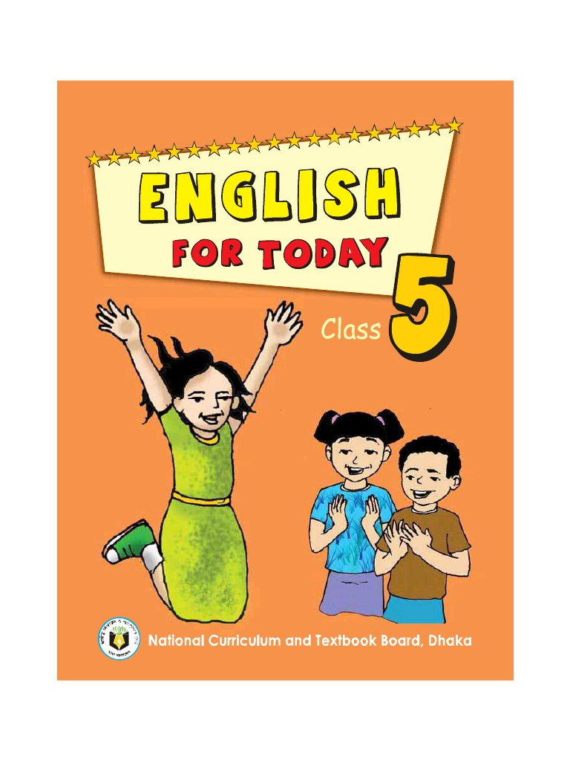
Teacher’s loud reading:
Student’s reading:

Slide 16
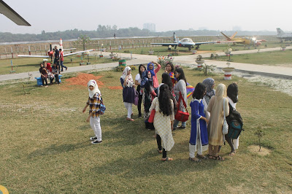

Let’s Find out new words with meaning.
Field trip
Liberation
An educational trip away from the classroom.
The setting free of someone or something.

Slide 17
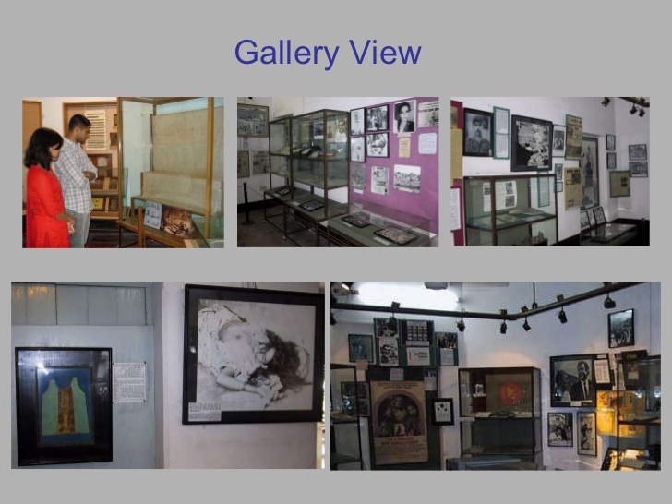
Gallery
Museum
A room or building for the display.
A building in which objects of historical, sciencetific, artistic interests are kept.

Slide 18


Group wprk:
In this group there wiil be 6 students and one is group leader. The rest of students will read one by one. Leader will listen and write down errors. who has mistaken or who has problem to read ? They will help them to read the text.
The Daily Ittefaqe
In this group there will be 6 students. Firstly Captain will read several times and anothers will listen attentively. Then remaining students will read one by one. Then Captain will find new words with the help of group. Students will practise that words with meaning.
The Daily Protham Alo
The Daily observer
In this group students will be same. Each student will read one line for 2 minutes. After finishing one line they will read next line for 2 minutes .in this way they will read all lines. At last they will try to find unknown words.

Slide 19
Pair Work:
Each pair will read the text again and again with the meaning.
Then they will check their reading with each others.
Each will find 5 words which are unknown to them.
Then they will exchange their words.

Slide 20
Evaluation
Each learner will come to the
front of the class and read one line from the first para.

Slide 21
Planned activity
Write two sentences on Liberation War Museum on the basis of reading of the 1st para.

Slide 22

Thank you

