Slide 1



Slide 2
MD. KOWSER ALI
ASISSTANT TEACHER
DURLOVPUR GOVT. PRIMARY SCHOOL
HORINAKUNDU, JHENIDAH.
kowser.gps@gmail.com
Sub: English
Class: Two
Lesson : Numbers (5,6,7)
Parts of the lesson: Activity-C
Page No-8

Slide 3
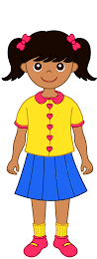
Safety environment by greetings song.
Hello! Hello! How are you?
I’m well, I’m good.
I’m great, I’m wonderful.
Hello! Hello! How are you?
I’m fine! I’m great today.

Slide 4
Checking homework and justify the previous lesson.

Slide 5
Our today’s lesson is too--
Numbers-5,6,7
Activity-C

Slide 6
LEARNING OUTCOMES
By end of the lesson students will be able to-------
Speaking: 1.1.1 repeat after the teacher simple words and phrases with proper sounds
and stress.
Reading: 2.1.1 recognize and read cardinal numbers up to 30.
Writing: 2.1.1 write cardinal numbers up to 30 in figures.

Slide 7
Look, listen and say.
How many X are there?
How many circles are there?
X
X
X
How many A are there?
How many circles are there?
A
A
A
A
A

Slide 8
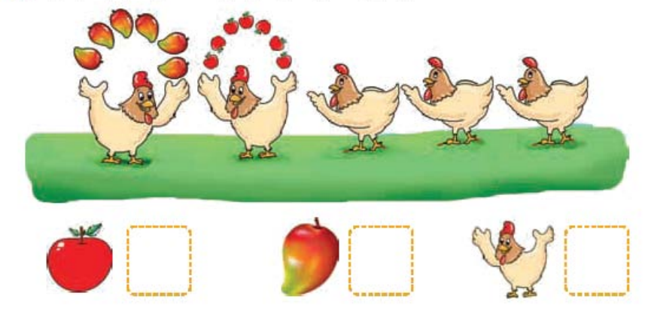
Open your English book at page-8 and see the Activity- C
What can you see in the picture?
See the right answers.
Count and write the numbers..
7
6
5
How many mangoes are there?
How many hens are there?
How many apples are there?
Exchange your book and check the text of other.

Slide 9
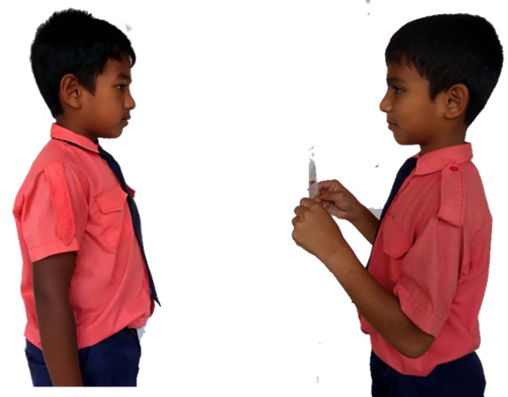
Pair work.
How many ----------?
One more.

Slide 10
Read, say and write the numbers .
-- one
-- two
-- four
-- three
-- five
-- six
-- seven

Slide 11
Read and say.
three
one
four
two
six
five
seven
Identifying weak students and taking to cure.

Slide 12

One day one word
How many flowers?
seven
সাত
Spell out the word - SGW

Slide 13
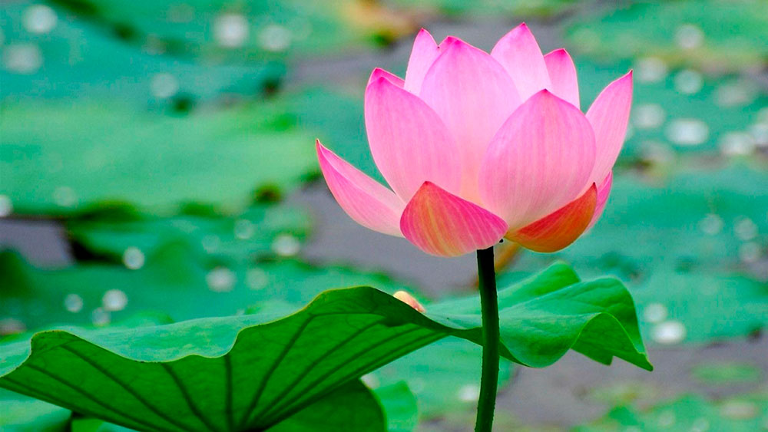
Find out the letters that are made by the word -------.
s
n
e
c
v
t
e
k
n
u
Find out the word ------.
saven
sevan
sevin
seven

Slide 14
Say the missing letter.
se--en
--even
seve--n
sev--d
Write the word to your notebook.
Date-
/ /20
seven
সেভেন
সাত

Slide 15
Home work
Page 5 will be well read and written.

Slide 16

That’s all for today. Goodbye. See you tomorrow.

