Slide 2
MD. KOWSER ALI
ASISSTANT TEACHER
DURLOVPUR GOVT. PRIMARY SCHOOL
HORINAKUNDU, JHENIDAH.
kowser.gps@gmail.com
Sub: English
Class: Two
Lesson : Alphabet
Parts of the lesson: P-T(Activity-C)
Page No-9

Slide 3
Safety environment by greetings song.
Hello! Hello! How are you?
I’m well, I’m good.
I’m great, I’m wonderful.
Hello! Hello! How are you?
I’m fine! I’m great today.

Slide 4
Checking homework and justify the previous lesson.

Slide 5
Our today’s lesson is too--
Alphabet (P-T)
Activity-C

Slide 6
LEARNING OUTCOMES
By end of the lesson students will be able to-------
Speaking: 1.1.2 say simple words and phrases with proper sounds and stress.
Reading: 1.4.1 read words and phrases with the help visual clues and simple
sentences.
Writing: 1.2.1 write non-cursive small letter.

Slide 7
Spell the words we learned the previous class.
pot
quail
rose
sun
tiger

Slide 8
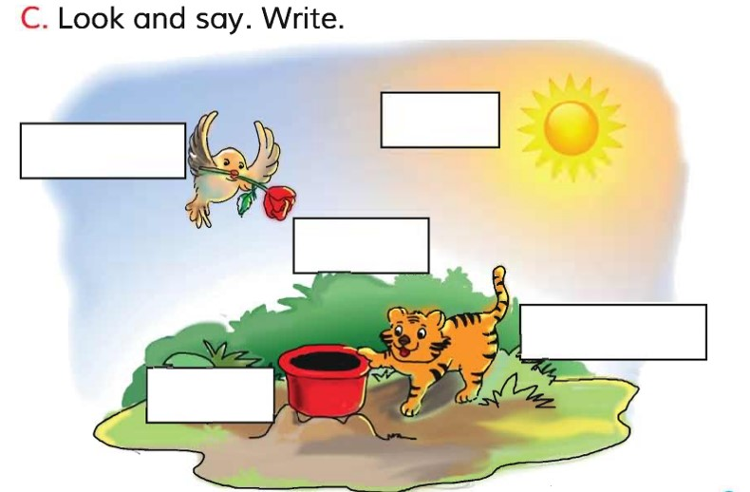
Open your English book at page-9 and see the Activity-C
What can you see in the picture?
sun
quail
rose
tiger
pot
What can you see in the sky?
What is the tiger doing?
Exchange your books and check the text of other.
Match your answers.

Slide 9
SGW
Say and write the small letter.
P---
Q---
R---
S---
T---

Slide 10
Read and say.
rose
quail
pot
tiger
sun
tiger
sun
rose
pot
quail
rose
quail
pot
tiger
sun
tiger
sun
rose
pot
quail
Identifying weak students and taking to cure.

Slide 11
One day one word
What is this?
igloo
বরফের ঘর
Spell out the word - SGW

Slide 12
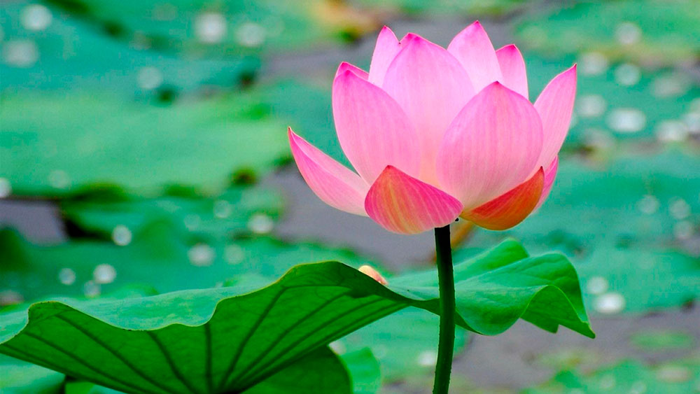
Find out the letters that are made by the word-------.
i
n
g
l
c
e
o
k
o
u
Find out the correct word-------.
igloo
egloo
agloo
igglo

Slide 13
Say the missing letter.
iglo--
i--loo
ig--oo
igl--o
Write the word to your notebook.
Date-
/ /20
igloo
ইগলু
বরফের ঘর

Slide 14
Home work
Page 6 will be well read and written.

Slide 15
That’s all for today. Goodbye. See you tomorrow.

