Slide 1
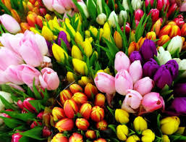
Welcome

Slide 2
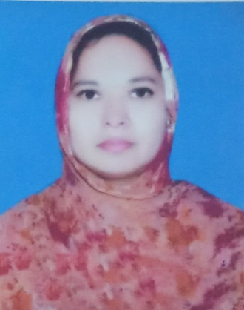
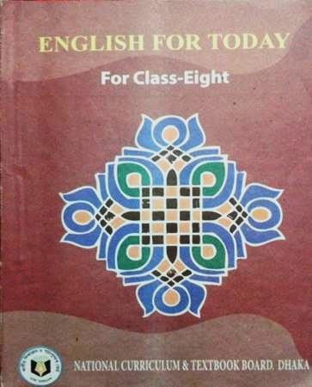
Introduction
Musa. Rahima Akther
Assistant teacher ,
Khulna Engineering University School
Kuet campus, Khulna
Class – Eight ,
Sub:- English 1st ,
Time – 50minutes ,
Date – 01-11-2018.

Slide 3
4. what do we do with it?
1. What do you see in the picture?
2. What is it called?
3. Have you seen it before? Where?

Slide 4
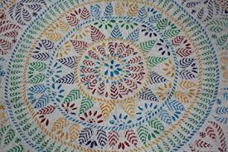
Today’s lesson is --
“ Nakshi Kantha”
Unit – one .
Lesson – 02 .

Slide 5
Learning outcomes -
At the end of the lesson, students will be able to –
Discuss about pictures;
Read and understand the text;
Infer meaning from context ;
Ask and answer questions;
Complete the sentences with given clues;

Slide 6
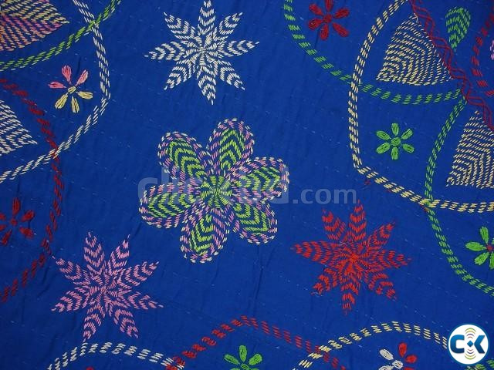
New words
Quilt (noun)
coverlet
splotch
লেপ, কাঁথা
We use quilt in winter.

Slide 7
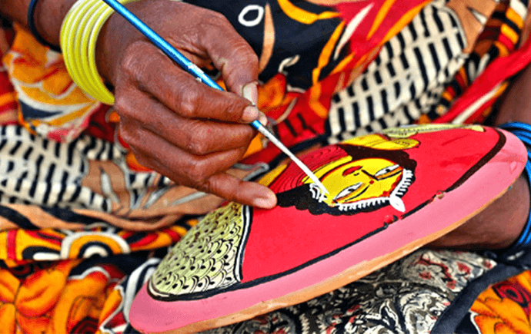
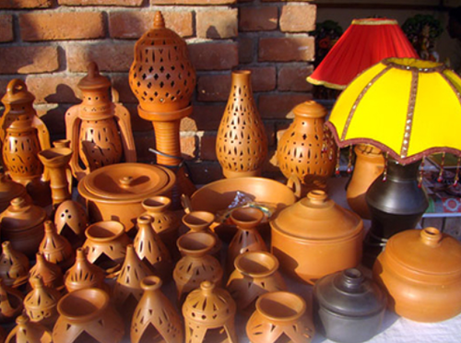
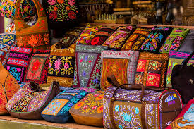
New words
handicraft (noun)
artistry
Hand made things
হস্তশিল্প
Our women are expert in handicraft.

Slide 8
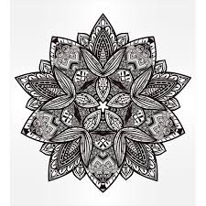
New words
Pattern (noun)
design
model
নকশা
I will use this pattern in my dress.

Slide 9
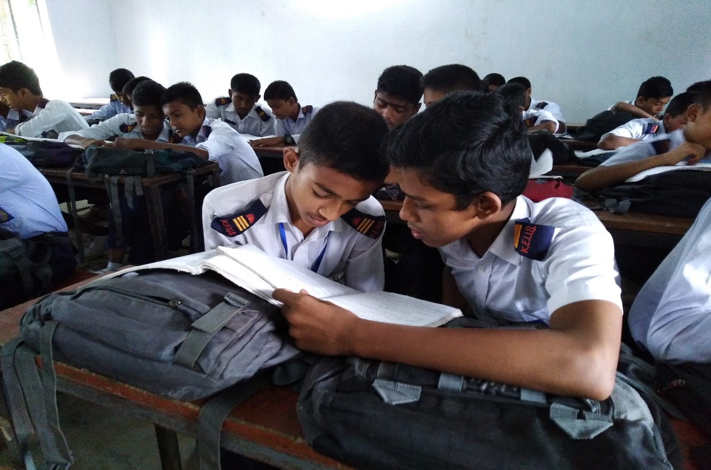
Read the text silently (7 m.)

Slide 10
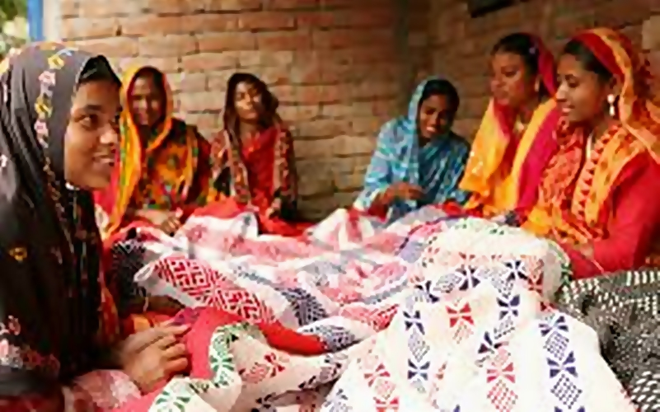
Write a paragraph describing how the nakshi kantha is made. Start like this: Old or new cloth and coloured thread are needed. First the cloth is folded, then..........

Slide 11
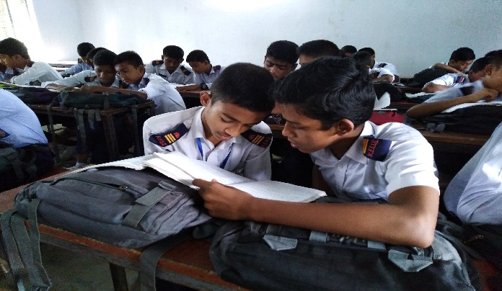
Pair work
(10m)
Write the shosrt answer -
1.Where can you find nakshi kanthas?
2.What made nakshi kanthas popular?
3.When the name ‘nakshi kanthas’ became popular ?

Slide 12
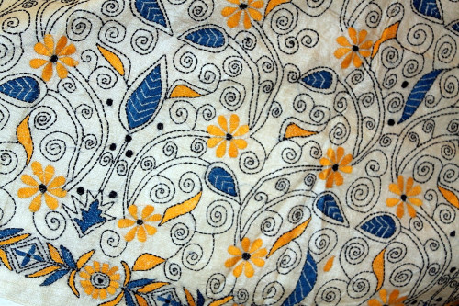
1. What is nakshi kantha ?
Nakshi kantha is a kind of embroidered quilt.
Notes:
The teacher will ask the questions and the students will try to answer and then the teacher will show the pictures and answer box.

Slide 13
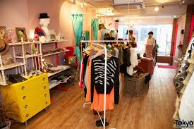
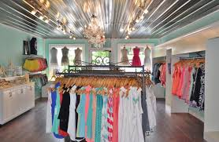
2. Where can you find nakshi kanthas?
You can find nakshi kantha in many expensive handicraft shops in cities.
Notes:
The teacher will ask the questions and the students will try to answer and then the teacher will show the pictures and answer box.

Slide 14
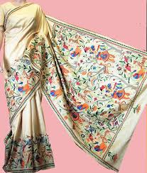
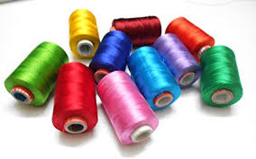
3. What is needed to make nakshi kantha ?
Old or new cloth and thread are needed to make nakshi kantha.
Notes:
The teacher will ask the questions and the students will try to answer and then the teacher will show the pictures and answer box.

Slide 15
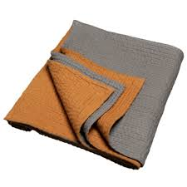
Do you like a nakshi kantha or an ordinary kantha? Why?
A nakshi kantha
An ordinary kantha

Slide 16
E. Complete the sentences with clues given
Bengali patterns embroidery years fashion art rural designs quilt naksha
patterns
Naksha means artistic ……………….
The name was taken from a ……… word ………….
The art has been practised in ……….. Bengal for ……….
Nakshi kanthas are now sold in ……………..shops.
Nakshi kanthas are in great demand because of their colourful…………….and …………
Naksha kanthas are a kind of…………….
bengali
naksha
rural
years
fashion
patterns
designs
quilt

Slide 17
F. Write down five questions for the completed statements in activity E
Naksha means artistic patterns.
Q. What does naksha mean?
The name was taken from a Bengali word nakshi.
Q. Where was the name taken from?
The art has been practiced in rural Bengal for years.
Q. How long has the art been practiced?
Nakshi kanthas are now sold in fashion shops.
Q. Where are nakshi kanthas sold now?
Nakshi kanthas are in great demand because of their colourful designs and patterns.
Q. Why are nakshi kanthas in great demand?

Slide 18
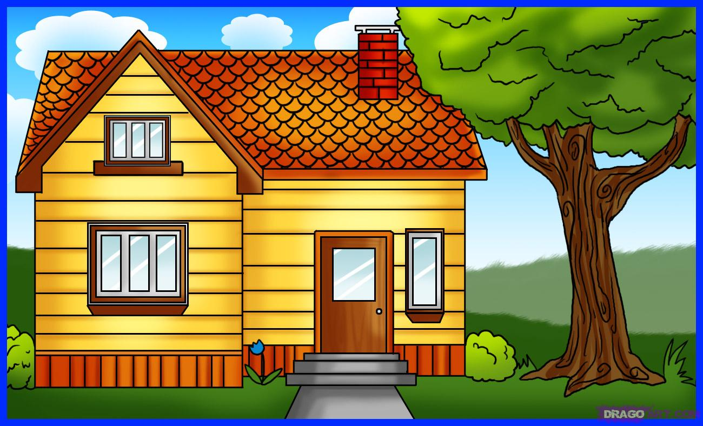
Home work
Write a parragraph on “Nakshi kantha”.

Slide 19
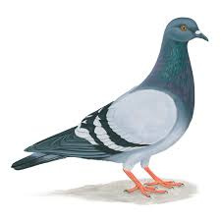
Thank you

