Slide 1
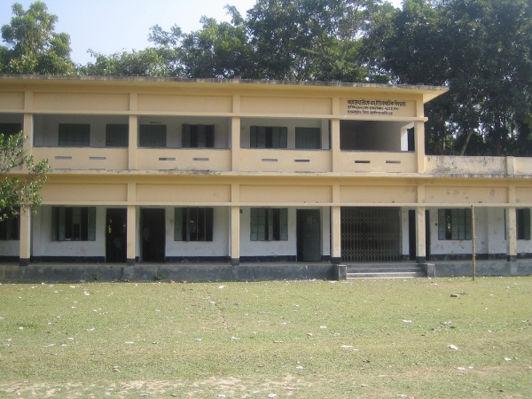
Surongal Govt. Primary School

Slide 3
Identity
Abul Kalam
Assistant Teacher
Surongal Govt Primary school
Mobile: 01917867646
Kalam_master2018@gmail.com
Class : One
Subject : English
Lessons : 1-3
Unit : 4
Period: 1

Slide 4
Learning outcomes: By the end of the unit students will be able to…
Reading
2.1.1 recognize and read cardinal number up to 10.
writing
2.1.1 write cardinal numbers up to in figures.

Slide 5
Greeting
Teacher
Students
Good Morning Students
Good Morning Teacher
How are you ?
Fine thank you and you?
I am also find.

Slide 6
How many words learn by A & B
Ant
Ball
Apple

Slide 7
Look, listen, Say and Count
1
How many apple ?

Slide 8
Look, listen, Say and Count
1
How many ant ?

Slide 9
Look, listen, Say and Count
1
How many ball ?

Slide 10
Look, listen, Say and Count
2
How many apples ?

Slide 11
Look, listen, Say and Count
2
How many ants ?

Slide 12
Look, listen, Say and Count
2
How many balls ?

Slide 13
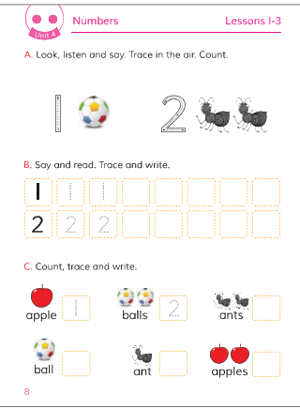
Take your English Book and open your book at page no. 8

Slide 14
Dear students, loudly say 1 & 2 again and again
1
1
2
Group Work
2

Slide 15
Evolution
1
How many apple ?

Slide 16
Evolution
1
How many ball ?

Slide 17
Evolution
2
How many apples ?

Slide 18
Evolution
2
How many ball ?

Slide 20
The End

