Slide 1

Welcome

Slide 2

Introduction
Mumtahina Khushbu Hasan
Assistant Teacher (English)
Lohanipara High School, Badargonj,
Rangpur.
Class: IX
Subject: English
Paper: 1st

Slide 3
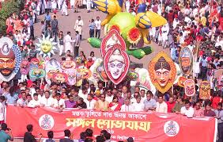
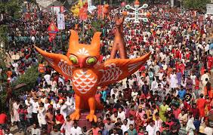
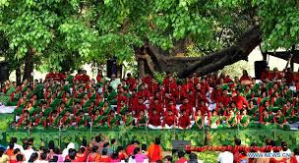
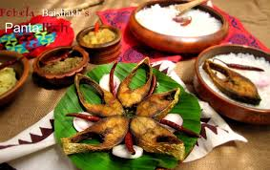
What are the pictures about?
Celebration of Pahela Boishakh

Slide 4

Pahela Boishakh
Unit: Three, Lesson:6

Slide 5
Learning Outcome:
Students will be able to say about the festival.
Students will be able to say about the history behind the festival.
Students will be able to say about the traditional activities of this day.

Slide 6
Let us watch a video of the colorful procession of the biggest festival…

Slide 7
Read the text and note down unknown words:
‘Pahela Boishakh’ is the first day of Bangla new year. The day is a public holiday. This day has a special significance for us as it is a part of Bangalee culture and tradition. People from all walks of life irrespective of their ethnic identity or religious beliefs, celebrate the day with traditional festivities. On this day the whole of Bangladesh is in a festive mood. The day inspires people to start life with renewed hopes and inspirations.

Slide 8
Every year the day is celebrated traditionally. People wake up early in the morning, have a bath and wear traditional clothes. Women wear white sharees with red borders and adorn themselves with colourful churis and flowers, while men dress themselves in pajamas and punjabis. It is a day when people love eating traditional food.
One of the most colourful events of the day is held in Dhaka. Early in the morning, people in hundreds and thousands pour in from all directions to attend the cultural function at Ramna Batamul organised by Chhayanaut.

Slide 9
The cultural programme begins just at sunrise and the reknowned artist of the country take part in the programme that starts with the famous Tagore-song Esho-he-boishakh, Esho Esho…Artists also sing traditional folk songs, and perform classical dances to the rhythm of musical instruments.
People also come to join the colourful processions, the biggest carnival of the country, organised by the Fine Arts students of Dhaka University. The procession usually displays the traditional practices of Bangalee Culture.

Slide 10
The masks and wreaths worn by the people are so fascinating! Often they symbolise contemporary worries or happiness in the national life. It attracts an increasing number of foreign tourists every year. The day is also observed all over the country. Different social and cultural organisations and educational institutions celebrate the day with their own cultural programmes. On this day, newspaper bring out special supplements. There are also special programmes on the radio and television.
The celebration of Pahela Boishakh marks a day of cultural unity for the whole nation.

Slide 11
Spell and Pronounce the word
T
R
A
D
I
T
I
O
N
Tra
Di
Tion
Tradition
Meaning:
Heritage, Practice, Custom, Law…etc.
Grammar: Noun

Slide 12
Try Some More Words
Word | Meaning | Grammar
Belief | Faith, Trust | Noun
Celebrate | Hold, Perform | Verb
Mask | Guise, Makeup | Noun
Wreath | Garland, Laurels | Noun
Fascinating | Impressive, Showy | Adjective
Supplement | Sequel(n.), Help out(v.) | Noun, Verb

Slide 13
Main Points of The Text
Pahela Boishakh is a public holiday.
The day inspires people to start life with renewed hopes and inspirations.
The day is celebrated traditionally.
Women wear white sharees with red borders and adorn themselves with colorful churis and flowers.
Men dress themselves in pajamas and punjabis.
People eat traditional food like Panta-Ilish.
Chhayanaut organises the biggest cultural function at Ramna Batamul.

Slide 14
Complete the passage with suitable words.

Slide 15
The word Pahela means the first and Boishakh is the month of Bangla calendar. The day is observed not in Bangladesh but in some other parts of the world. It is celebrated in West Bengal, Assam and Tripura. It is also in Australia and the UK. In Australia, the largest event for Bangla new year is the Sydney Boishakhi Mela held Sydney Olympic Park.
first
only
also
celebrated
in

Slide 16
Home Work
Write a paragraph on
“Pahela Boishakh”

Slide 17

Thank You!

