Slide 2
Teachers Identity
Md Rokibul Hassan
Assistant Teacher
Mirzapur Govt. Primary School
Singair,Manikgonj.
Mobile:01714781146

Slide 3
Sub: English
Lesson:1-3
Unit:4
Class:3

Slide 4
Learning Outcomes
1.Students will able to count the numbers
2.Students will able to write the missing numbers

Slide 5
1
One

Slide 6
2
Two

Slide 7
3
Three

Slide 8
4
Four

Slide 9
5
Five

Slide 10
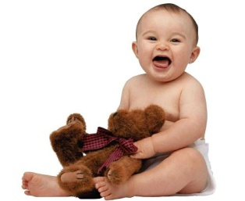
A.Say,Count and write the numbers
4
3
2
5
1

Slide 11
B.Say,trace and write
3
4
5
1
2
One
Two
Three
Four
Five

Slide 12
C.Write the missing number or word
1_______3_______5
_____ two three _____ _____

Slide 13
Cheaking Learning
Matching
A
B
3
4
5
1
2

