Slide 1

Welcome

Slide 2
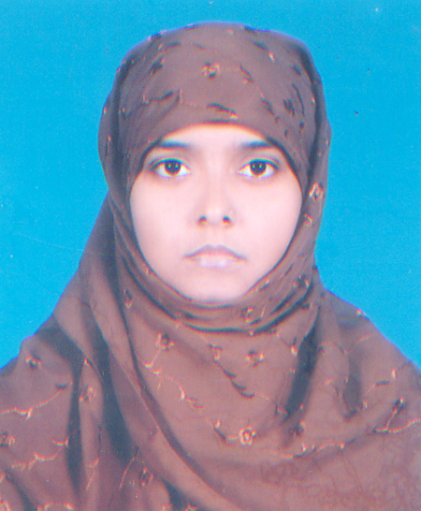
INTRODUCTION
SUBJECT: English 1st Paper
CLASS: Six
Prepared by
Farhana Akter
Assistant Teacher( ICT)
Jaria I.S.D Madrasah
Fakirhat, Bagerhat.

Slide 3
Today our topic is
Birds of Bangladesh
Lesson- 12

Slide 4
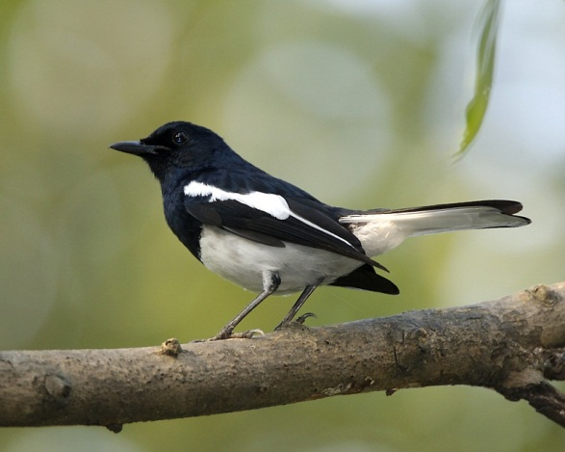
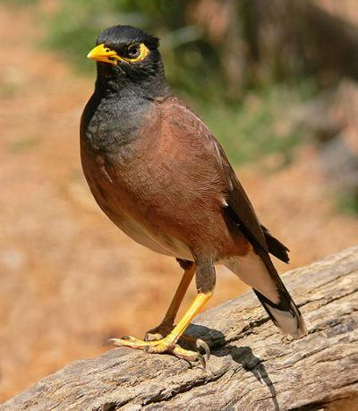
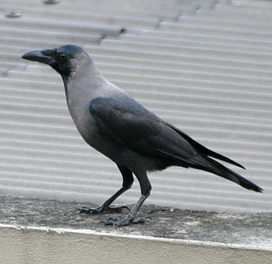
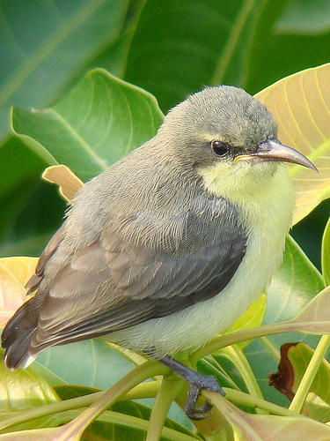
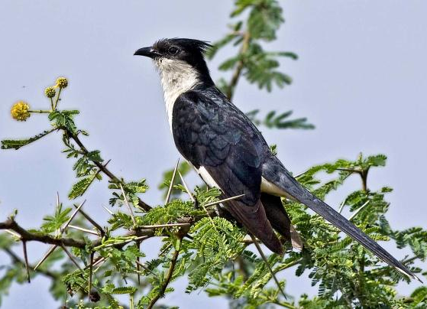
Can you tell the names of the following birds?
1
2
3
Magpie Robin
Shalikh/Myna
Crow
4
5
Tuntuni/Tailorbird
Cuckoo (Kokil)

Slide 5
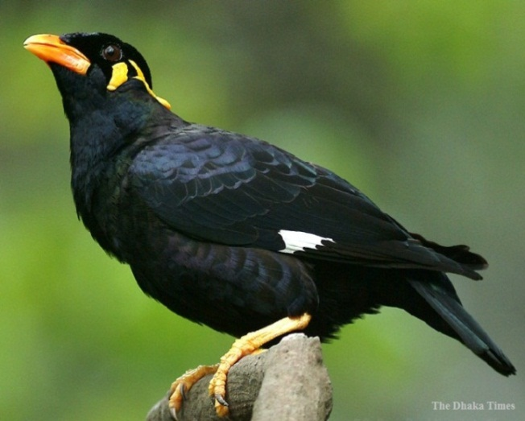
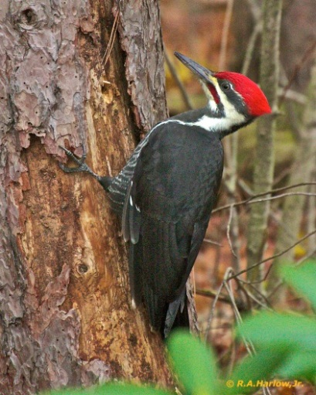
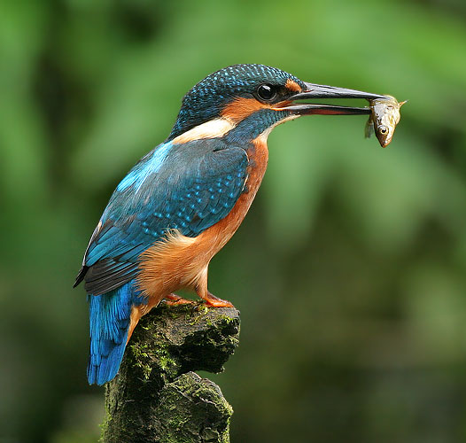
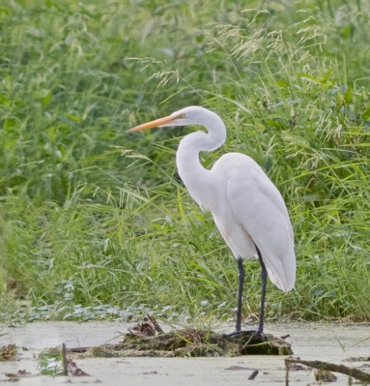
6
7
Moyna
Woodpecker
8
9
Kingfisher
Heron

Slide 6

OBJECTIVES OF THE LESSON
By the end of the lesson the students will be able to
1. Read and understand text.
2. Write answers to questions.
3. Write a short paragraph.
4. Tell the meaning of some key words from the inference. Vocabulary(Plentiful, Fauna, Sprightly, Pleasant)

Slide 7
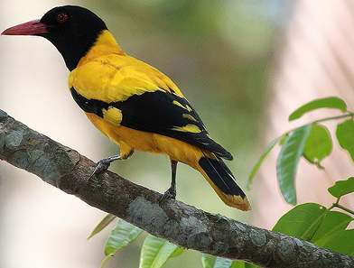
Can you tell the name of this bird?
Blackheaded Oriole
(Benebau)

Slide 8
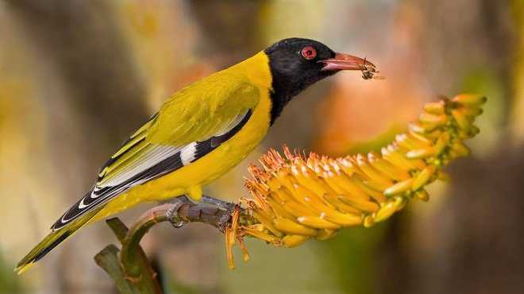
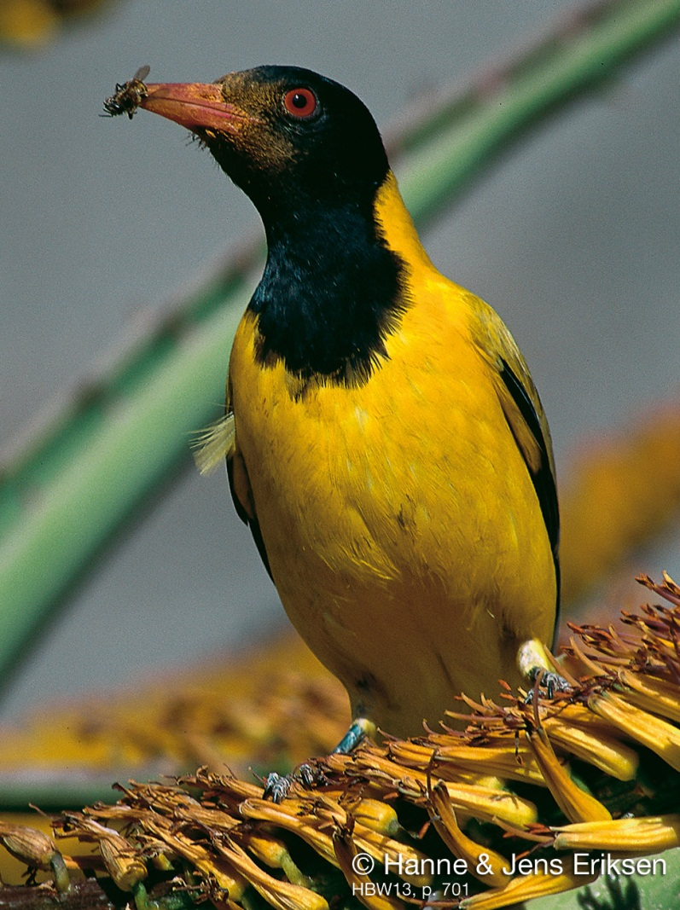
Guess what does this bird eat?
All kinds of insects and worms

Slide 9
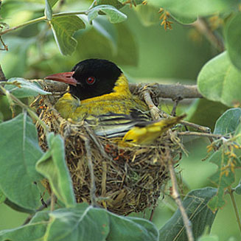
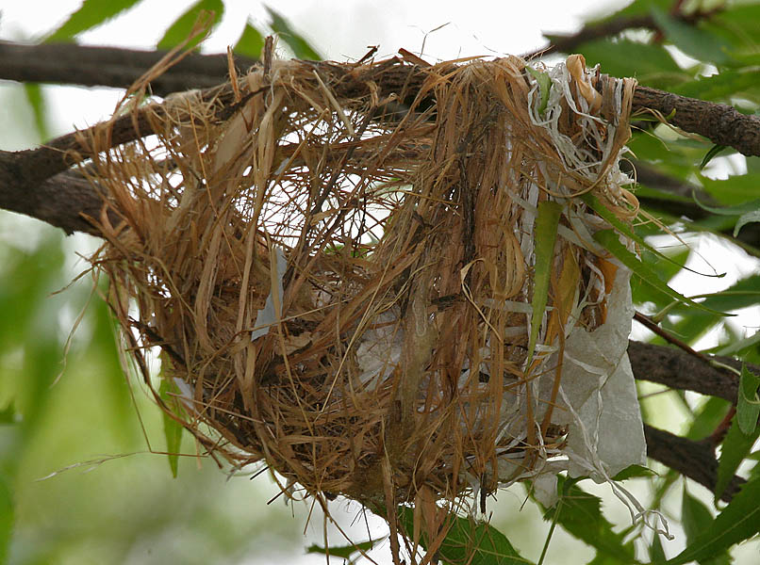
Can you guess by which the nest is made of ?
Dry grass and barks of trees.

Slide 10
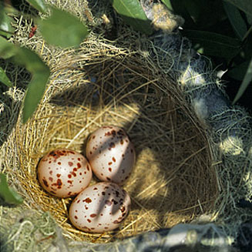
The black headed Oriole lays two or three eggs at a time.

Slide 11
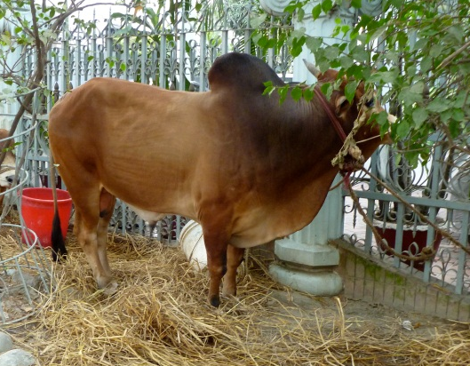
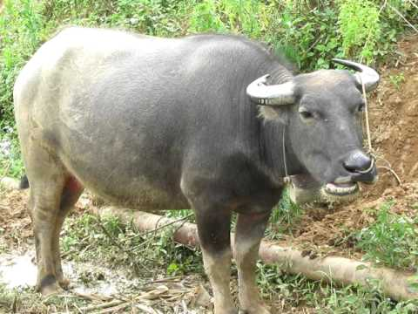
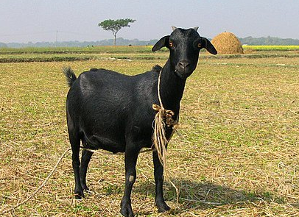
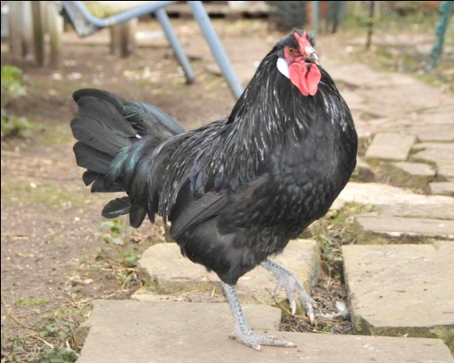
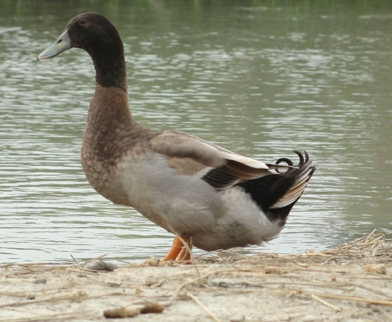

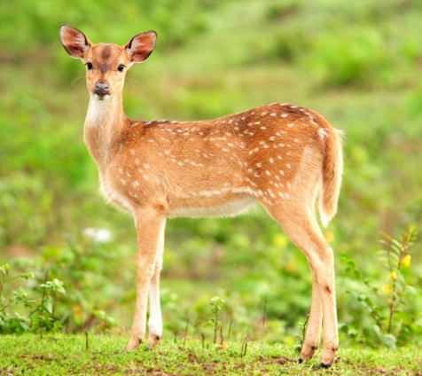
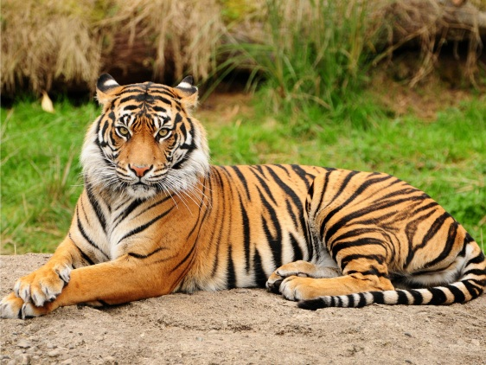
Fauna
(Noun)
These animals are the fauna of Bangladesh.
The animals of a particular region.

Slide 12
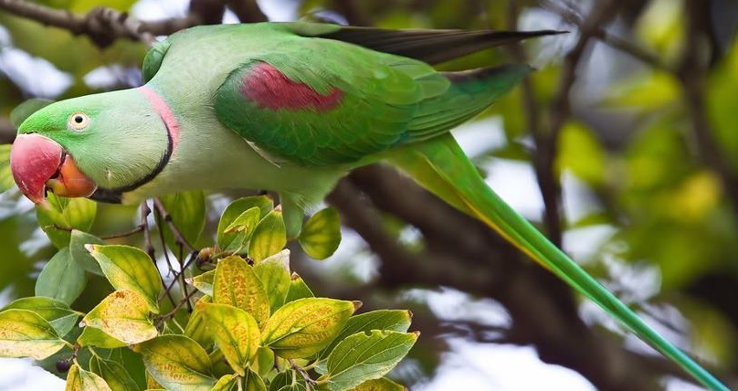
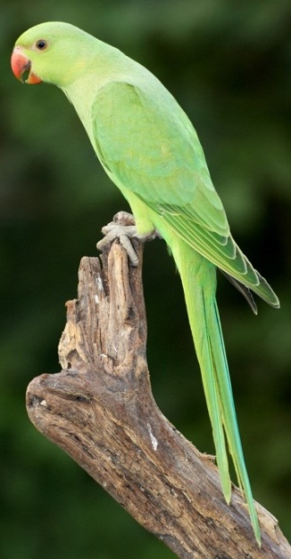
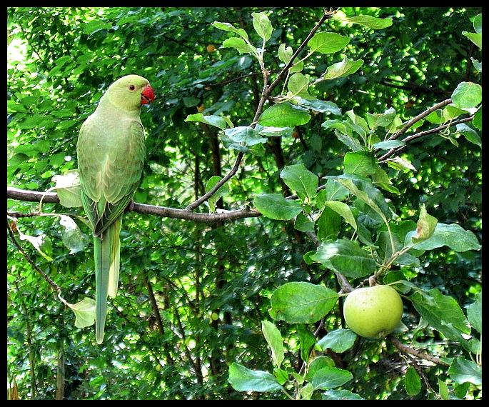
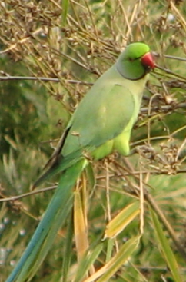
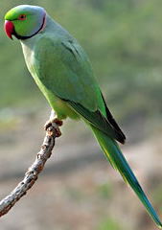
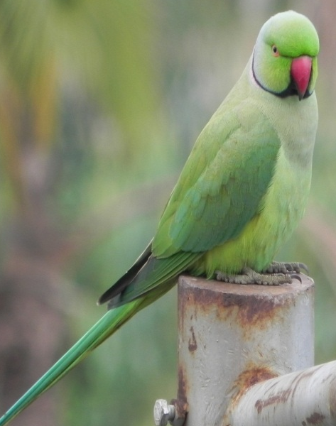
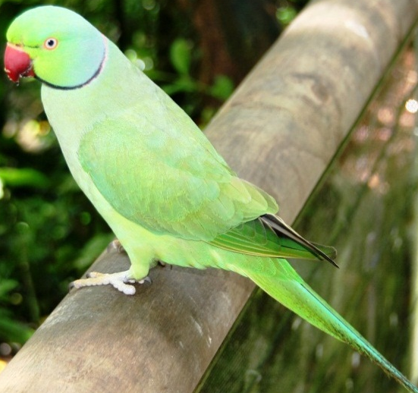
Can you tell the name of the bird?

Slide 13





Slide 14
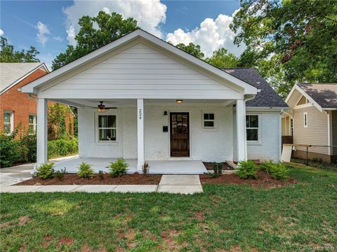
Home Work
1. What are we proud of?
2. In which countries is Blackheaded Oriole seen?
Notes:
The teacher can ask SS to go to the textbook. After reading the passage student will find out the answer from the passage. 10 minutes can be given for the task. Then the teacher can elicit answer from 4/5 students. Then the teacher can show the answer.

Slide 15

Thank you

