Slide 1



Welcome to my presentation class.

Slide 2
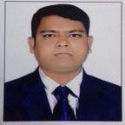
Conducted by-
Welcome
To
English Class
Md. Sharif Hossen Mozumder
Asst. Teacher in English
Bataichhari High School.
Barura, Cumilla
Class-8
English First Paper
Notes:
This slide means introduction of teacher & class.

Slide 3

Beginning
Notes:
Teacher may give the students some time to think about picture, then click for animation.

Slide 4
Our Today’s Lesson is-
The beginning
Unit-5, Lesson-1
Notes:
Lesson declaration.

Slide 5
Learning outcomes
At the end of the lesson, we will be able to learn…
read and understand text through silent reading
ask and answer questions
write answer to questions
write a paragraph
Notes:
All the four skills will be focused in this lesson. If the teacher wants to avoid word meaning option, he may use hyperlink.

Slide 6
Not for the students
Keywords
Teacher may show this option if time may allow. To conduct this portion teacher can show the word first to ask meaning, then he can advance according to animation.

Slide 7
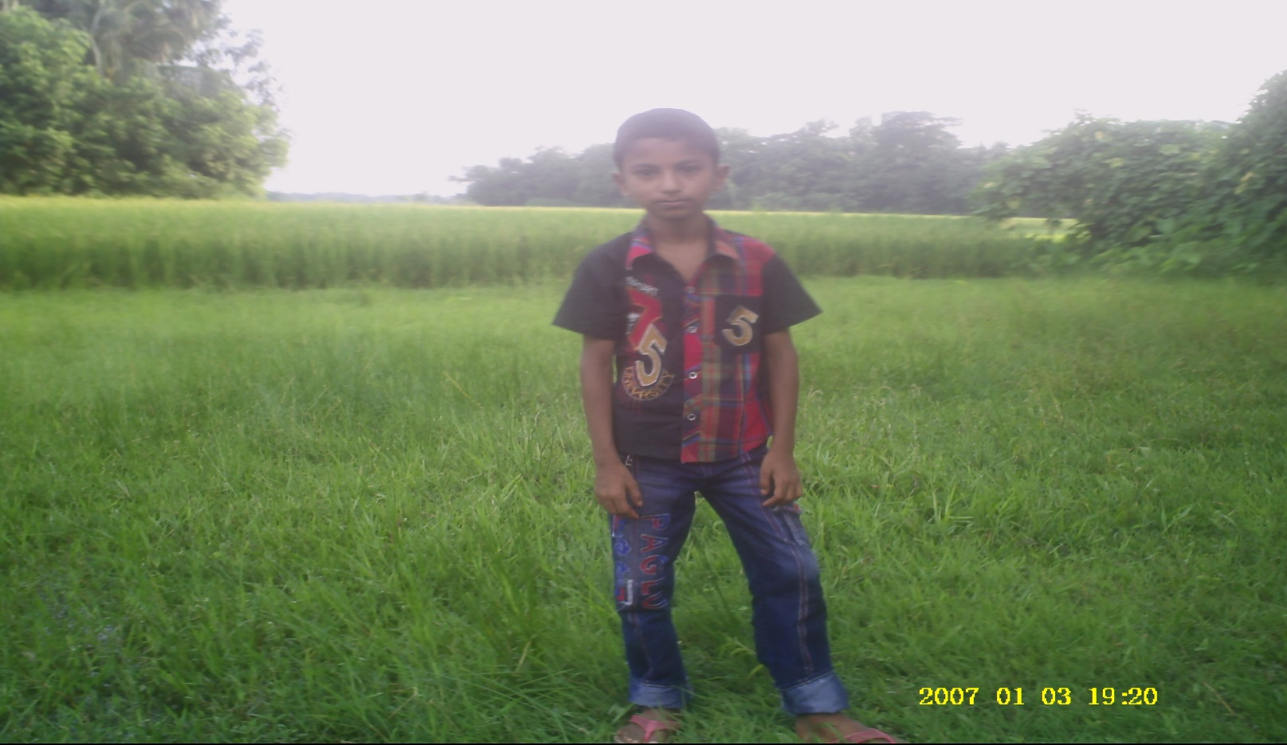
Typical
Meaning: Characteristic/usual
Pomtola is a typical village .

Slide 8
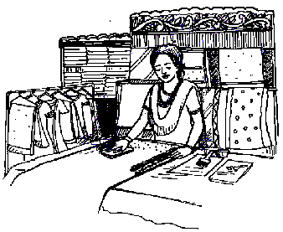
Extra ordinary
Meaning: Unusual/tremendous
Shamima Akter is an extra ordinary woman

Slide 9
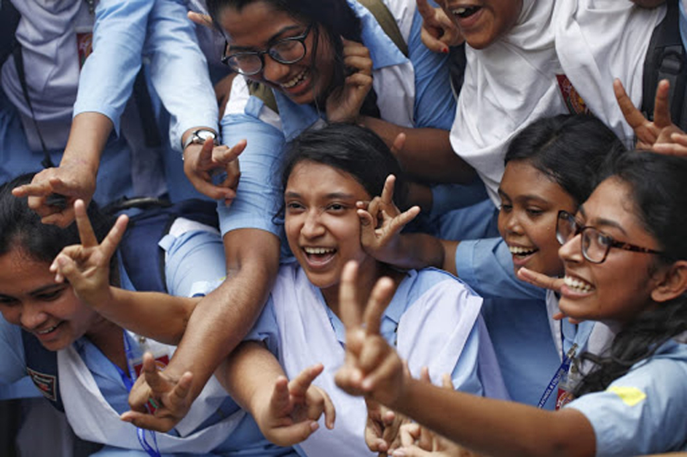
Willpower
Meaning: Confidence
Everything is possible if your willpower is strong.

Slide 10
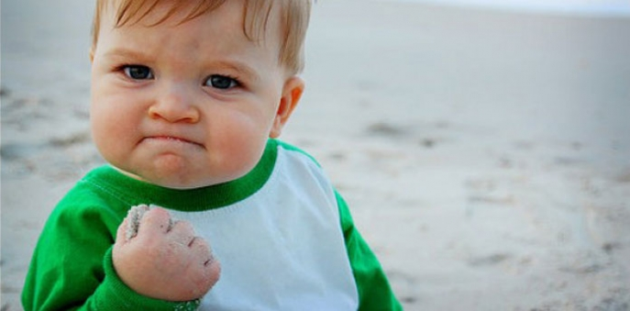
Determination
Meaning: Confidence/ power of mind
Everything is possible if you are determind.

Slide 11

Defying
Meaning: Avoid/disobey
He succeeded defying all the odds of life.

Slide 12
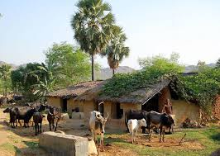
Bhabanipur, a small village in Jhenaidah.

Slide 13
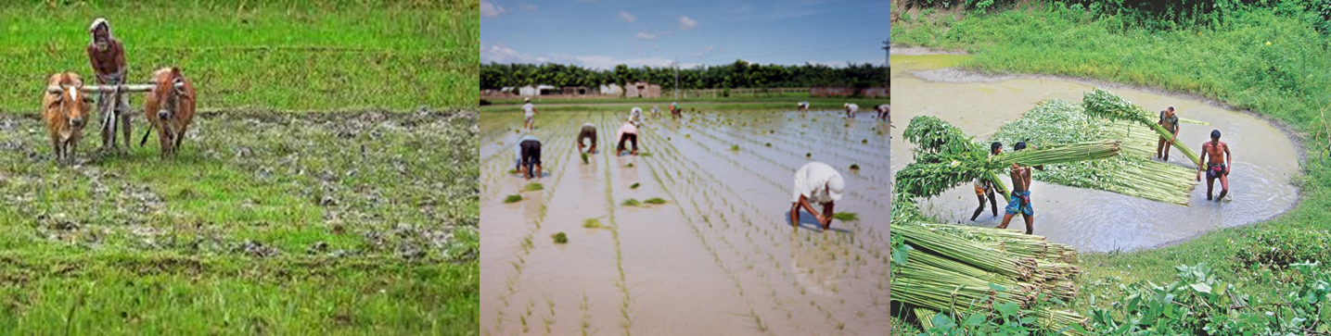
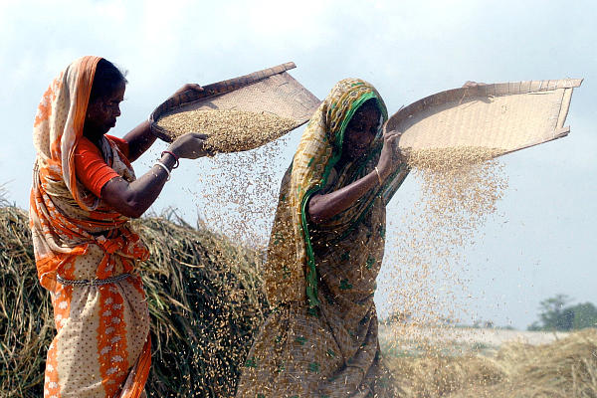
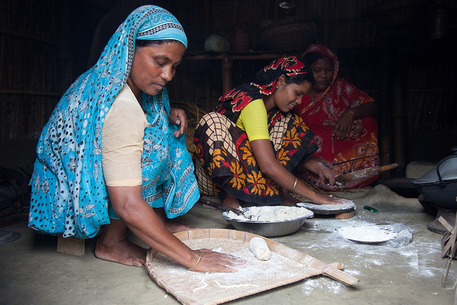
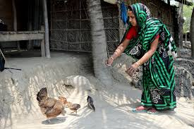
People here spend their day-to-day life mostly working in the fields and doing household works.

Slide 14
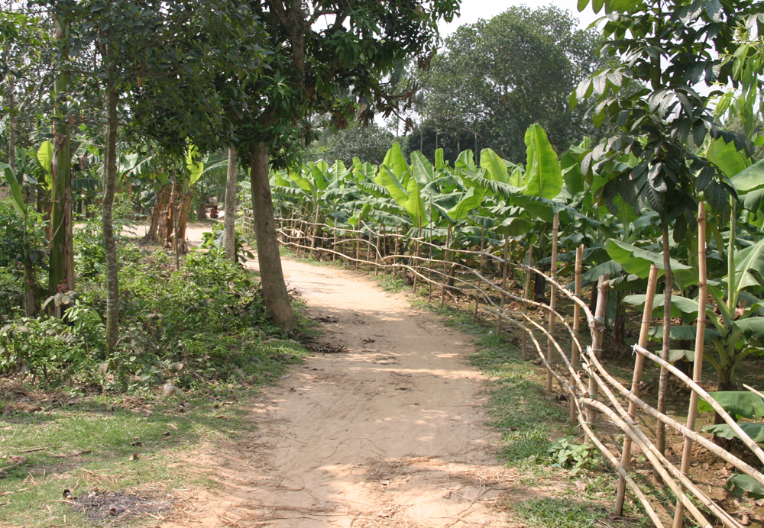
Extra ordinary woman
Ordinary village
Shamima Akter Maya (32)

Slide 15
A Read the text and tick the best answers to the following questions.
Shamima’s willpower and determination have made her extraordinary. She has seen the most cruel aspect of life. But the cruelty could not defeat her spirit. She has come out as a winner, defying all the odds of life. Shamima is now 32 years old. She runs a small boutique called ‘Oikko Nari Kollayan Shangstha’ in her village. Let’s hear from Shamima, how she succeeded in setting up her boutique.
Dear students,
Open your text book, page no-49, read silently from (Shamima’s will power and determination-----------setting up her boutique)

Slide 16

1 Bhabanipur is a typical Bangladeshi village.
The underlined word means
a unusual. b usual.
c famous. d infamous.
2 Shamima is an extraordinary person.
Here underlined word means
a common. b simple.
c amazing. d normal.
3 People of determination succeed in the long run.
Here underlined word means
a willpower. b weakness.
c strong desire. d wish.
Notes:
Teacher may ask the answer first, then he may advance to check if the students are correct or not.

Slide 17
4 Shamima has faced the most dark aspect of life.
Here the underlined word means
a appearance.
b position.
c characteristics.
d piece.
The tragedy in Shamima’s life could not defeat. her spirit. Here spirit means-
a ghost.
b soul.
c strength.
d wisdom.
Notes:
Teacher may ask the answer first, then he may advance to check if the students are correct or not.

Slide 18
Home Task
Suppose your village name is Purbachan. It is full of natural beauty. Now write a paragraph about your village.

Slide 19
Thank you all
Notes:
Advice to the students.

