Slide 1



WELCOME
Good morning everybody

Slide 2
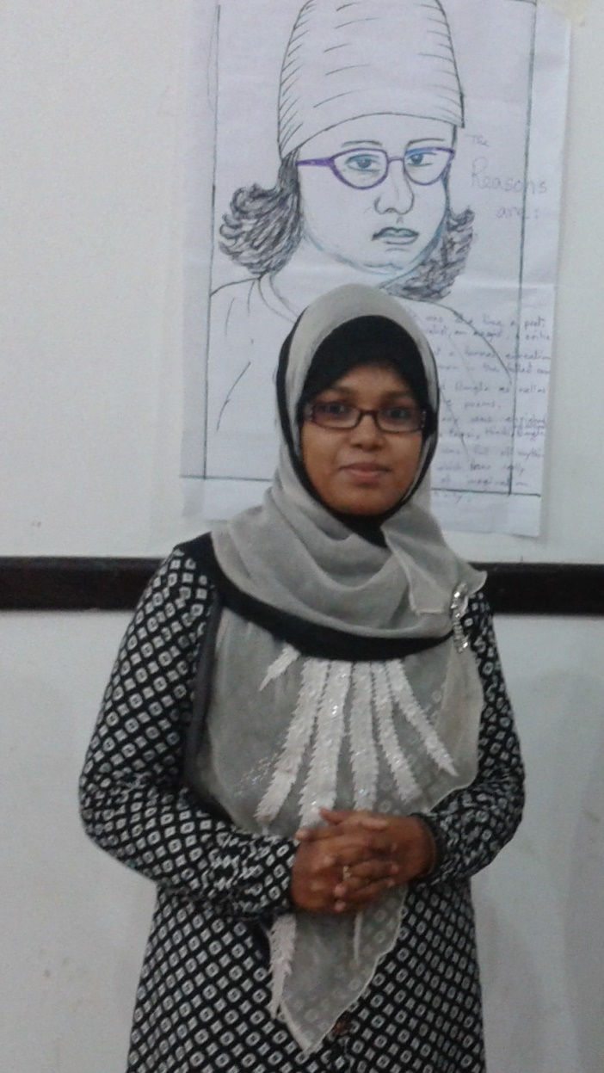

Introducing Myself
SALMA BEGUM
Assistant Teacher
Purbo Charpata Govt. Primary School
Raipur, Lakshmipur

Slide 3
Let’s sing the “Hello” song………..

Slide 4
Lesson Identity
Class :One
Subject: English
Lesson Title: Commands
Unit : 5(A,B)
(Listen and say)

Slide 5
Learning Outcomes
By the end of the lesson students will be able…………..
1.1.2. To say simple words and phrases
2.1.1. To follow simple commands and instructions

Slide 6
Let’s watch a video
https://www.youtube.com/watch?v=s4ePFtMGBrw

Slide 7
Today our lesson………..
Commands

Slide 8


Window
Door

Slide 9

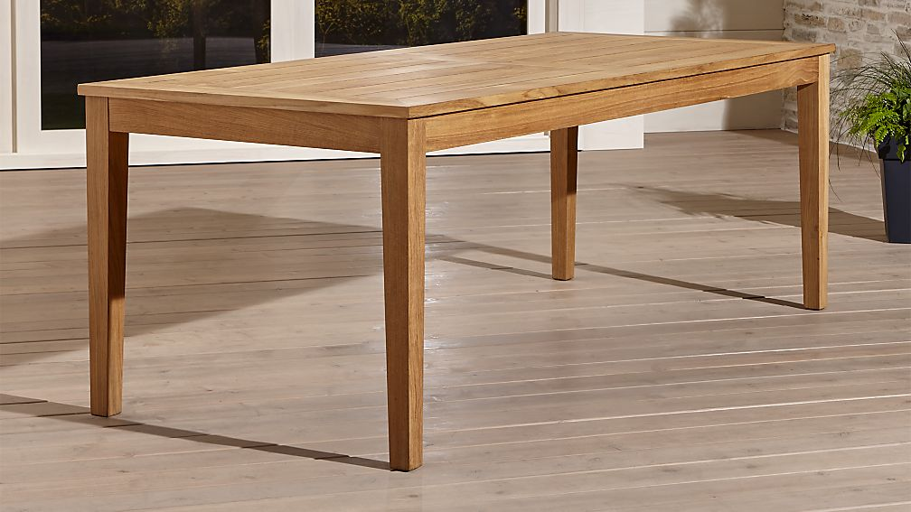
Chair
Table

Slide 10
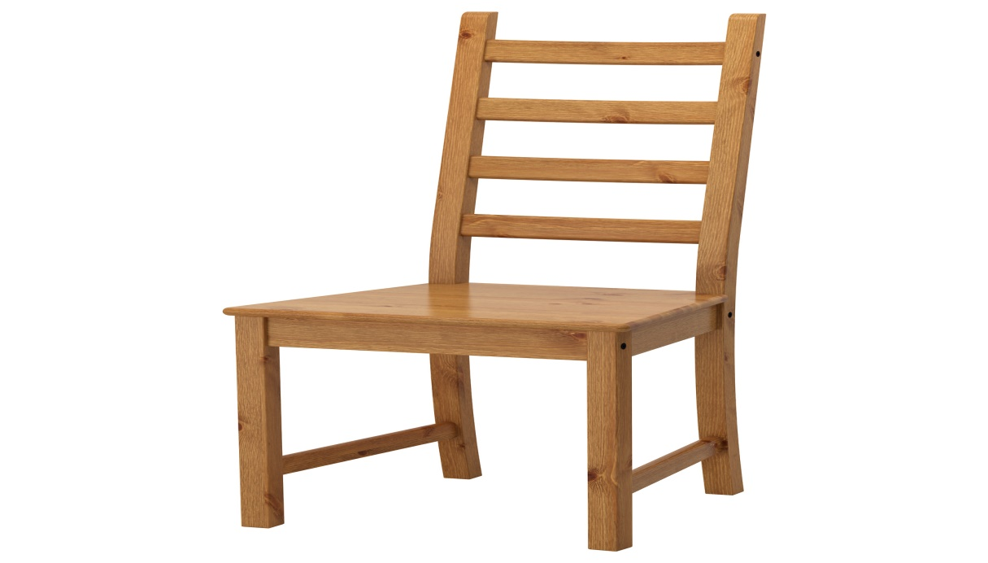



Slide 11



Lets match the words with pictures
word
Picture
Window
Door
Chair
Table

Slide 12

Open your book
Page no:10

Slide 14

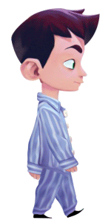
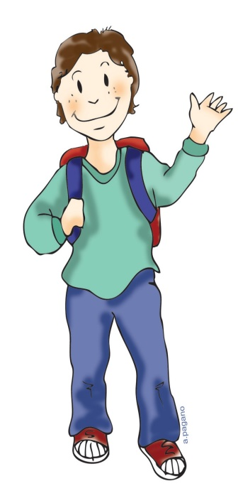
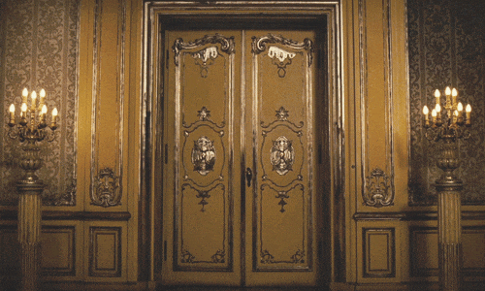
Go to the door
Open the door

Slide 15


Go to the window
Open the window

Slide 16
Action Song
Stand up, sit down…..(2)
It’s the time to play the game

Slide 17
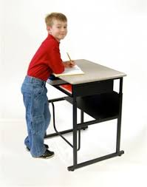
Pairwork
Go to the door

Slide 18

Open the door

Slide 19
Pairwork
Go to the window

Slide 20

Pairwork
Open the window

Slide 21

What is this
Window
Chair
Table
What is this?
What is this?

Slide 22
Goodbye Song

Slide 23

Thank you all

