Slide 1
WEL COME

Slide 2
TEACHER`S INTRODUCTION
Ashis Kumar gosh
M.S.S (Med)
Assistant Teacher
Forazikandi owisa kamil Madrasah
Matlab(N),Chandpur
Mobile:01961751450

Slide 3
LESSON INTRODUCTION
Class :Eight
Subject:English
Lesson:Preposition
Time:40 Minutes
Date: 27.01.2016

Slide 4
LESSON TITLE
PREPOSITION

Slide 5
LEARNING OUTCOMES
By the end of the lesson students will be able to -
1. say, what is preposition.
2. identify the preposition.
3. know preposition and proper use of preposition.

Slide 6
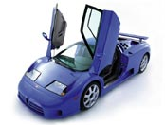
behind
in
on
beside
under

Slide 7
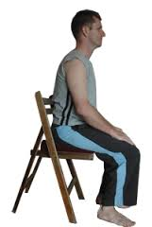
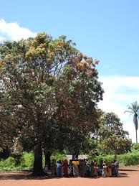
on
over
on
under

Slide 8
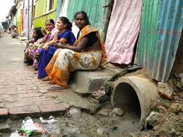
beside

Slide 9
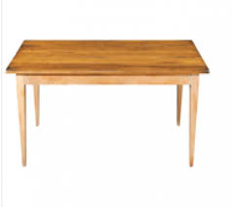
over

Slide 10
LESSON PRESENTATION
Sumona sat beside Rozina.
I saw a man in the car.
Sit on the chair
Mina sat down under a tree.
Shima stands on the road behind the car.

Slide 11
INDIVISUAL WORK
since | on | At
in front of | in | before
We live ____Gulshan.
The doctor can`t see you_____ 2 o`clock.
Put the book _____ the table.
Put the keys ____ the drawer.
It has been raining ____ 8 o`clock.

Slide 12
Evalution
Fill in the gaps with preposition
A dog is sleeping______ the car.
There is a shopping mall___ the town.
Sabina sits ___the chair.
He will come back _____ an hour.
e.The bird is flying _______ the tree.

Slide 13
a. Make five sentences with preposition about neighbors.
Home work

Slide 14
Thanks

