Slide 1
WELCOME

Slide 2
Identity
Ashis kumar gosh
Asst.English Teacher
Frazikandi kamil Madrasha.
Matlab(N),Chandpur
Mobile:01917-083886
E-mail:ashisghoshroma@gmail.com.

Slide 3
Presentation
English 2nd paper
Grammar item
Made for class Six to Ten

Slide 4
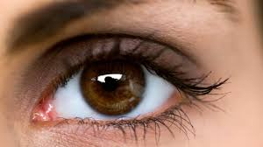
Look at the pictures & text below…
A book
An eye
The Quran

Slide 5
What do you think about these words…
A, An. The
Articles…?

Slide 6
Yes, today’s topic is…
Article

Slide 7
Target…
At the end of the lesson the students will be able to
identify articles.
fill the gapes with appropriate articles.

Slide 8
At first we should know about English letters to begin a discussion on Articles
English letter is 26 in number.
They are Vowel-05 & Consonant-21
Let’s go for details in Articles…

Slide 9
FORM 01
CONCEPTION
Generally it’s used according to vowel & consonant…
consonant
vowel
A book.
An egg

Slide 10
FORM 01
EXERCISE
__ mango
__ apple
__orange
__house
__ eye
__ egg
__ fan
__ pen

Slide 11
FORM 01
SOLUTION
A mango.
An apple
An orange
A house
An eye
An egg
A fan
A pen

Slide 12
FORM 02
H
CONCEPTION
A house
An honest man
হ
অ

Slide 13
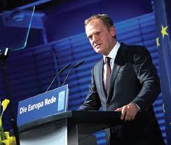
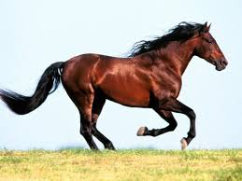
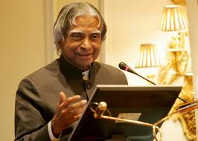
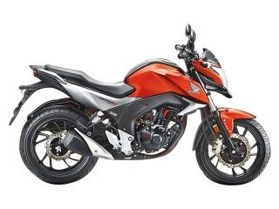
FORM 02
EXERCISE
_honorable man
__ horse
__ house
__ honest man
__ honda
__ hour

Slide 14
FORM 02
SOLUTION
An honorable man
A horse
A house
An honest man
A honda
An hour

Slide 15
FORM 03
U
CONCEPTION
A university
An umbrella
ইউ
আ

Slide 16
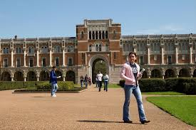
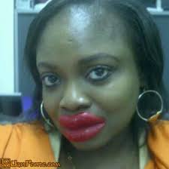
FORM 03
EXERCISE
_ university
__ umbrella
__ ugly girl
__ union leader
__ uncle
__ umpire

Slide 17
FORM 03
SOLUTION
A university
An umbrella
An ugly girl
A union leader
An uncle
An umpire

Slide 18
FORM 04
O
CONCEPTION
An orange
A one eyed man
O
one

Slide 19
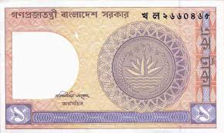
FORM 04
EXERCISE
_one legged man
__ oil pot
__ orange
_ one eyed man
_ old man
_one taka note

Slide 20
FORM 04
SOLUTION
A one legged man
An oil pot
An orange
A one eyed man
An old man
A one taka note

Slide 21
FORM 05
E
CONCEPTION
An egg
A European leader
“E”
as vowel
“U”
pronunciation

Slide 22
FORM 06
CONCEPTION
Abbreviation
An MA
A BA
এম
vowel
বি

Slide 23
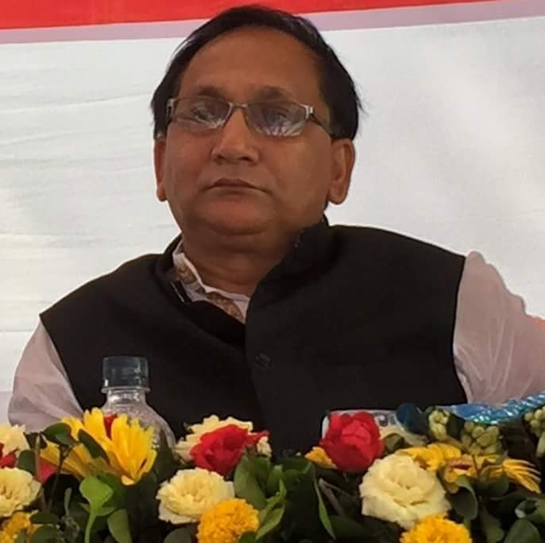
FORM 06
EXERCISE
__ BA
__ MA
__ DC
__ SP
__ MP
__ SSC

Slide 24
FORM 06
SOLUTION
A BA
An MA
A DC
An SP
An MP
An SSC

Slide 25
Articles according to degree…
Rohim is x good. ( _ adj )
Rohim is a good boy. ( _ noun + adj )
Rohim is a boy. ( _ noun)
Rohim is a good x boy. ( adj _ noun )
Rohim is x better than any other boy. ( _com+better+than)
Rohim is the better of the two boys. ( _com+better+of the)
Rohim is the best boy. ( _ superlative.form)

Slide 26
Articles according to passage…
I saw a girl. The girl was going to school. I liked the girl as she was a nice x girl. One day I met the girl while she was playing with a girl.

Slide 27
Thank you

