Slide 1
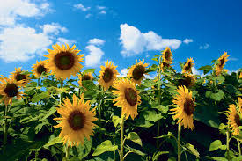
Good morning to all.

Slide 2
Teacher’s introducing.
Md. Abdur Razzaque
Headmaster
Ranihati Govt. Primary School
Shibganj, Chapainawabganj.

Slide 3
Lesson identity
Class: Five
Sub: English for today
Today’s lesson:
Story: The hare and the tortoise.
Time: 40 minutes
Date: 04/02/2019.

Slide 4
Let’s sing a song together.

Slide 5
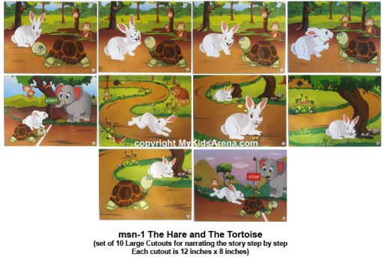
Look at the pictures and think .
What are the pictures about?
The pictures are about a hare and tortoise

Slide 6
Today’s lesson is : story
‘The hare and The tortoise.’

Slide 7
Learning outcomes :
At the end of the lesson students will be able to know
and write a story about the hare and the tortoise

Slide 8
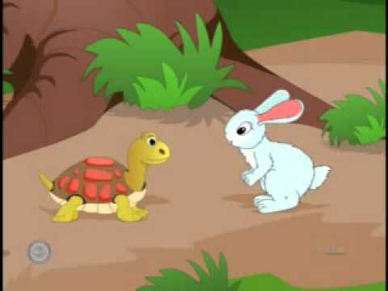
Look at the picture and think about it.
One day, a hare was walking in the forest when
He saw a tortoise. The hare was the fastest animal
In the forest. The tortoise was the slowest animal
In the forest.

Slide 9
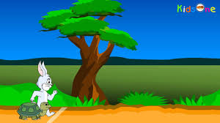
What are you looking ?
The hare called out to the tortoise, “Hurry
Up! You are so slow! Can’t you walk faster?
Can’t you run ?”

Slide 10
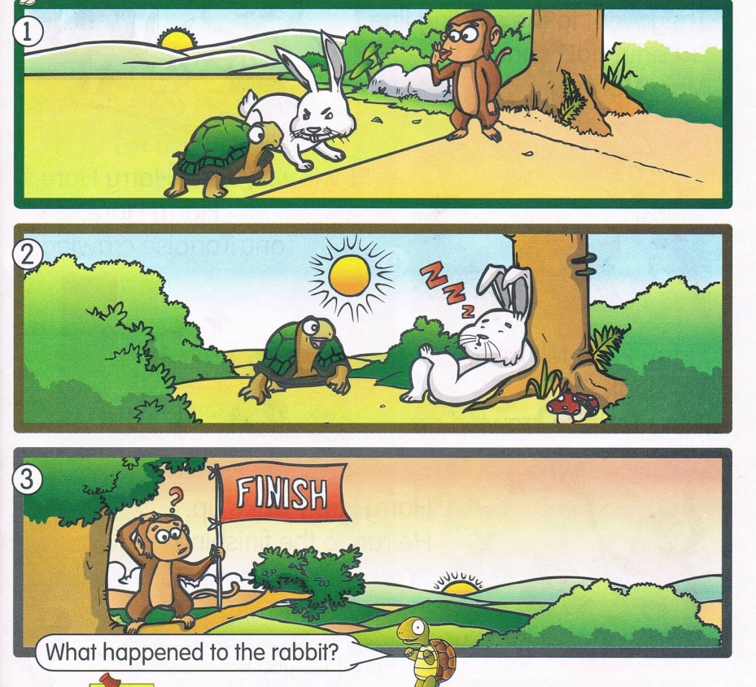
What can you see in the pictures ?
So they decided to have a race . They
chose a starting and finishing point.

Slide 11
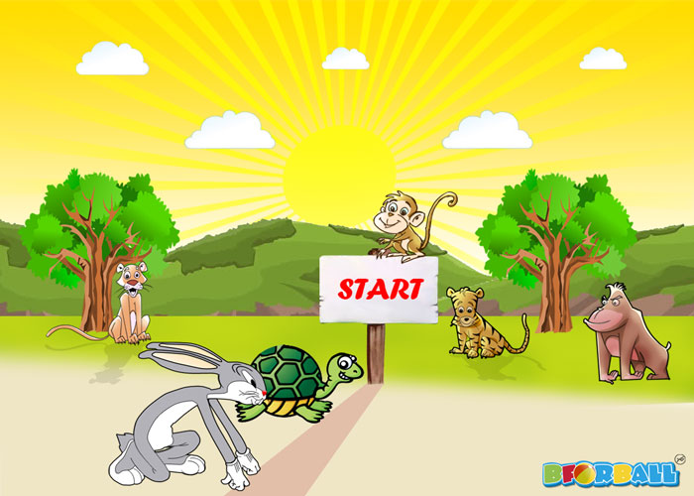
Why did the animals came there?
They were ready to start their race.

Slide 12
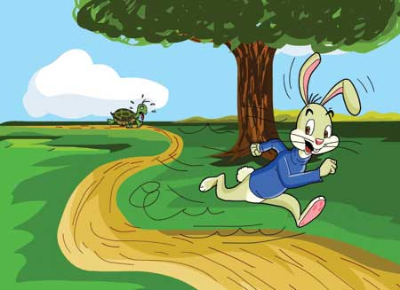
What are you looking in the picture?
The rabbit ran really fast and soon
left the tortoise far behind.

Slide 13
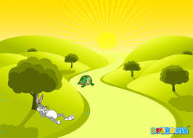
What can you see in the picture?
The rabbit thought that tortoise is
too slow and he can rest for a while .

Slide 14
Everybody, look at the picture?
So he stopped under a
tree and went to sleep.

Slide 15
What is happening at now?
Meanwhile tortoise kept walking the whole
time and reached the wining point.

Slide 16
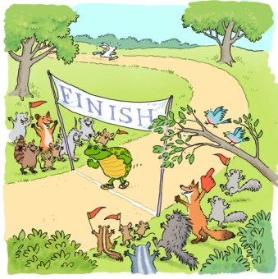
What was happened at last?
When the rabbit woke up he saw that tortoise
has already reached and won the race.

Slide 17
Let’s read the story again.
The Rabbit and the Tortoise
Once upon a time there was a rabbit and a tortoise.
They were good friends. They used to meet and
play everyday. The rabbit always boasted that he
could run faster than the tortoise. So they decided
to have a race. They chose a starting and finishing
point. The rabbit ran really fast and soon left the
tortoise far behind. He thought that tortoise is too
slow and he can rest for a while. So he stopped
under a tree and went to sleep. Mean while
tortoise kept walking the whole time and reached
the winning point. When the rabbit woke up he saw
that tortoise has already reached and won the race.

Slide 18
Group work
Make a logical assemble
with the words-rabbit, tortoise
started, always, chose, behind,
walking , reached, win .

Slide 19
Evaluation
Write five senteces about
Slow and steady wins the race.

Slide 20
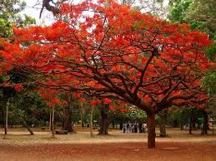
No more today
THANKS TO ALL

