Slide 1

WELCOME

Slide 2


Presented by:
Abdur Razzaque
Headmaster
104 No. Ranihati Govt. primary school
Ranihati , Shibgonj , Chapai nawabgonj .

Slide 3
Subject English
Lesson five
Class Three
Lesson unit- Introducing myself.
Date 11/04/2019
Time 40 minutes

Slide 4

Learning outcomes:
Students will be able to Read the poe correct pronunciation.
Know new words with sentences

Slide 5
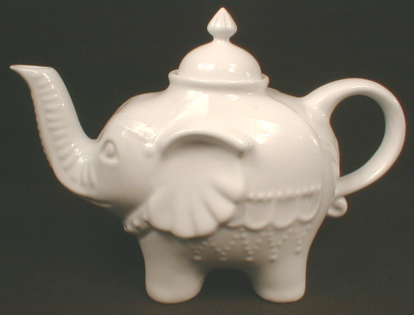

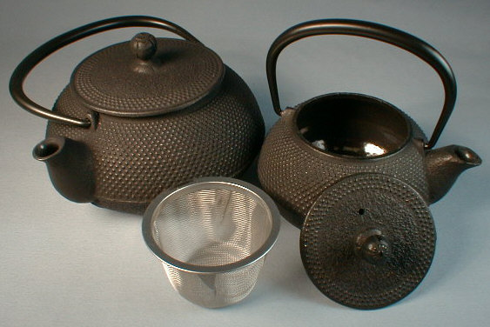
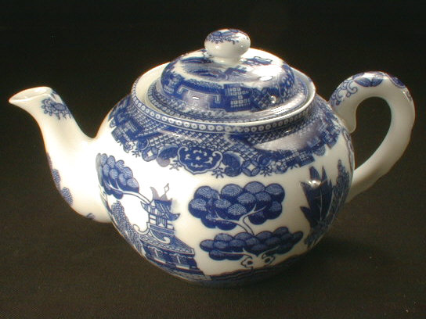
TEA- POT

Slide 7
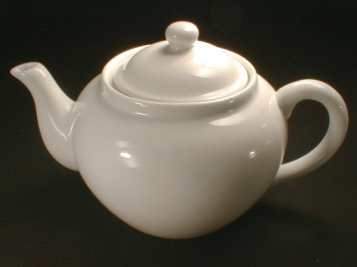
I am a little tea-pot,
Short and stout.
This is my handle,
And this is my spout.

Slide 8
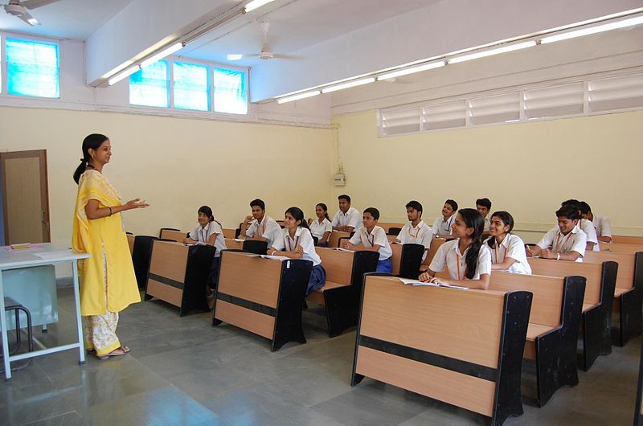
Teacher,s loud reading:

Slide 9

Student,s loud reading:

Slide 10

Task:
Ask student recite the rhyme.

Slide 11

THANK YOU
SEE YOU AGAIN

