Slide 1

WELCOME

Slide 2
Teacher’s identity
HABIL AHMED
Assistant teacher (computer)
Ashujia j n c institution
Kendua, Netrokona.

Slide 3
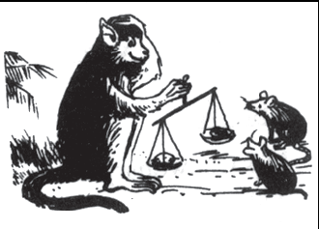
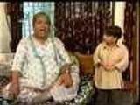
Rafiq
Rafiqs Grand Father
Khibur Rahman
Mr monkey and Rat’s

Slide 4
Introduction of Lesson
Class - 7
Subject – English Ist paper
Unit – 4 Lesson – 10
Time – 40 Minute
Date : 07 – 12 - 2019

Slide 5
Objectives :
By the end of the lesson SS will be able:
To Tell some new vocabularies
To give answer of some questions
To Under stand the message of the passege

Slide 6
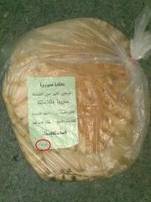
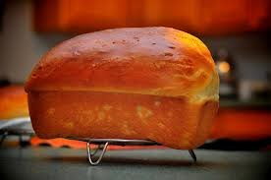
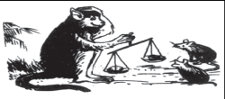
VOCABULARIES
Divide
Argued
Equal
To come level of two things
Make Division
Not to come to the Disesion

Slide 7
Use these words to fill in the gaps
Rafiq and his grandfather continue their conversation
1. That’s a good story, grandfather,” said Rafiq. “Mr monkey was--------- than the
2. Rats and he’s-------------me something too!” “Really, Rafiq?” grandfather laughed
3. “yes, grandfather. It’s much ---------to share the land than ------ --it. So I’ll
4. Ask the Agriculture officer about ----------our land tomorrow.
wiser
teach
divide
Share

Slide 8
EVALUATION
1. Who do you think was greedy in the story?
2. Why did two rat’s get the proper position of the bread?
3. Why did Mr monkey try to divide the bread so many times?

Slide 9
HOME TASK
Write a paragraph about dividing the Bread 40 words.

Slide 10

Thank you

