Slide 1
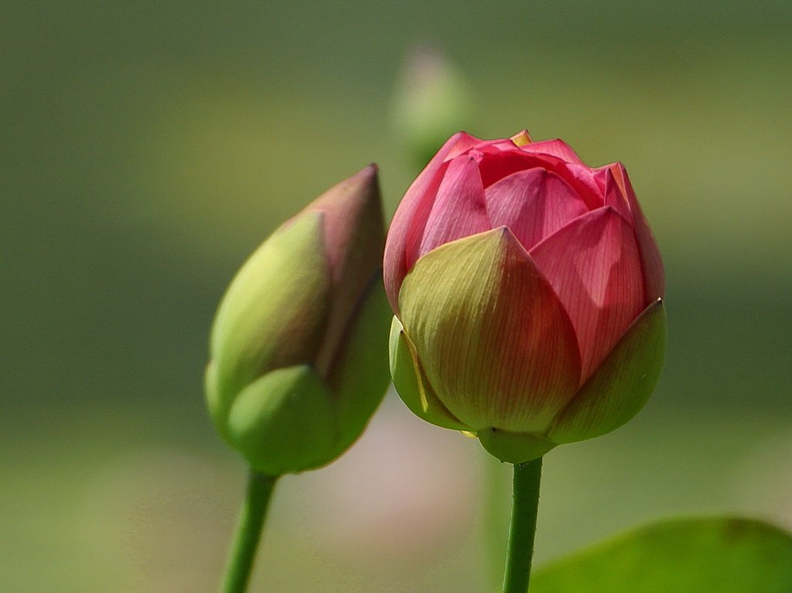
সবাইকে স্বাগত…

Slide 2
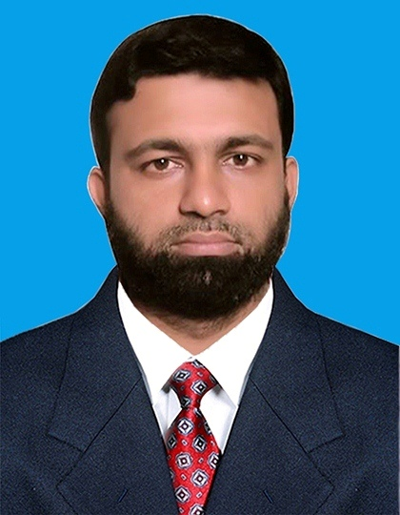
Md. Younus Patwary
Asst. Teacher (ICT)
West Larua Karamatia Girls Dakhil Madrasah
Faridganj, Chandpur.
Class: Eight
Sub: English 1st Paper
Time: 50 minutes

Slide 3
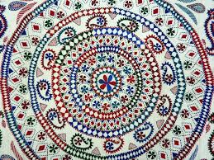
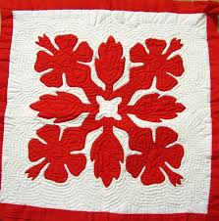
Nakshi Kantha

Slide 4
Today’s lesson is
Nakshi Kantha

Slide 5
Learning Outcomes:
Speak in English.
Read silently.
Ask and answer questions.
Write a story.

Slide 6
A . Look at the picture and the questions . Then ask and answer the questions with your partner.
What do you see in the picture ?
2. What is it called ?
3. Have you seen it before ? Where ?
4. What do we do with it ?

Slide 7
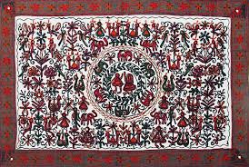
B. Read the text to know
about Nakshi Kantha.

Slide 8
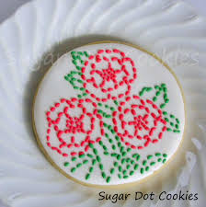
Pattern (noun)
Decorative arrangement

Slide 9
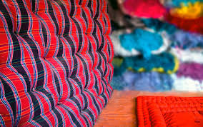
Quilt (noun)
A bed covering consisting of two layers of fabric stitched

Slide 10
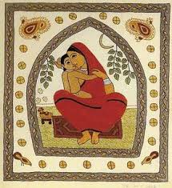
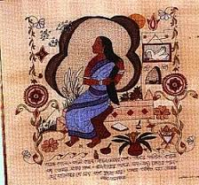
Artistic (adjective)
Relating to or characteristic of art or artists
Or skillful

Slide 11
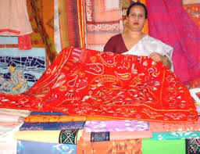
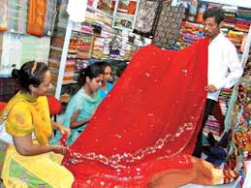
Commercially (adverb)
An advertisement in a common media

Slide 12
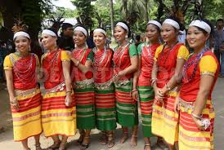
Traditional (adjective )
Attached to old customs;
old fashioned

Slide 13
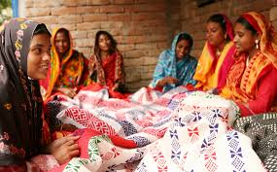
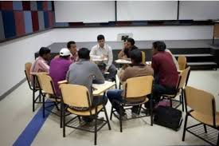
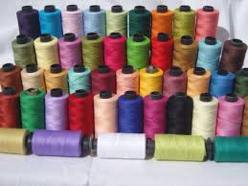
Group work
Write a paragraph describing how the Nakshi Kantha is made?

Slide 14
Evaluation
Write sentences with the new words.
1. Pattern
2. Quilt
3. Artistic
4. Traditional
5. Commercially

Slide 15
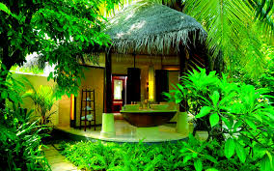
Home work
Write the main idea of the text in ten sentences.

Slide 16
Thank You ...

