Slide 1
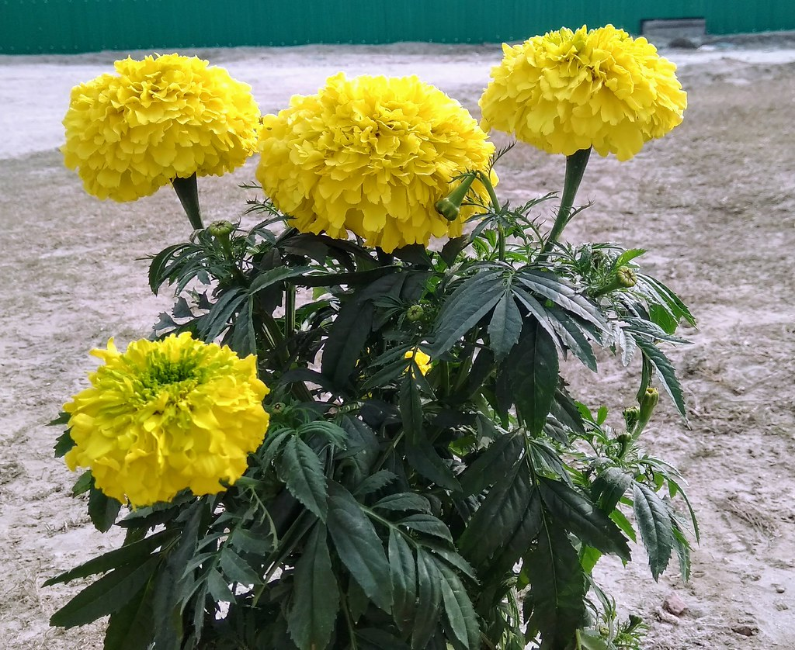
Welcome to Everybody

Slide 2
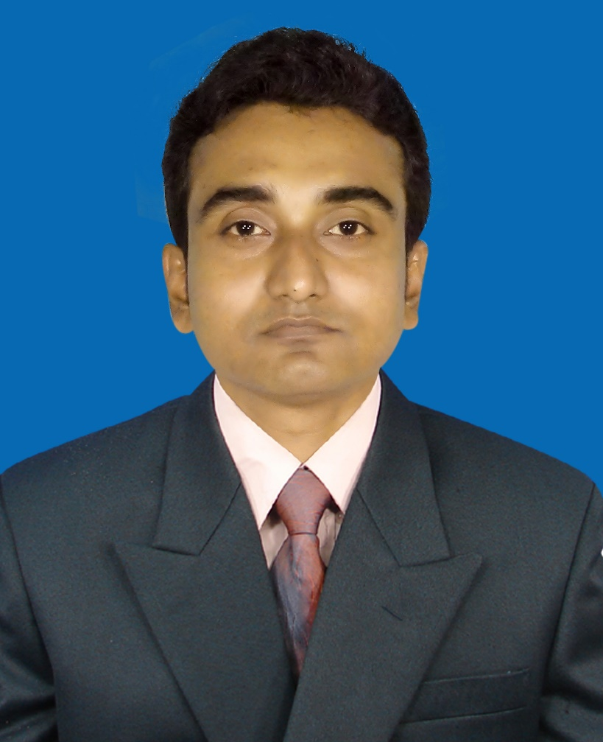

Md.Sojib Sikder
Assistant Teacher
Kustia GOVT.PRI. School
Shibalaya.Manikgonj
E-mail:sojibsikder81@gmail.com
Class:2
subject:English
Unit:4
Lesson:4-6
Time:40 minutes
date:22/06/2019

Slide 3
Today’s Lesson
Alphabet
(P------T

Slide 4
Learning Outcomes
By the end of the lesson the students will be abble to ------
Listening
1.1.1 become familiar with English sounds by listening to common English words.
Speaking
1.1.1Reapeat after the teacher simple words with proper sound stress.

Slide 5
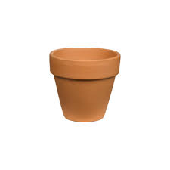
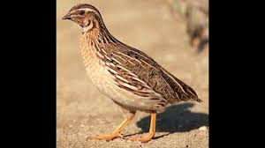
Now look at the picture and say loudly
What is this?
What is this?
Pot
quil

Slide 6


Now look at the picture and say loudly
Rose
Sun

Slide 7
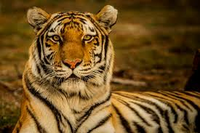
Now look at the picture and say loudly
Tiger

Slide 8
Dear students, Open at page 9 of your English book and look activity A

Slide 9


Loud Reading by the teacher
Q
Quil
P
Pot
Rose
S
Sun
R
Tiger
T

Slide 10
What can you see?
P
p
What is the letter name?

Slide 11
What can you see?
Q
q
What is the letter name?

Slide 12

What can you see?
R
r
What is the letter name?

Slide 13
What can you see?
S
s
What is the letter name?

Slide 14
What can you see?
T
t
What is the letter name?

Slide 15

Match the word with the letter
P
p
Tiger
Q
q
Sun
R
r
Rose
S
s
quil
T
t
Pot

Slide 16
Evaluation
What is this?
What is this?
What is this?
What is this?

Slide 17
Home work
Learn these word with the letters

Slide 18

Goodbye

