Slide 1

WELCOME

Slide 2

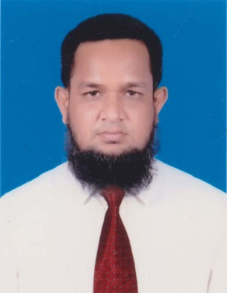
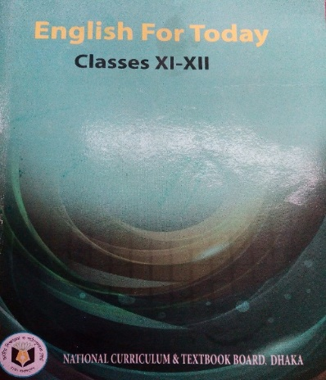
IDENTITY
Md. Abdur Rouf
Lecturer in English
Khalna Islamia Fazil(Degree) Madrasah,Patnitala,Naogaon.
Cell: 01767650169
Email: rouf301285@gmailcom
Class: XI-XII
Subj: English 1st Paper
Time: 45 minutes

Slide 3
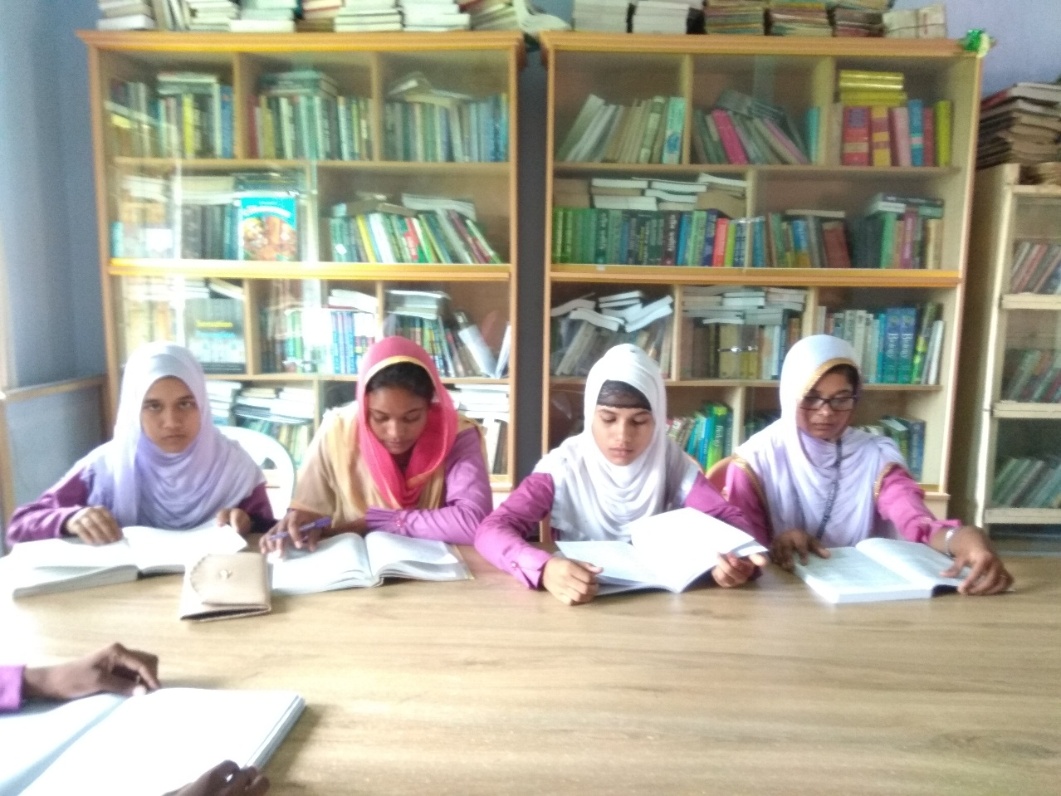
What are you looking in the picture?
Library

Slide 4
Let us discuss about a paragraph-
Our College Library

Slide 5
Learning Outcomes
After the lesson the students will be able to-
ask and answer questions;
tell some information about a library;
practice writing;
write a paragraph.

Slide 6
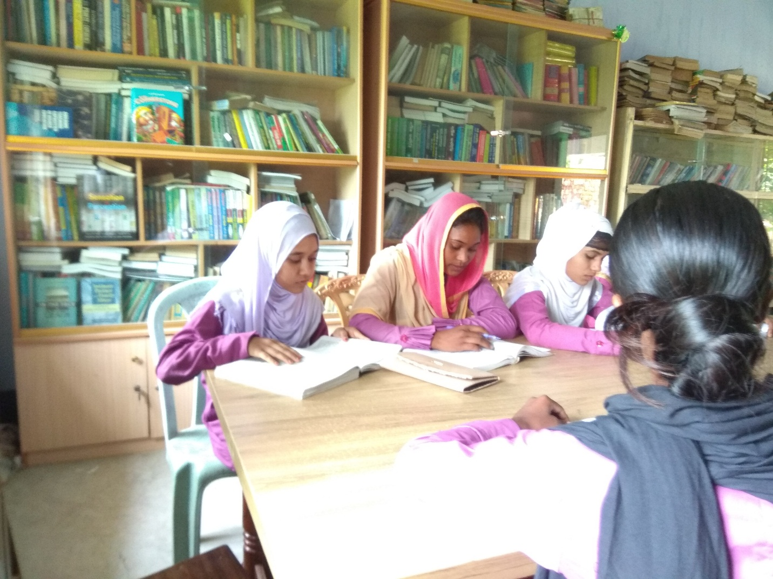
What is a library?
A library is a place where books are kept for reading.

Slide 7
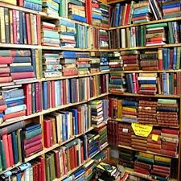
It is a store house of books. It is a part and parcel of a College.
So, there is a library in our College.

Slide 8

It is a quiet place. It remains open all day.

Slide 9
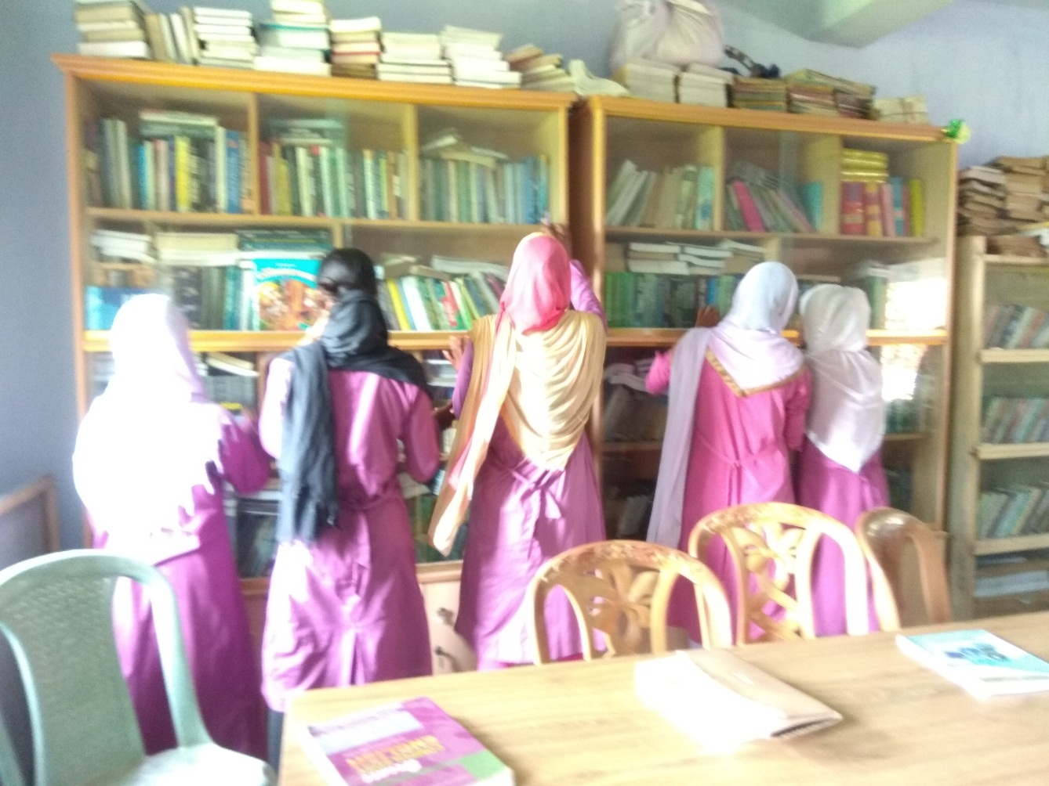
What do students collect from there?
The students peacefully go there and borrow books.

Slide 10
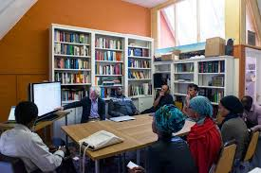
When do students and teachers go to the library?
Students and teachers come to the library when they have no class.

Slide 11

Group Works
Make five sentences about A College Library by dividing groups each having 5 students.

Slide 12
Evaluation
Write the answer of the following question:
What is library?
What kind of books are there in a library?
What should a library be like?

Slide 13
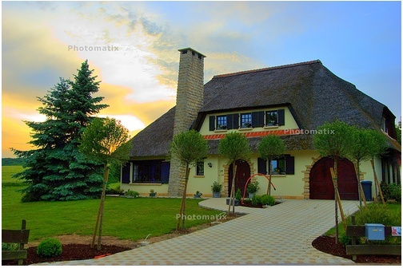
Home Work
Write a paragraph about A College Library.

Slide 14
THANKS OF ALL

