Slide 1
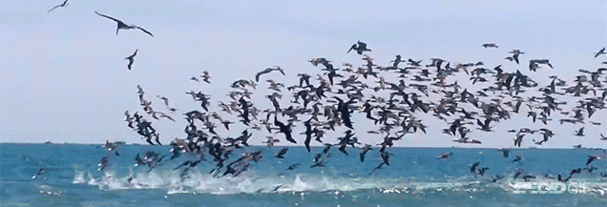
WELCOME

Slide 2

Teacher’s Identity
Name: MD.ABDUR ROUF
Lecturer in English
Khalna Islamia Fazil(Degree) Madrasha
Patnitala,Naogaon.
Mobile: 01767650169
Email:rouf301285@gmail.com

Slide 3
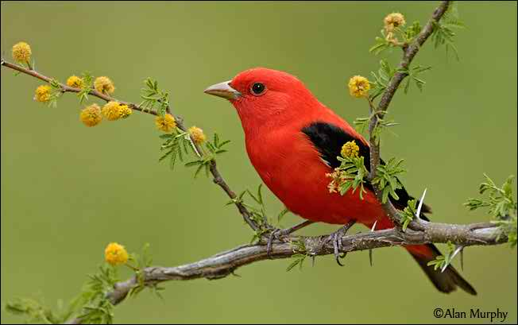
Introducing the lesson
English 1st Paper
Class-Xi
Unit-8, Lesson-2
Time-45 minutes
Date-01/09/2019

Slide 4
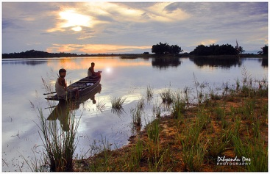
Watch the pictures

Slide 5
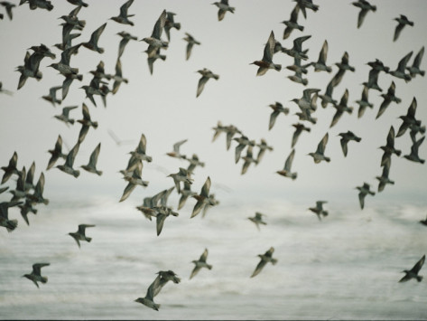

Slide 6
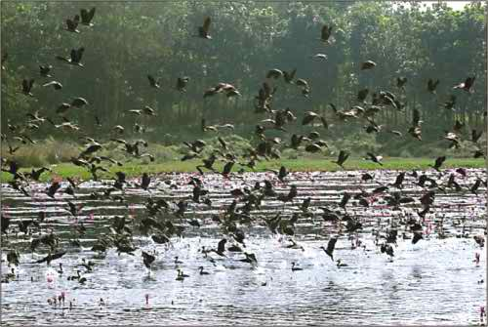

Slide 7
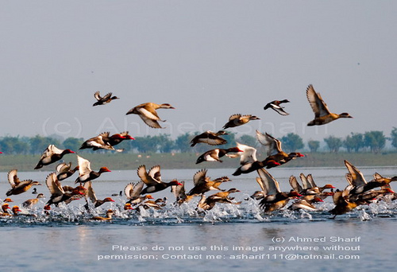
Announcement of the lesson
The Hakaluki Haor

Slide 8
Learning Outcomes
The students will be able to tell about
#the meaning of some words
# the location and surrounding areas of the Hakaluki Haor
# the kinds of fish available in Hakaluki Haor
# the kinds of migratory birds that visit the Haor in winter
#The economic importance of the Haor.

Slide 9



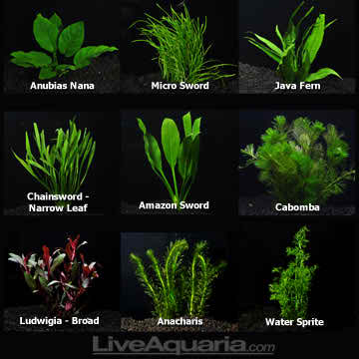
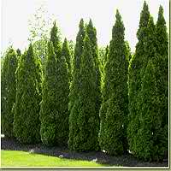
Word meaning
Resources
Wealth
Biological difference
Biodiversity
Community
Anything of common interest
Aquatic
Water based
Evergreen
Always green

Slide 10
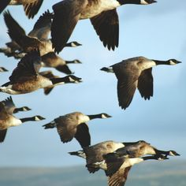
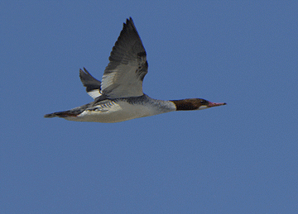
The haor is a very important resting place for migratory waterfowls flying in from the north

Slide 11
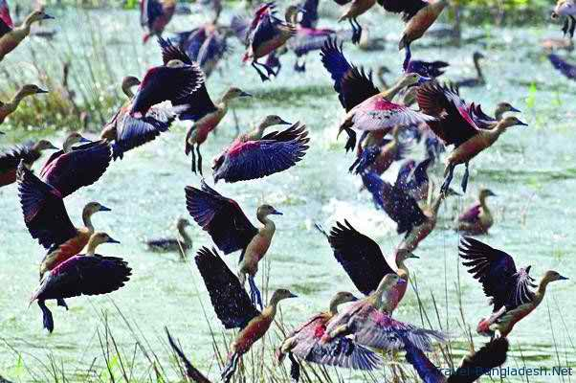
These species of waterfowls make the haor their temporary home

Slide 12
Single work
What is the land area of the Hakaluki Haor?
2. Name some important beels of the Haor.
3. Name some fish species of the Haor.
4. Which bird is the main migratory waterfowl of the Hakaluki haor?

Slide 13
Homework
Describe theHakaluki Haor in your own words.

Slide 14

Thanks to all

