Slide 1
WELCOME

Slide 2
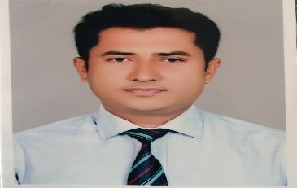
Identity
Mohammad Nesar Uddin
Assistant teacher
Babuchi Govt. primay school
Cell phone: 01842519587
E-mail: nesaruddin1981@gmail.com
Class: Two
Subject: English
Unit: 26( Kaniz’s life)
Lesson: 1-3
Time: 50 minutes
Date:
Teacher
Lesson

Slide 3
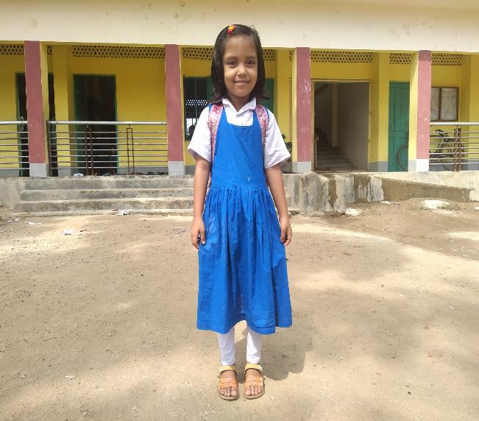
What is the picture about?
The picture is about a girl. Her name is Kaniz.

Slide 4
Today’s lesson
Kaniz’s life

Slide 5
Learning outcomes
Students will be able to..........
understant simple quiestions and statements about them.
understant simple questions and statements about familiar objects.
ask and answer questions about themselves.
ask and answer questions about familiar objects.
read words and phrases with the help of visual clues and simple sentences.

Slide 6
This is Kaniz.

Slide 7
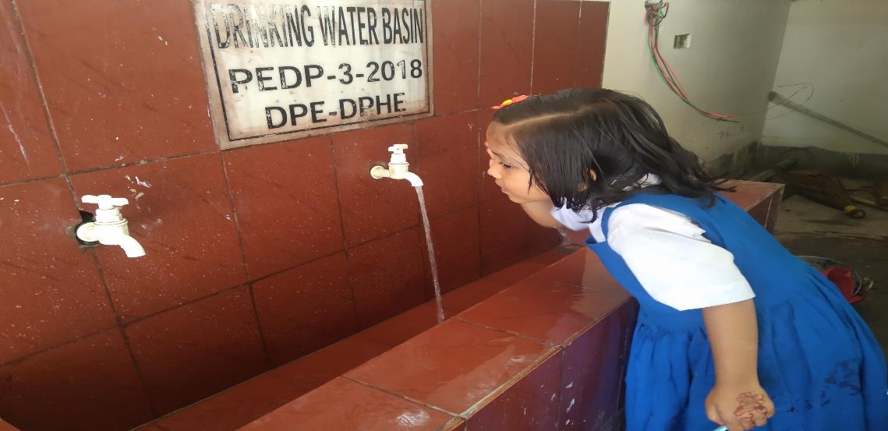
In the morning, she washes her face.

Slide 8
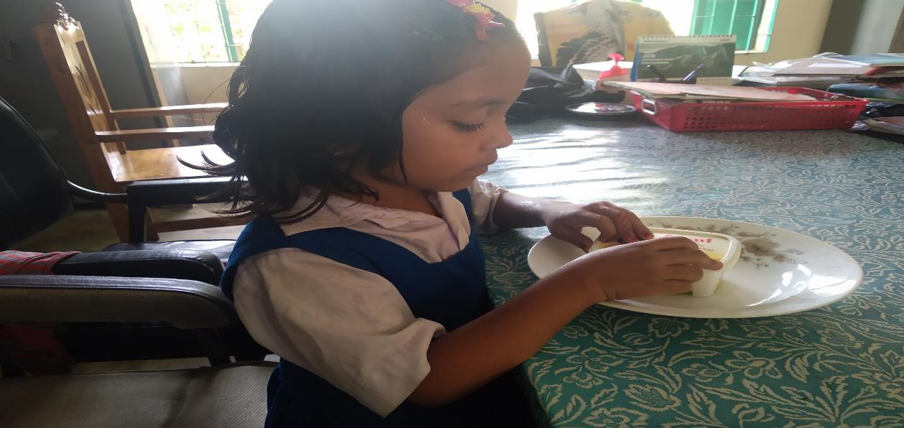
Then, she has breakfast.

Slide 9
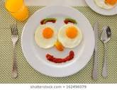
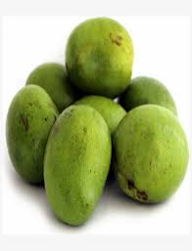
She has eggs and mangoes.

Slide 10
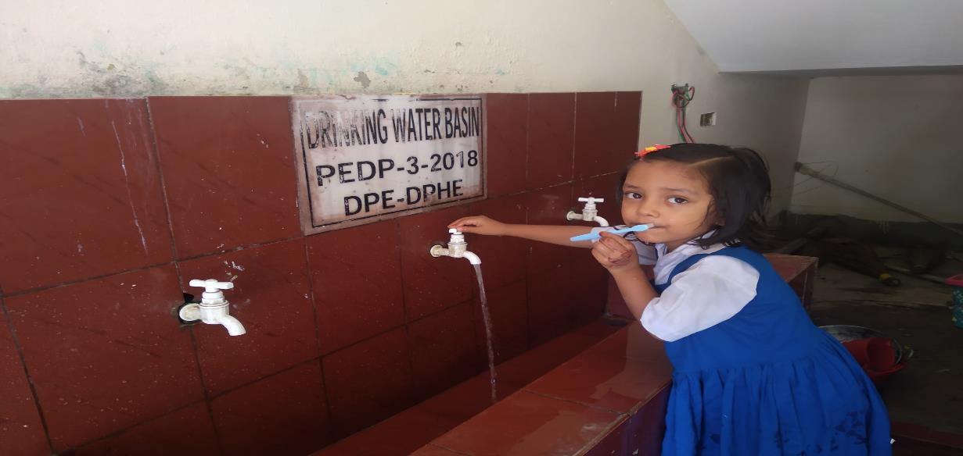
Then, she brushes her teeth.

Slide 11
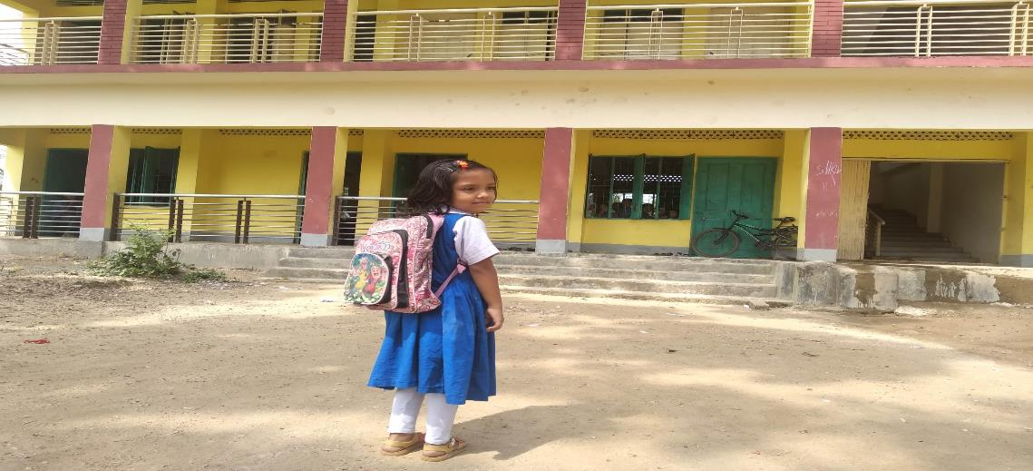
She goes to school.

Slide 12
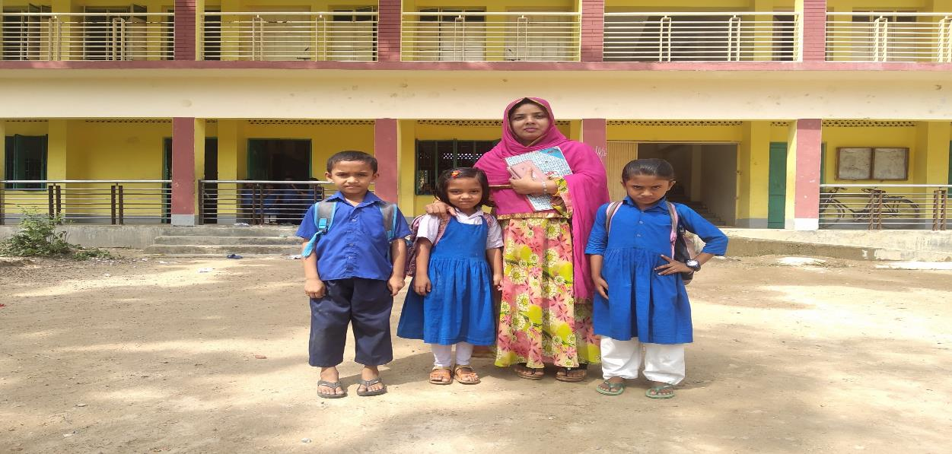
Miss Mariam is her teacher.

Slide 13
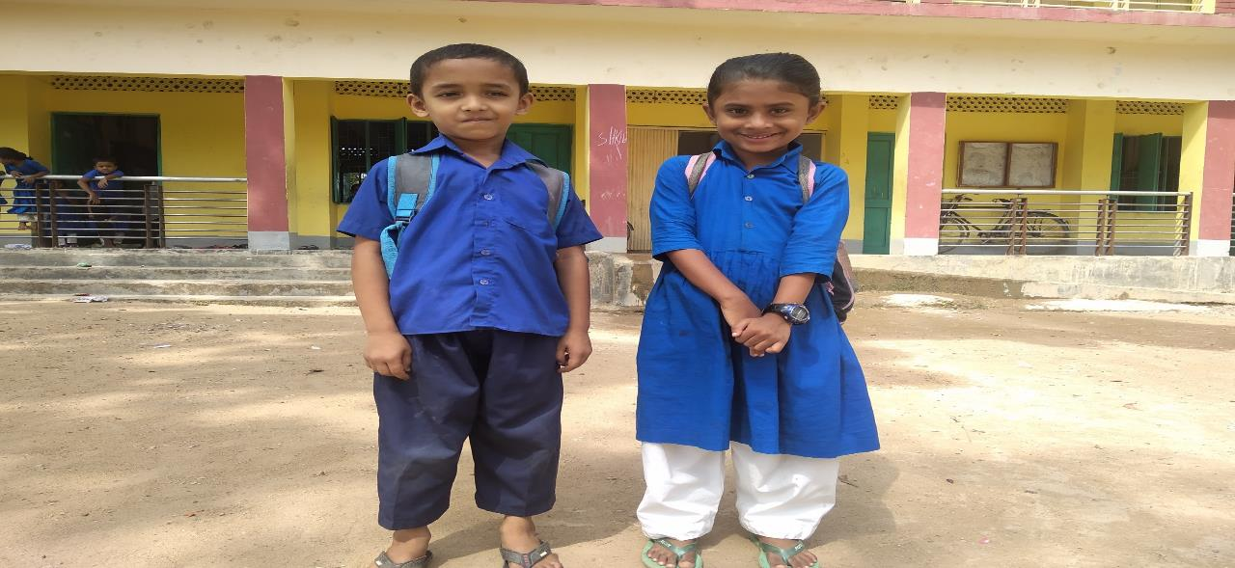
Sujan and Joya are her friends.

Slide 14
Students loud reading
Now open your book at
Page- 52

Slide 15
Pair work
Time: 5 minutes
Who is the girl?
Kiniz is the girl.

Slide 16
Evaluation
Time: 5 minutes
Who is her teacher?
Miss Mariam
What does she have for breakfast?
Eggs and Mangoes
Who is her friend?
Sujon and Joya

Slide 17
Thank you

