Slide 1
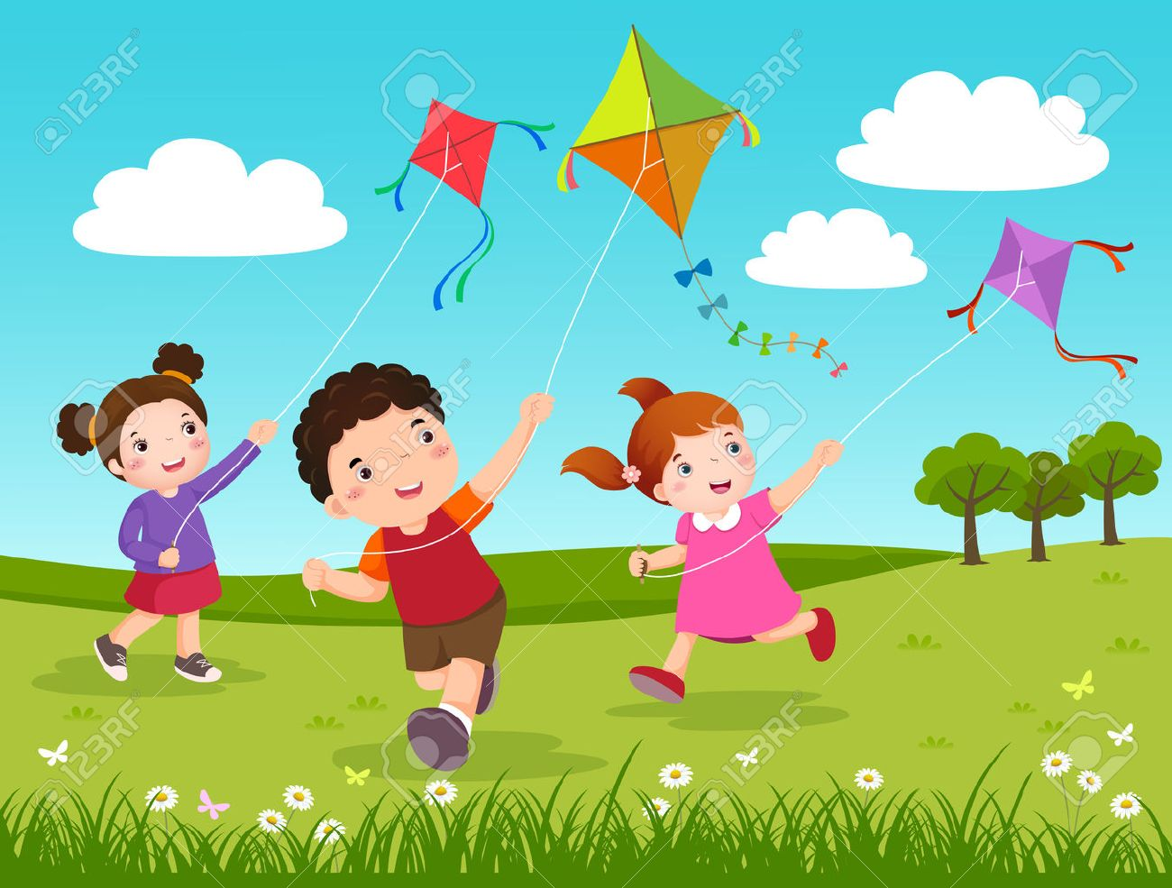
01
WELCOME
WELCOME

Slide 2
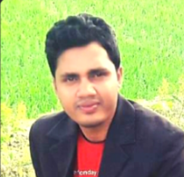
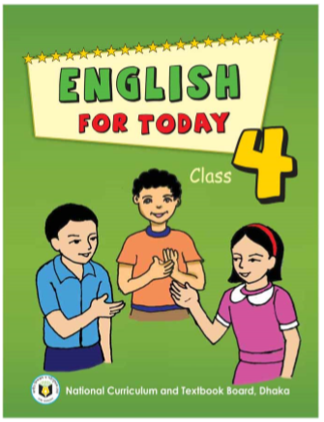
02
IDENTITY
MOHAMMAD JAKIR HOSSAIN
ASSISTANT TEACHER
BADERA GOVT.PRIMARY SCHOOL
TARAIL,KISHOREGANJ.
MOBAIL:01719341643
EMAIL:jakir5959@gmail.com
SUBJECT:ENGLISH FOR TODAY
UNIT:40, LESSON: 3
(A GARMENT WORKER’S DAY
ACTIVITY-B. PAGE NO:81)
TIME: 45 MINUTES.
DATE: 24.09.2019

Slide 3
03
GREETING
Teacher
Good morning, students.
Student,s
Good morning, teacher
How are you today?
Fine. and you?
Fine, thank you.

Slide 4
04
WATCH VIDEO
Dear students’ let us watch a video.
https://youtu.be/8QSC_9c6qCQ
Discuss about the video with the students.

Slide 5
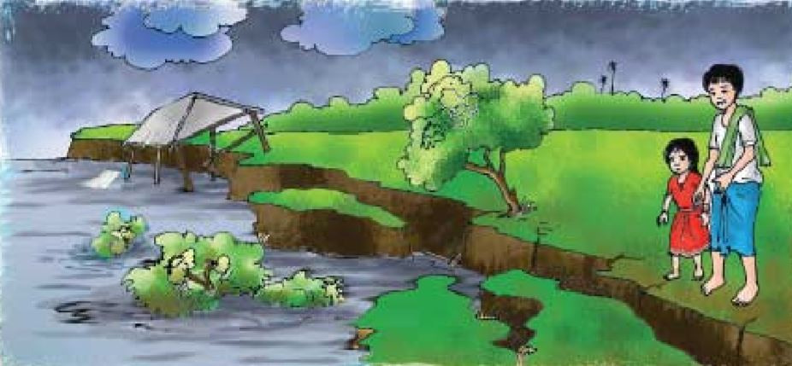
05
DISCUSS BE…LESSON
Dear students’ read the text silently in activity-A
Reshma is a garment worker in Dhaka. She’s 18 years old. Her family came to Dhaka from a village eight years ago.There was a river erosion in her village. They lost their home. So the family came to Dhaka. Reshma’s father worked as a rickshaw driver, but he died in an accident. Reshma’s uncle Ratan helped the family. He found a small house for them at Kalyanpur.

Slide 6
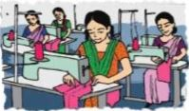
06
DISCUSS BE…LESSON
Dear students’ read the text silently in activity-A
He took Reshma to a Garment factory in Mirpur. She works their now.Her younger brother Babul goes to school. He is in class 5. Her mother stitches “Nakshi Kathas” at home and sells them.The garment factory is two kilometres from Reshma’s house. In the morning, she walks to work. Some of her friends go by bus,rickshow or scooter. Sheworks from 8 a.m. to 4 p.m. Reshma likes to go to the cinema, but she doesn’t have much free time or money for this. She often works extra hours until 6 p.m. so she can make more money. Her family needs this money for food and other things.

Slide 7
07
DISCUSS BE…LESSON
Students’ read the following question silently and think what will answer
1. Who is Reshma?
2. Who is Babul?
3. How old is Reshma?
4. Where does Reshma work?
5. What was Reshma’s father’s occupation?

Slide 8
08
TODAYS LESSON
Ok! Dear students’ Todays lesson is…
‘A garment worker’s day’
(ACTIVITY-B)
Page no:81

Slide 9
09
LEARNING OUTCOMES
By the end of the lesson students will be able to…
Reading:
5.1.1 Read silently with understanding paragraphs, stories and other text materials.

Slide 10
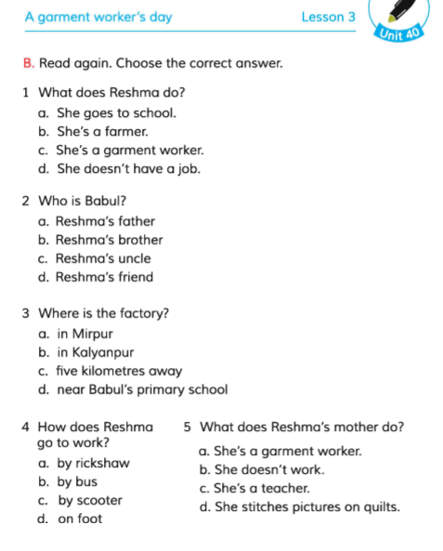
10
W.C.WORK
B. Read again, Choose the correct answer.
Dear Students’ open your book at page no.81, then read the instruction in activity-B.

Slide 11
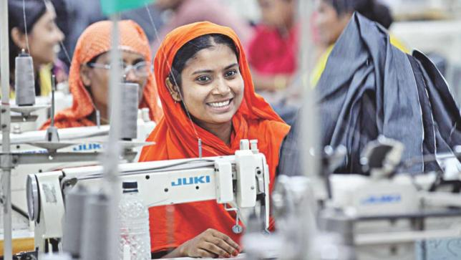
11
W.C.WORK
Dear students’ read the statement and choose the correct answer.
What does Reshma do?
a. She goes to school.
b. She is a farmer.
$$√$$
c. She’s a garment worker.
b. She does’t have a job.
Yes, students, Reshma is a garment worker.

Slide 12
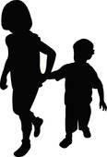
12
W.C.WORK
Dear students’ read the statement and choose the correct answer.
2. Who is babul?
a. Reshma’s father.
b. Reshma’s friend.
$$√$$
c. Reshma’s brother.
b. Reshma’s uncle.
Yes, Babul is a Reshma’s brother.

Slide 13
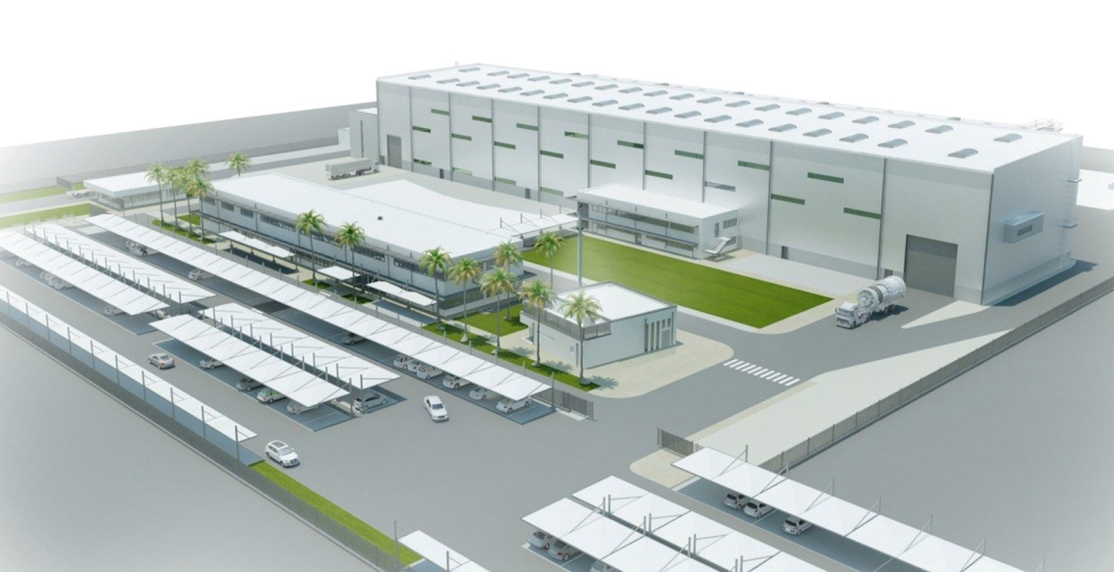
13
W.C.WORK
Dear students’ read the statement and choose the correct answer.
3. Where is the factory.?
$$√$$
a. In Mirpur.
b. In Kalyanpur.
c. five kilometres away.
b. Near Babul’s primary school.
Yes, the factory is in Mirpur.

Slide 14
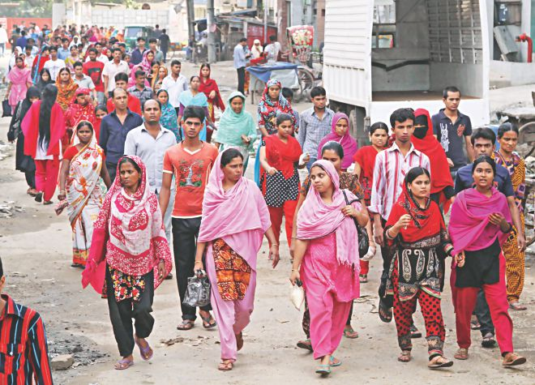
14
W.C.WORK
Dear students’ read the statement and choose the correct answer.
4. How does Reshma go to work?
a. by rickshow.
b. by bus.
c. by scooter.
$$√$$
b. on foot.
Yes, Reshma go to work on foot.

Slide 15
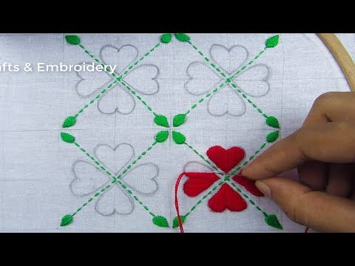
15
W.C.WORK
Dear students’ read the statement and choose the correct answer.
5.What does Reshma’s mother do?
a. She’s a garment worker.
b. She doesn’t work.
c. She’s a teacher.
$$√$$
b. She stitches pictures on quilts.
Yes, Reshma’s mother stitches picture on quilts.

Slide 16
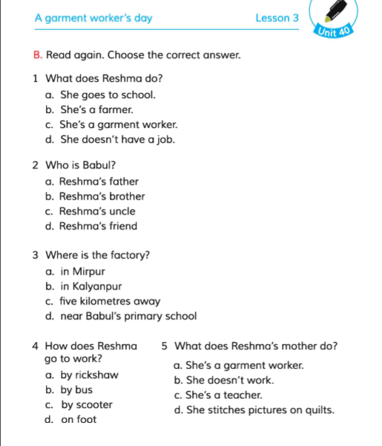
16
SINGLE WORK
13
21
Dear Students’ Read the statements again at page no.81 and try to choose the correct answer.

Slide 17
PAIR WORK
PAIR WORK
17
PAIR WORK
13
21
Dear Students’ choose the correct answer with pair.

Slide 18
18
EVALUTION
Dear Students’ please come on the stage 2 or 3 students and choose the correct answer one by one.
What does Reshma do?
a. She goes to school.
b. She is a farmer.
c. She’s a garment worker.
d. She does’t have a job.
2. What does Reshma’s mother do?
a. She’s a garment worker.
b. She doesn’t work.
c. She’s a teacher.
b. She stitches pictures on quilts.

Slide 19
19
EVALUTION
Dear students’ choose the correct words and
fill in the gaps.
younger | worker | driver
work | small | cinema
a. Reshma is a garment___________.
b. Reshma go to___________on foot.
c. Reshma likes to go to___________.
d. Reshma father was a___________.
e. Bulbul is a ___________ brother of Reshma.

Slide 20
20
EVALUTION
Dear students’ read the statements and say
true or false.
1. The garment factory is 4 kilometres from Reshma’s house.
2. Reshma’s uncle Ratan helped the family.
3. Reshma’s father worked as a bus driver.
4. Reshma’s family came to Dhaka eight years ago.

Slide 21
21
HOME WORK
Dear students’
You will write 5 sentences about Reshma.

Slide 22
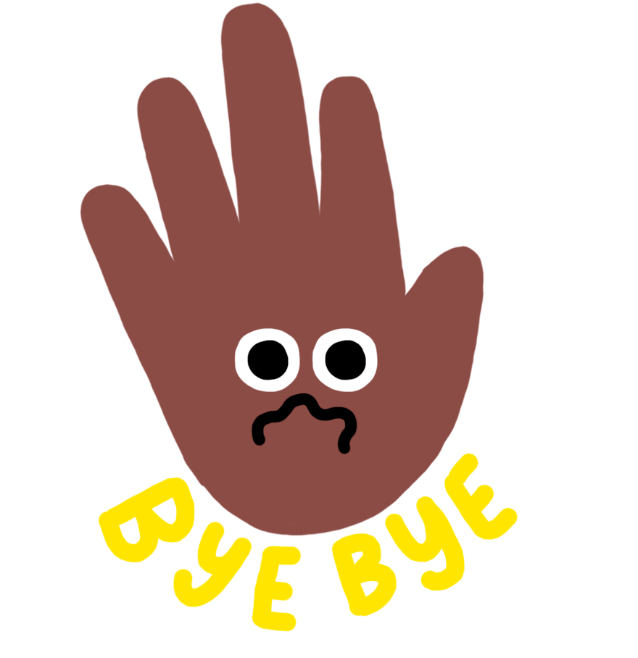
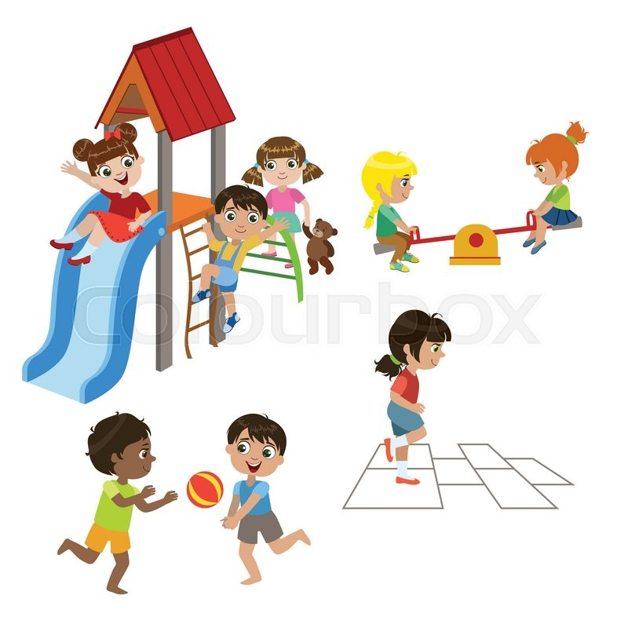
22
BYE BYE
THE END

