Slide 1
Welcome

Slide 2
Teacher’s Identity
Mohammad Abdul Gafur Mojumder
Assistant teacher
Gaiar Bhanga Govt. Primary School
Lalmai, Cumilla.

Slide 3
Lesson Identity
Class: Five
Subject: English
Lesson: Cyclone Aila
Lesson unit: Babul………in the sky.

Slide 4
Learning outcomes
Students will be able to……..
3.4.1- understand statements made by the teacher and students.
1.1.2- say sentences with proper intonation.
1.7.1- read paragraphs,dialoges stories,letters and other texts.
9.1.1-write short and simple paragraphs.

Slide 5
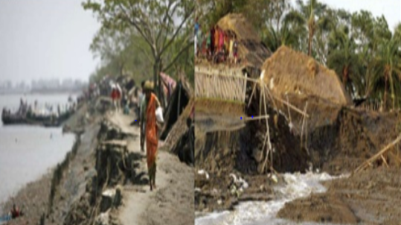
Look at the picture and think
What do you see the picture?

Slide 6
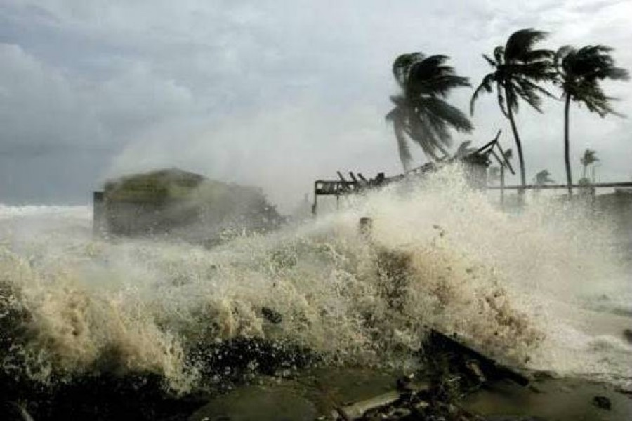
Cyclone Aila

Slide 7
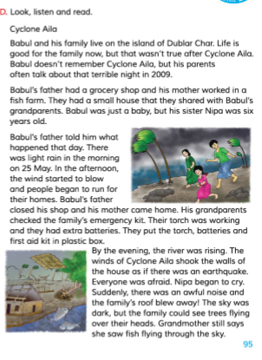

Slide 8
New words
Grocery shop
A shop selling foodstuff and other household necessities.
Island
A small land surrounded by water.
Roof
A protective covering of the top of a house.
Dark
Having no or very little light.

Slide 9
Pair work
Write “True” for correct statement or “False” for incorrect statement
Babul’s family lives on an island.
Nipa was seven years old
Babul’s parents checked the emergency kit.

Slide 10
Group work
Group A
Write 5 sentences about Cyclone Alia.
Group B
Write 5 sentences about Babul’s family.

Slide 11
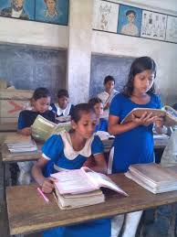
Student’s read silently

Slide 12
Evaluation
Answer the question
1.Where does Babul and his family live?
2.What was Babul’s father?
3.Why was everyone afraid?

Slide 13
Thanks everybody
Goodbye

