Slide 2
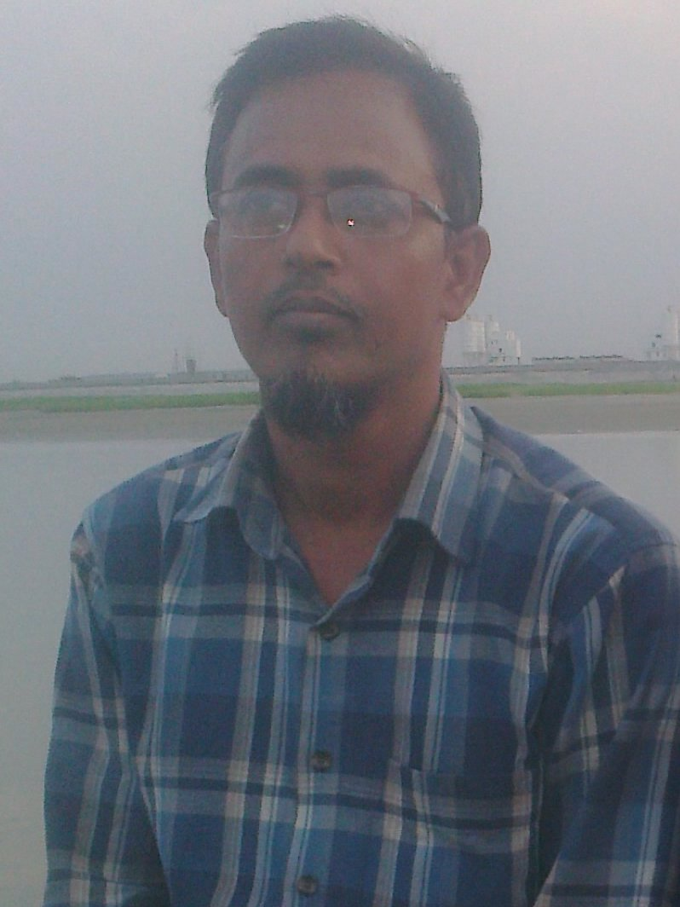
Presented
By
Md Abul Kashem
B R K High school
Munshigonj
01912834421

Slide 3
Class ten
Sec: B
English 2nd
Total Students:80
Time 40 minutes

Slide 4
Man is mortal (neg)
Man is not immortal
What kinds of grammar apply here?
Ans: Transformation

Slide 5
Our todays topics is
Transformation
From complex to simple

Slide 6
Learning out come
By the end of the class
Ss will be able to know
About complex& simple sentence
They can change it

Slide 7
Complex sentence
গঠনঃ s + v + extension+ conjunction + s +v + extension
অর্থাৎ দুইটি clause থাকবে principal clause/subordinate clause
Conjunction টি প্রথম ও থাকতে পারে।
Simple sentence
S + finite verb+ non finite verb + extension

Slide 8
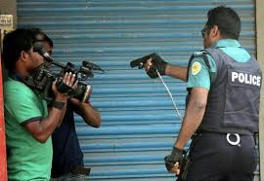
When the thief saw the police he ran away
দুই টি clause এর Subject একই হলে প্রথম subject টি বাদ দিয়ে verb এর শেষে ing হয়।
Seeing the police the thief ran away

Slide 9
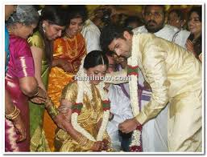
When the marriage ceremony was over the guest were all going to the fest.
Subject ভিন্ন হলে সে ক্ষেত্রে , কোন subject বাদ যাবেনা। be verb এর ক্ষেত্রে being এবং have verb এর ক্ষেত্রে having হয়।
The marriage being over , the guest were all going to the feast.

Slide 10
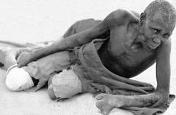
As he is ill ,he can not work hard.
As দিয়ে কারন বুজালে because of এর পর subject এর possessive case হয়।
Because of his being ill , he can not work hard.

Slide 11
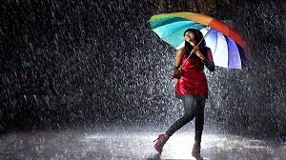
When they were playing, it began to rain.
When দিয়ে সময় বুজালে at the time of বসে।
At the time of their playing, it began to rain.

Slide 12
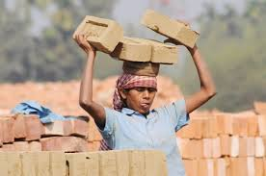
If you work hard , you can prosper in life.
If যুক্ত clause affirmative হলে By + gerund হয়।
By working hard , you can prosper in life.

Slide 13
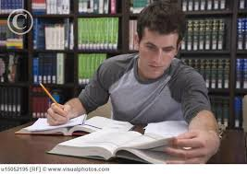
If you do not read more, you can not pass the exam.
Negative হলে with out+ gerund হয়।
With out reading more , you can not pass the exam.

Slide 14
He is so weak that he can not walk.
So বাদ দিয়ে too এবং thatও negative অংশ বাদ দিয়ে verb এর আগে to বসে।
He is too weak to walk

Slide 15
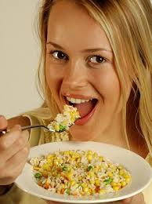
We eat so that we may live.
So that ও subject , may/might বাদ দিয়ে verb এর আগে to বসে।
We eat to live

Slide 16
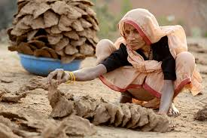
Though she tried heart and soul , she could not prosper in life.
Though/although থাকলে in spite of ও subject এর possessive case হয়।
In spite of her trying heart and soul , she could not prosper in life.

Slide 17
Evaluation.
1.When the girl stood by the window, she looked out
2.As he saw the tiger, he ran away in fair.
3.He is so weak that he can not speak a single word.
4.If you do not write much , you can not write well.
Ans
1.Standing by the window , the girl looked out.
2.Seeing the tiger , he ran away in fair.
3.He is too weak to speak a single word.
4. Without writing much , you can not write well.

Slide 18
Home work.
1. You came here when you were only four.
2. As I had forgotten him I went out.
3.Since he was small ,he could not work hard.
4.Although the man has vast riches, he wants more.
5.If you read more ,you will know more.

Slide 19
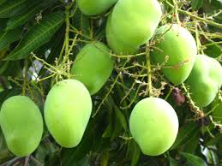
Thank you

