Slide 1
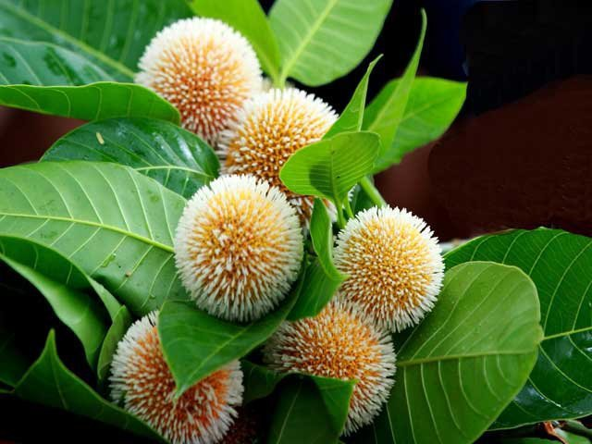
Welcome

Slide 2
PAHELA BOISHAKH

Slide 3
Learning out comes
By the end of this lesson ss will be able to-
Talk about events and festivals.
Ask and answer questions and give opinions in
Logical sequence.
Infer meanings from the context.

Slide 4
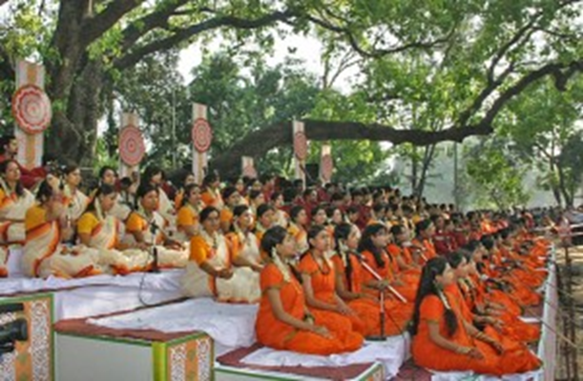
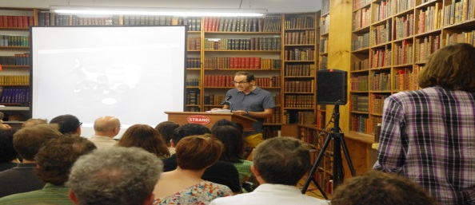
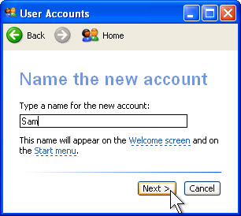
Vocabs
Occasion
celebration
Significance
magnificence
New account book
Khalkhata

Slide 5
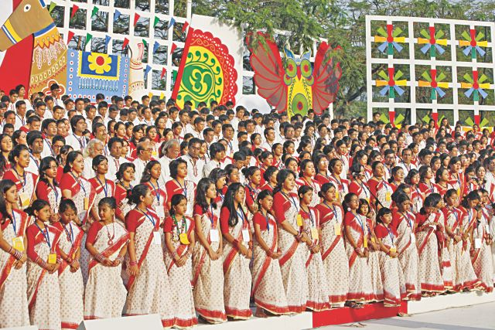
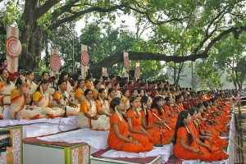
Preparation of mangal subazatra
Celebration of pahela boishkh with a song
Ramna bottomul
Boishkhi mela

Slide 6
Ask and answer the question in pairs what kind of food do you eat in the morning of pahela boishakh ?

Slide 7
Ask and answer these questions in group
1.DO YOU go out in the morning of pahela boishakh ?If you do, where do You go? If not ,what do you do?
2. Do you wear any special clothes on this
occasion? And why ?

Slide 8
Evaluation Complete the passage with suitable words, The word pahela means the first and Boishakh is the --- Month of bangla calendar. The day is observed not____ in bangladesh but__ some other parts of the world.
e

Slide 9
HOME WORK
Write a paragraph about your own cultural festival that you celebrate .you can use the following words .
Colorful , special, traditional, traders, cultural, flowers, food, songs, festive,

