Slide 2
Identity
Manik Chandra Majumder
Senior Teacher (English)
Gazirhat High School
Senbag, Noakhali
Mobile No: 01717155169
Class : Nine-Ten
Subject : English 1st paper
Time : 50 Minutes
Date : 00/00/2019

Slide 3
Observe the following vertical Graph
A vertical graph is used to show relationships between groups.
The two items being compared do not need to affect each other.
It's an easy way to show big differences.
Notice how easy it is to read a bar graph.

Slide 4
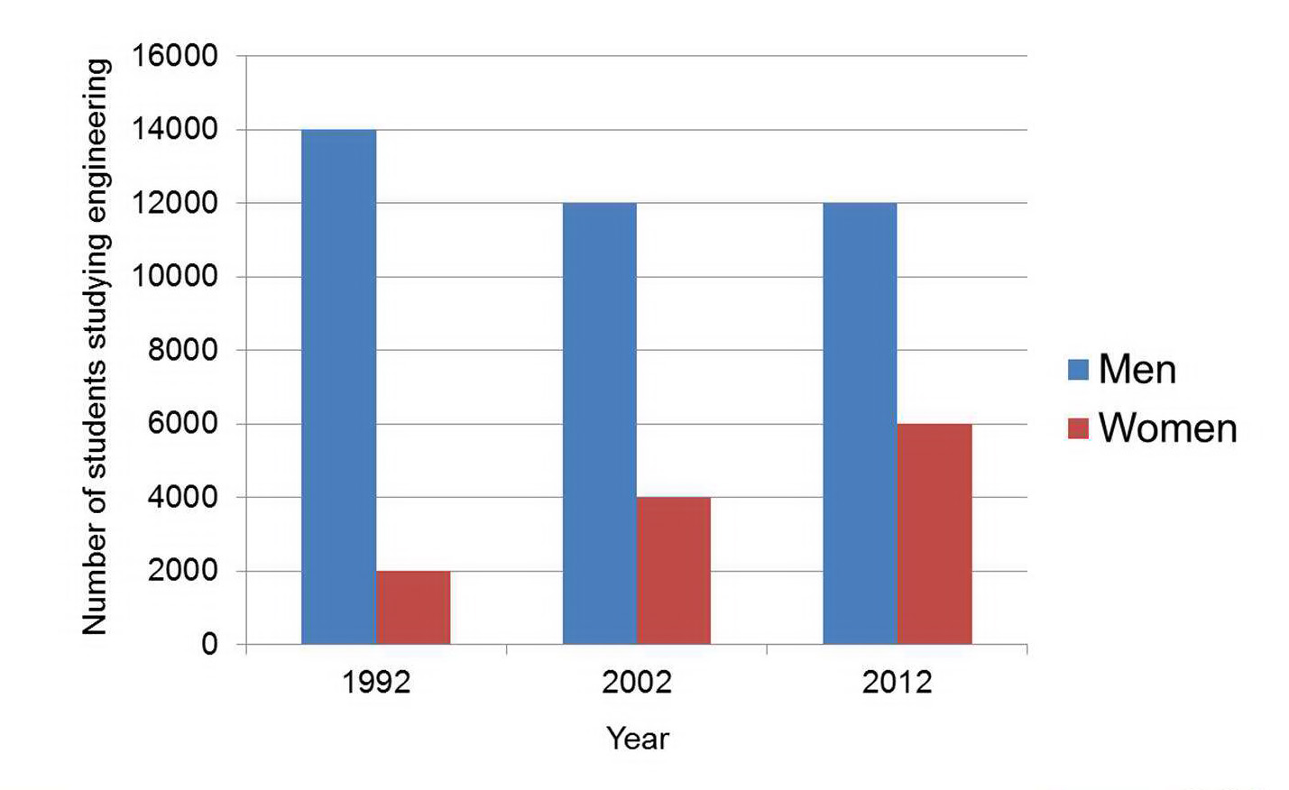
So, Dear Learners, Our Today’s Lesson is------
Describing Graph and Chart
This vertical graph

Slide 5
Learning outcomes
By the end of the lesson, students will be able to------
a) compare the information
b) tell and write what the chart and time period show,
c) describe the changes easily using data and number
from the chart,
d) talk about similarities and differences between the
groups shown.

Slide 6
Let’s observe the graph
Discus in a group about the number of men and women studying engineering at Australian University

Slide 7
Let’s analyzing the Graph
0-16000
Ten years intervals

Slide 8
Let’s analyzing the graph according to students number and timing period.
Men = 14000 - 1992
Male ss decrease
Men = 12000-2002
Men = 12000-2012
Women = 6000-2012
Female ss increase
Women = 4000-2002
Women = 2000 -1992
From 1992 to 2002 male students decrease slightly from 14000 to 12000 and then remained level. On the other hand the number of female students started from very low number then increased steadily by 2000 each decade.

Slide 9
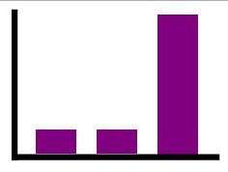
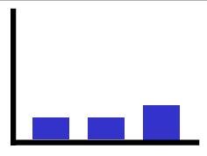
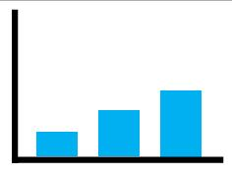
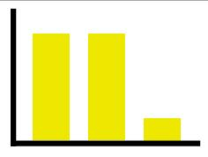
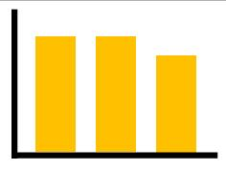
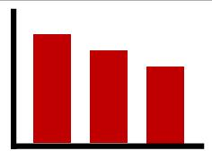
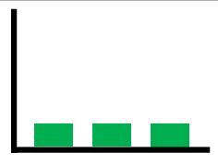
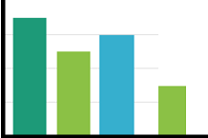
Write the caption in the boxes below for the changes.
a sharp rise
a slightly rising
a steady rising
a sharp fall
a slightly decreasing
no change
a steady falling
fracture

Slide 10
Let’s Analyzing the verb formation for describing the graph.
Describe/illustrate/ show : (verb formation)
Present Tense
I describe/illustrate/show
You describe/illustrate/show
He/she/it describes/illustrates/shows
We describe /illustrate/show
They describe/ illustrate/show
-ing form :describing illustrating/showing
past simple : described/illustrated/showed
past participle : described/illustrated/showed

Slide 11
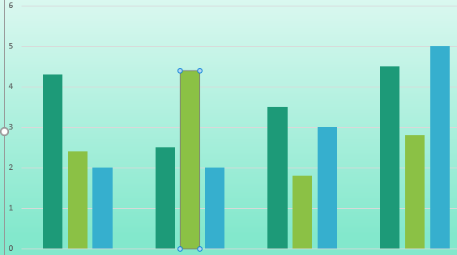
Observe the changes
Sharply rasing
Present situation
A sharp rise
gradually rising
A great fall
Present situation
No change/ Remain level
Great fall
Present situation

Slide 12
Let’s Analyzing word formation for describing the graph.
Slight (Noun) > Slight(Adj.) > Slightly (Adv)
Gradual(Adj.) > gradually (Adv)
Rapid(Adj.) > rapidly (Adv)
Relation (Noun) > relative(Adj.) > relatively (Adv)
For your better assistance you can use these words:
show, observe number of, percentage of gradually, respectively, incredibly slightly, steady, rapidly, increasing, decreasing, decade, age, more than ,less than, greater than, advancing, whereas, on the contrary, on the other hand , more over, besides, again,

Slide 13
Pair Works: Let’s follow the graph
Discus in Pairs about the number of men and women studying engineering at Australian University

Slide 14
Let’s observe the graph
Discus in a group about the number of men and women studying engineering at Australian University

Slide 15
Let’s observe the graph
Graph summary: The vertical graph shows the number of male and female students studying engineering in different decades. There is ups and downs of male and female students after ten years interval.

Slide 16
In the year of 1992,14000 male students study in engineering whereas the number of female students is relatively low. Only 2000 female students study in this discipline.

Slide 17
In 2002 after 10 years interval, the number of male students decreased 2000 and female students increased 2000.

Slide 18
In the same way, 2012 the number of male students again decreased 2000 and female students increased 2000. Thus the number of male students is lessening and female students is rising gradually.

Slide 19
We can see a clear upward trend in the number of female engineering students in this discipline. On the other hand, male students seem to be decreased.

Slide 20
Graph summary: The vertical graph shows the number of male and female students studying engineering in different decades. There is ups and downs of male and female students after ten years interval. In the year of 1992,14000 male students study in engineering whereas the number of female students is relatively low. Only 2000 female students study in this discipline. In 2002 after 10 years interval, the number of male students decreased 2000 and female students increased 2000. In the same way, 2012 the number of male students again decreased 2000 and female students increased 2000. Thus the number of male students is lessening and female students is rising gradually.
We can see a clear upward trend in the number of female engineering students in this discipline. On the other hand, male students seem to be decreased.

Slide 21
Evaluation
Complete the sentences with a preposition.
to
in
In
from
of
between
1. The vertical graph illustrates the number _____ male and female engineering students in 1992, 2002 and 2012.
2. The number of male students falls quite significantly __________1992 and 2002.
3. The number of female students was half the number of male students _______ 2012.
4. _______ contrast, the number of female students rose constantly.
5. Between 2002 and 2012, the number of female engineering students rose ________ 4,000 ______ 6,000.

Slide 22
Home work
The above graph shows sales amount of a departmental store in Dhaka. Now write a description of the graph in your exercise book.

Slide 23
Thank you all

