Slide 1
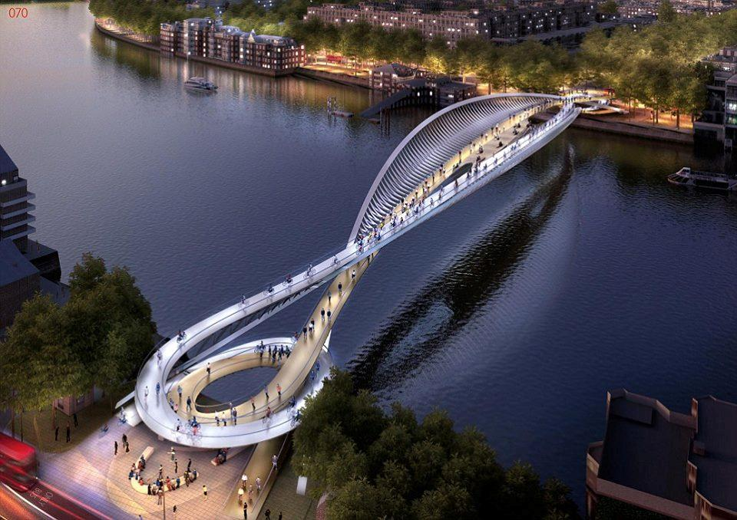
Welcome
Dear students
Notes:
Welcome slide.

Slide 2
Ilias Ahmed
B. A (Honors-English), M. A (English), B. Ed
Assistant Teacher ( English)
POLISHA HIGH SCHOOL
Mob. 01757451690
E-mail : ilias.ahcb@gmail.com
Notes:
Identity of teacher & class.

Slide 3
Our Today’s lesson is-
Direct and indirect speech
Narration Part-2
Notes:
Lesson declaration.

Slide 4
Learning outcomes
After we have studied this lesson,
we will be able to---
Know the exception rules.
Get idea about passage Narration.
change speech from direct to indirect
Notes:
Target of today’s class.

Slide 5
Some Special /Exceptional Rules
He says, “ My mother loves me more than her life.”
= He says that his mother loves him more than her life.
The student will say, “ He has completed his home work.”
= The student will say that he has completed his home work.
If the reporting verb is in present & future tense, there will be no change of the verb of reported speech.
Notes:
Practice & implementation of verb & adverb shown through example.

Slide 6
Some Special /Exceptional Rules
My father said to me , “ Honesty is the best policy.”
My father told me that honesty is the best policy.
The student said, “ The sun rises in the esat .”
The student said that the sun rises in the esat.
Rule : Universal truth will not be changed in indirect speech.
Notes:
Practice & implementation of verb & adverb shown through example.

Slide 7
Some Special /Exception Rules
My father said to me . “Good morning .”
My father wished me good morning .
The student said to the teacher , “ Good evening .”
The student wished the teacher good evening.
Structure : Sub + wished +Obj + good morning / good evening / good night .
Notes:
Practice & implementation of verb & adverb shown through example.

Slide 8
Some Special /Exception Rules
Runa said to me . “Good bye .”
Runa bade me good bye .
The student said to the teacher , “ Good bye .”
The student bade the teacher good bye .
Structure : Sub + bade +Obj + good bye .
Notes:
Practice & implementation of verb & adverb shown through example.

Slide 9
Some Special /Exception Rules
thank you /congratulations / welcome
He said to me, “Thank you .”
He
Thanked
me
1. The teacher said to him , “Congratulations.”
The teacher congratulated him
He said to the teacher , “ Welcome , Sir .”
He respectfully welcomed the teacher .
Structure : Sub + thanked/congratulated/welcomed +Obj
Notes:
Parts of direct speech.

Slide 10
Some Special /Exception Rules
Sir /Madam
He said to me, “Sir , help me please.”
He
Respectfully
requested
me
to help him.
“How are you , Madam?” He said to the teacher
He respectfully asked the teacher how she was.
Structure : Add `Respectfully` after Subject/ Object
Notes:
Parts of direct speech.

Slide 11
Some Special /Exception Rules
OK
The tourist said to the receptionist ,“Ok, it will be suitable for me.”
The tourist
confirmed
the receptionist that
It would be suitable .
Structure: Sub+ confirmed + obj + that + (reported speech)
Notes:
Parts of direct speech.

Slide 12
Some Special /Exception Rules
Excuse me
He said to me, “Excuse me,Can you tell me the way to the Hotel ?”
He
politely
asked
me
If I could tell him the way to the hotel .
Structure : Add ` politely ` after Subject for ‘Excuse me’
Notes:
Parts of direct speech.

Slide 13
Some Special /Exception Rules
Addressing
He said to Mina, “ Are you hungry , friend ?”
Addressing Mina as friend,
he asked if she was hungry.
Structure : Addressing + object + as + address , + from First to Last with Normal answer.
“Sister , help me please .” He said to her.
Addressing her as sister , he requested to help him .
Notes:
Parts of direct speech.

Slide 14
Some Special /Exception Rules
He said to me, ” By Allah, I will never tell a lie.”
Swearing by Allah
he told me that
he would never tell a lie.
Rule :
Swearing by Allah,+from First to Last with Normal answer.
Notes:
The use of ‘By Allah’ in indirect speech shown here.

Slide 15
Some Special /Exception Rules
Yes/ Oh Yes
The tourist said to the receptionist ,“Yes, it will be suitable for me.”
The tourist
replied in the affirmative and
Said that
It would be suitable for me.
Structure: Sub+ replied in the affirmative and
Notes:
Parts of direct speech.

Slide 16
Some Special /Exception Rules
No/ Oh No
The teacher said to the student ,“No, it will not happen again.”
The teacher
replied in the negative and
said that
It would not happen again.
Structure: Sub+ replied in the negative and
Notes:
Parts of direct speech.

Slide 17
Some Special /Exception Rules
Mother said to me, “so, we will do this.”
Mother told me that
that is why
we would do that.
Structure: Reported speech এর শুরুতে so থাকলে এর পরিবর্তে
that is why হয় ।
Notes:
Parts of direct speech.

Slide 18
Some Special /Exception Rules
how much cost of the picture.
the picture is fifty
“This is a nice picture” I said. “How much?”The salesman said, “Fifty.”
I told the salesman that that was a nice picture. Then I asked him how much cost of the picture. The salesman replied that the picture was fifty
Notes:
Lesson declaration.

Slide 19
Some Special /Exception Rules
“I’m going to my home.” The man replied.
The man replied that he was going to his home.
The girl asked the man, “Where are you going?” .
The girl asked the man where he was going. .
Rule : ‘replied, uttered, cried, asked’ will always be unchanged in indirect speech.
Notes:
Lesson declaration.

Slide 20
Some Special /Exception Rules
“I’m going to my home.” The man said.
The man told the person spoken to that he was going to his home.
The girl asked , “Where are you going?” .
The girl asked the person spoken to where he was going. .
Rule : If there is no Object in reporting speech , Write ‘ the person spoken to ’ as object .
Notes:
Lesson declaration.

Slide 21
Some Special /Exception Rules
“Are you going to start a business?”“Yes,I am going to start.”
The speaker asked the listener if he was going to start a business.
The listener replied in the affirmative and told that he was going to start
Rule : যদি Direct speech এ বক্তা ও শ্রোতা উল্লেখ না থাকে Indirect speech এ বক্তা হিসেবে the speaker ও শ্রোতা হিসেবে the listener উল্লেখ করতে হবে
Notes:
Parts of direct speech.

Slide 22
Some Special /Exception Rules
Ratan said “ I’ve done it . But I haven’t understood some matter.”
Ratan told that he had done it and added that he hadn’t understood some matter.
Ratan told that he had done it and also said that he hadn’t understood some matter.
Ratan told that he had done it and he told that he hadn’t understood some matter.
If connect two assertive sentence .
Notes:
Lesson declaration.

Slide 23
Some Special /Exception Rules
Karim said to the boy, “What is your name?” The boy said, “My name is Hasan.” Then he said to the boy, “Where do you live?” The boy said, “I live in Jmalpur.” Again he said to the boy, “Are you busy now?”
Karim asked the boy what his name was. The boy replied that his name was Hasan. Then he again asked the boy where he lived. The boy replied that he lived in Jamalpur. He further asked him if he was busy then.
In answer –write Replied that *** In Question – 1st time – asked , 2nd Time – again asked , 3rd Time – further asked
Notes:
Lesson declaration.

Slide 24
Home Work
Write a paragraph about- A Rainy Day

Slide 25
Continue to
Narration Part-3
Allah Hafez

