Slide 1
Welcome

Slide 2
Introduction
Khandaker Md. Abdullah Al Mamun
Assistant Teacher
Bindubasini Govt. Girls’ High School Tangail
Mobile: 01552437153
E-mail: al_mamun1972@yahoo.com

Slide 3
Introduction
Subject: English 2nd Paper
Subject Code: 108
Class : Nine/ Ten
Grammar part
Interchange of Assertive and imperative sentences

Slide 4
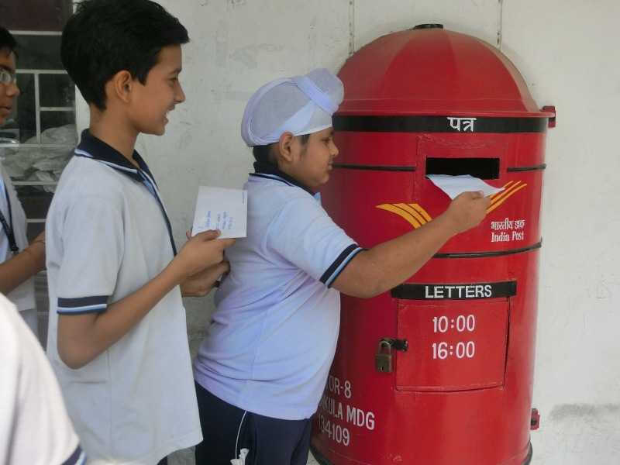
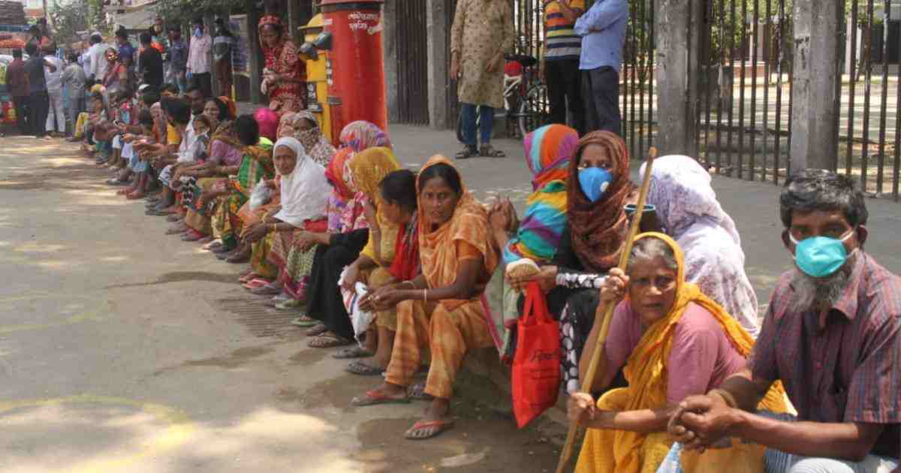
Look at the sentences
You are ordered to post the letter into the letter box.
Post the letter into the letter box.
You are requested to help the poor.
Please help the poor.
You should not tell a lie.
Don’t tell a lie.

Slide 5
Learning outcomes
At the end of the lesson students will be able to…
identify assertive & imperative sentences.
transform them according to rules.

Slide 6
Imperative Sentence
A sentence which expresses order , request, advice, command or proposal is called an Imperative sentence.
Example: Leave this place at once.
Let us have a walk.
Open the door , please.
Don’t speak of all others.
Let us play in the field

Slide 7
To day we will learn “ The Interchange Assertive to Imperative Sentence.”
A sentence which expresses order , request, advice, command or proposal is called an Imperative sentence.
Example: Leave this place at once.
Let us have a walk.
Open the door , please.
Don’t speak of all others.
Let us play in the field

Slide 8
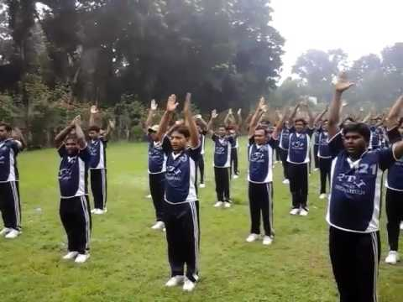
Rules-1: Assertive sentence টি 2nd person দ্বারা শুরু হলে উক্ত 2nd person এবং Auxiliary Verb উঠে যায়।
Structure: Verb+ Extension.
Example: You should take physical exercise regularly.
Take physical exercise regularly.
You should do the work.
Do the work.

Slide 9
Rules-2: Assertive sentence টি 2nd person এবং Negative হলে উক্ত 2nd person এবং Auxiliary Verb+ not উঠে যায়।
Structure: Don’t + Verb+ Extension.
Example: You should not tell a lie.
Don’t tell a lie.
You should not waste your time.
Don’t waste your time.

Slide 10
Rules-3: Assertive sentence টি You are requested to দ্বারা শুরু হলে উক্ত You are requested to উঠে যায় এবং শুরুতে please / kindly বসে।
Structure: Please/ kindly + Verb+ Extension.
Example: You are requested to give me a glass of water.
Please give me a glass of water.
You are requested to attend the meeting.
Kindly attend the meeting.
.

Slide 11
Rules-4: Assertive sentence টি 1st person / 3rd person দ্বারা শুরু হলে উক্ত 1st person / 3rd person উঠে যায় এবং শুরুতে let বসে।
Structure: Let+ subject এর objective form+ Verb-1+ Extension.
Example: We should solve the problem .
Let us solve the problem.
She sings a song.
Let her sing a song.
We do not hate the poor.
Let us not hate the poor.
.

Slide 12
Rules-5: Assertive sentence টি You should allow দ্বারা শুরু হলে উক্ত You should allow উঠে যায় এবং শুরুতে let বসে।
Structure: Let+ subject এর objective form+ Verb-1+ Extension.
Example: You should allow him to do the work.
Let him to do the work.
You should allow me to go there.
Let me go there.
.

Slide 13
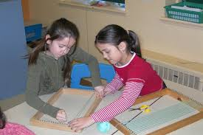
Pair work
Transform the sentences into imperative sentence:
You need not go out in the rain.
You are asked to speak the truth.
Karim may tell everything.
You are ordered not to go out.
They might attend the party.
You must not disturb me.

Slide 14
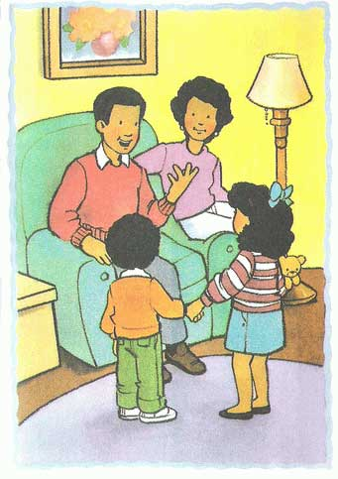
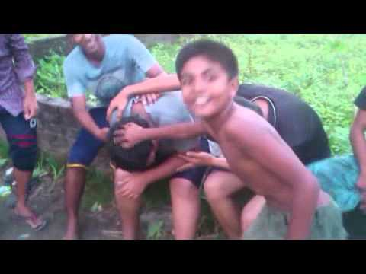
Guess the sentences
You should obey your parents.
= Obey your parents.
You should not make a noise.
= Do not make a noise.
You should never mix with bad boys.
= Never mix with the bad boys.
You are requested to come.
= Please, come.

Slide 15
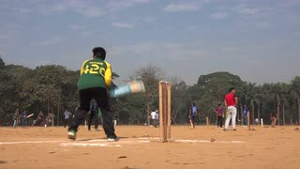
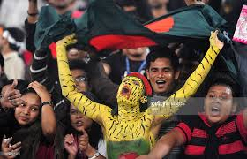
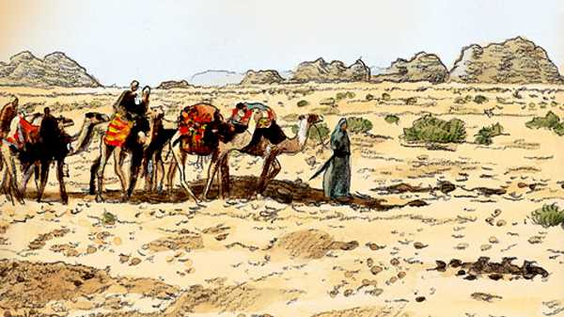
He wants to play cricket.
= Let him play cricket.
We want to witness the game.
= Let us witness the game.
They want to go to the zoo.
= Let them go to the zoo.
Saadi does not tell a lie.
=Let not Saadi tell a lie.

Slide 16
Individual work
Transform the following sentences into imperative and vice versa :
You must follow the rules of health.
You are requested to open the window.
You are orderded to bring five sticks.
We should be hard working.
You must follow the instruction.
f) Robi may do the work.
g) Don’t hate the poor.
h) Let’s go out.
Have a cup of tea.
j) Do the work.

Slide 17
Home work
Write the structures of imperative sentences with an example each of them.

Slide 18
Thank you all

