Slide 1
WELCOME TO EVERYBODY

Slide 2
Identity
Teacher’s Identity
Md. Bulbul Ahmed
Assitant Teacher
Dalaichor Govt . Pri. Schol
Knaighat , Sylhet .
Mob: 01552439826
Mail:- abulbul631@gmail.com
Lesson Identity
Class: Five
Sub:- English
Unite: 8
Lessson: 1-2
Lesson’s name: Write to me soon .

Slide 3
Learning outcomes
Listening : 1.2.1.recognizing which syllable ia word is stressed
1.3.1. recognize which words in a sentence are stressed .
Speaking:1.1.1. say words phrases and sentences with proper sounds and stress .
1.1.2. say sentences withproper intonation
6.1.2. say what other’s are doing
6.2.1. talk about people ,objects events ,etc .
Reading :1.5.1.read word and phrases and sentences in the text with proper pronounciation ,stress and intonation .
5.1.1. read silently with understanding paragraph .

Slide 4
Good morning students
Good morning teacher

Slide 5
I will ask the students to say the name of foods as the can
The students may say : rice , dread , milk ,vegetables, carrot,egg, fish,carrot,orange , banana ,meat,etc.

Slide 6
Now I will ask the students to write “H” at the side of healthy foods and “U” at the side of unhealthy foods.

Slide 7
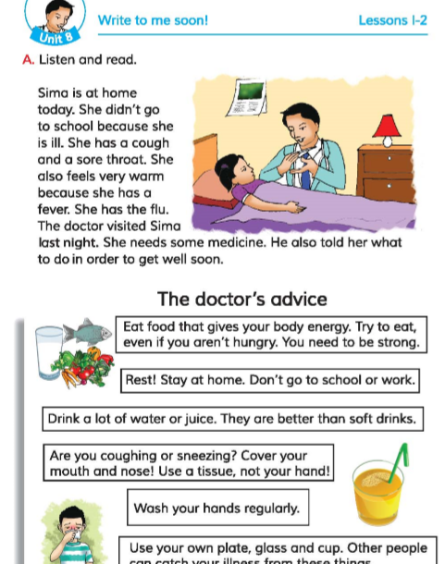
Open at page 30 , Unite -8 lesson 1-2

Slide 8
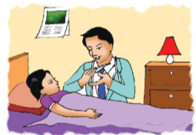
Look at the picture .
What do you see in the picture ?

Slide 9
How doyou know there is a doctor ?
We see the an has a stethoscope and we know a doctor uses a stethoscope so, the man is a doctor .

Slide 10
What are they doing ?
Sima is lying on the bed and the doctor is taking her temperature with a thermometer .

Slide 11
Some new words
House
Home
বাড়ী
Meaning
Ill
অসুস্থ
Meaning
sick
Throat
গলা
Meaning
neck
Feel
অনুভুতি
Meaning
sence
Come round
Get well
সুস্থ হওয়া
Meaning

Slide 12
I will play the audio clip of the text.

Slide 13
Iwill ask the students , “What do they understand by reading the text?”.
The students will try to say in English .

Slide 14
Why didn’t Sima go to school?.
Sima didn’t go to school because She is ill.
Why She is feeling warm ?
She is feeling warm because she has a fever .
Who visited Sima ?
The doctor visited Sima.

Slide 15
Who needs medicine ?
Sima needs medicine.

Slide 16
I will ask my students to read the text silently

Slide 17
Do you have any idea about “Flue”?
Influenza commonly knwn as flu ,is a respitratory illness that is caused by a virus .Flue is highly contagious and is usually spread by the coughs and sneezes of aperson who is infected .

Slide 18
Make four groups
Find out the answer of the Questions
Why didn’t Sima go to school?.
Why She is feeling warm ?
Who visited Sima ?
Who needs medicine ?

Slide 19
What have we learn from this lesson
We have learnt about the disease ‘Flue’
And What we have to do if we are effected with Flue .

Slide 20
Good Bye

