Slide 1
Note for the honourable teachers:
This slide is hidden.
Please start with F5 to keep it hide.
The subject teachers are requested to read the notes given below the slides.
A note is given bellow the slide no. 4

Slide 2
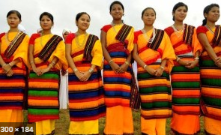
Welcome

Slide 3
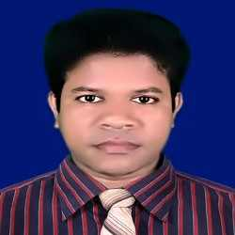
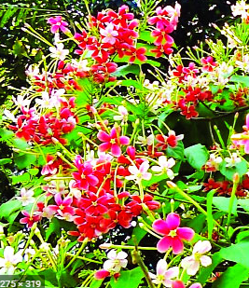
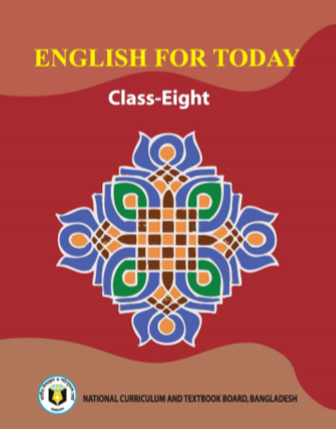
Azizul Fakir
Assistant Teacher
Dighirjan Secondary
School
Nazirpur, Pirojpur
Mobile: 01710745128
Email: azizul.nk@gmail.com
Class Eight
Unit: 1
Lesson: 3
Time: 50 mins.

Slide 4
Enjoy the video
What do you see in the video?
Culture of ethnic people
Notes:
This video is an You Tube link. Honorable teachers are requested to connect internet to play the video.

Slide 5
Our today’s topic is
Our ethnic friends (1)
Unit: 1
Lesson: 3
Time: 50 mins.

Slide 6
Learning outcomes
After we have studied this lesson, we will be able to
infer meaning from the context.
answer of true or false
write answers to the questions.
ask and answer to the questions.
fill gaps from listening the CD.

Slide 7
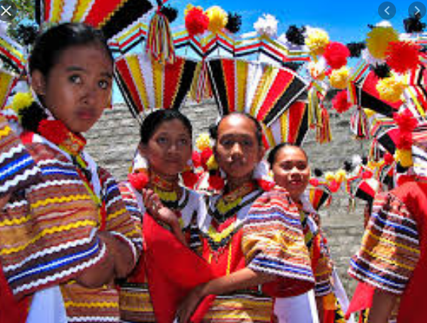
Key words
ethnic
(adj)
Meaning
tribal
Many ethnic people live in Bangladesh.

Slide 8
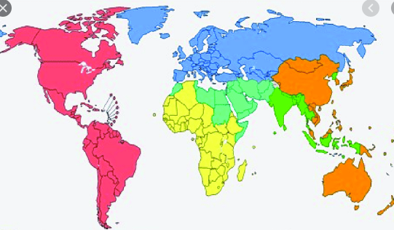
region
(noun)
Meaning
area
Two hundred and nine countries and regions are affected by corona virus.

Slide 9
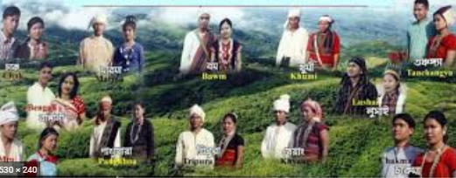
majority
(noun)
Meaning
great part
The majority of these people live in the chottgram and Hill Tracts.

Slide 10
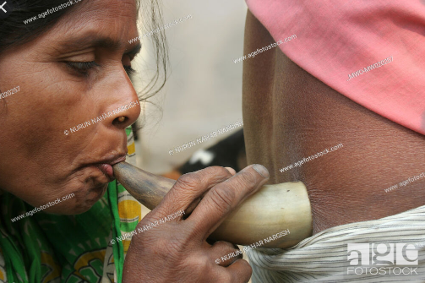
shifting
(noun)
Meaning
transfer
The bedey community are shifting their profession day bay.

Slide 11
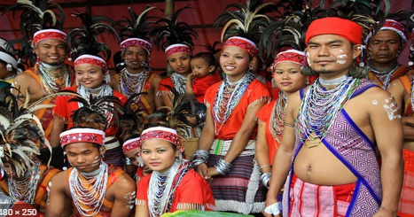
Open at page 05 in your book ‘English for today’ and read the passage carefully and silently.

Slide 12
The ethnic people in Bangladesh hold a very important place in the culture of the country. The majority of these people live in the Chittagong and Hill Tracts. The others live in the regions of Mymensingh, Rajshahi and Sylhet. They live in forest areas, in the hills and in rural areas. They do Jhum cultivation. For this work they clear a piece of land in the forest, prepare it and sow seeds in it. They are mostly farmers. By religion they are Hindus, Christians, or Buddhists. They speak their own mother tongue. Some of them are the Chakmas, the Marmans, the Tipperas and the Moorangs, who live in the Hill Tracts. The Santals live in Rajshahi. The Khasias and the Monipuries, live in Sylhet and the Hajangs and the Garos in Mymensingh.

Slide 13
True or false? If false, give the correct information.
1. All the ethnic people of our country live in the Chittagong Hill Tracts.
False: Corr: Some of them also live in Mymensingh, Rajshahi, Sylhet region.
2. Most of them are farmers.
True.
3. By religion all of them are Buddhists.
False: Corr: By religion some of them are also Hindus and Christians.
4. The Moorangs are an ethnic group.
True.
5. They practice jhum cultivation.
True.

Slide 14
Pair works:
5 mins
Answer the following questions
Q1. Do you know where the ethnic people live Bangladesh?
Q2. What are they called?
Correct your answers
Ans1: Yes, I know, the majority of these people live in the Chattogram Hill Tracts. And the rest live in the regions of Mymensingh, Rajshahi and Sylhet.
Ans2: They are called ‘The ethnic people’.

Slide 15
Group works:
6 mins
Look at questions and discuss in group then write the answers.
Q1. Have you heard the word ‘ethnic people’?
Q2. Can you tell what it means?

Slide 16
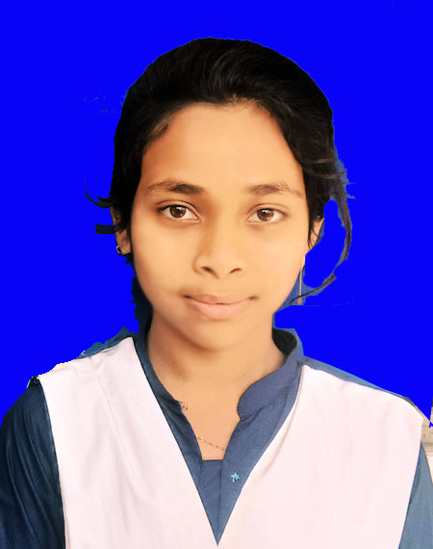
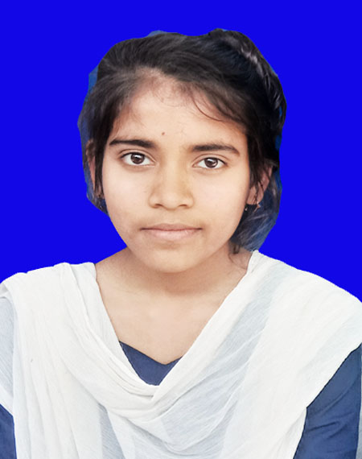
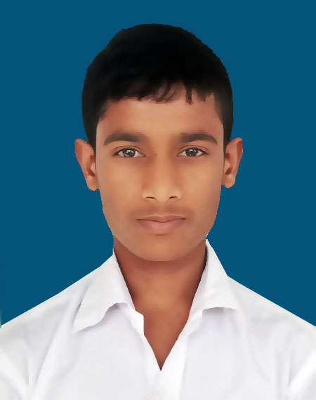
Correct your answers
Have you heard the word ‘ethnic people’?
Ethnic majority? Oh, no, I’ve never heard such words. Have you heard such thing Sadif?
Yes, I have heard the ethnic people.
Very well. But can any of you tell me what it means?
So far as I heard Ethnic people means a minor community or society that has specific ethnic characteristics.

Slide 17
Specific ethnic characteristic?
Yes, one of my senior brothers also told alike.
Thank you for your informative discussion.
Thank you very much too.

Slide 18
Listen to the CD
Evaluation
Now fill the gap
The ethnic people in Bangladesh (a) --- a very important place in the culture of the country. The (b) --- of these people live in the Chittagong Hill Tracts. The others (c) --- in the regions of Mymensingh, Rajshahi and Sylhet. They live in (d) --- areas, in the hills and in rural areas. They (e)---Jhum cultivation.

Slide 19
Homework
Answer the following questions
Q1. Where do you find the Marmas?
Q2. What language do the speak at home?
Q3. Where and how do they dothe Jhum cultivation?

Slide 20
Thank you

