Slide 1
WELCOME TO MULTIMEDIA CLASS

Slide 2
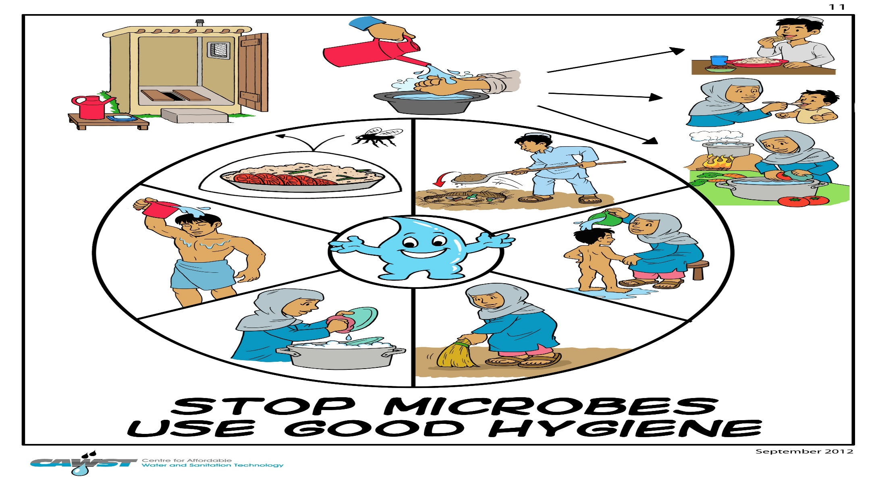
Can you guess what is the picture about?
It is about health and hygiene

Slide 3
Our Topic is:
Hygiene
Unit-3,Lesson -3 Hygiene

Slide 4
Introduction
Md. Alauddin
Assistant teacher Pagla Govt. Model High School and College SouthSunamgonj,Sunamgonj Mob.01765740395 | Class-8 English First Paper Unit-3,lesson-3 Topic-Hygiene

Slide 5
Learning Outcome…
1. SS will be able to explain of hygiene.
2. They will be able to write true or false.
3. They will complete the sentences.
4. They will be able to maintain personal hygiene.

Slide 6
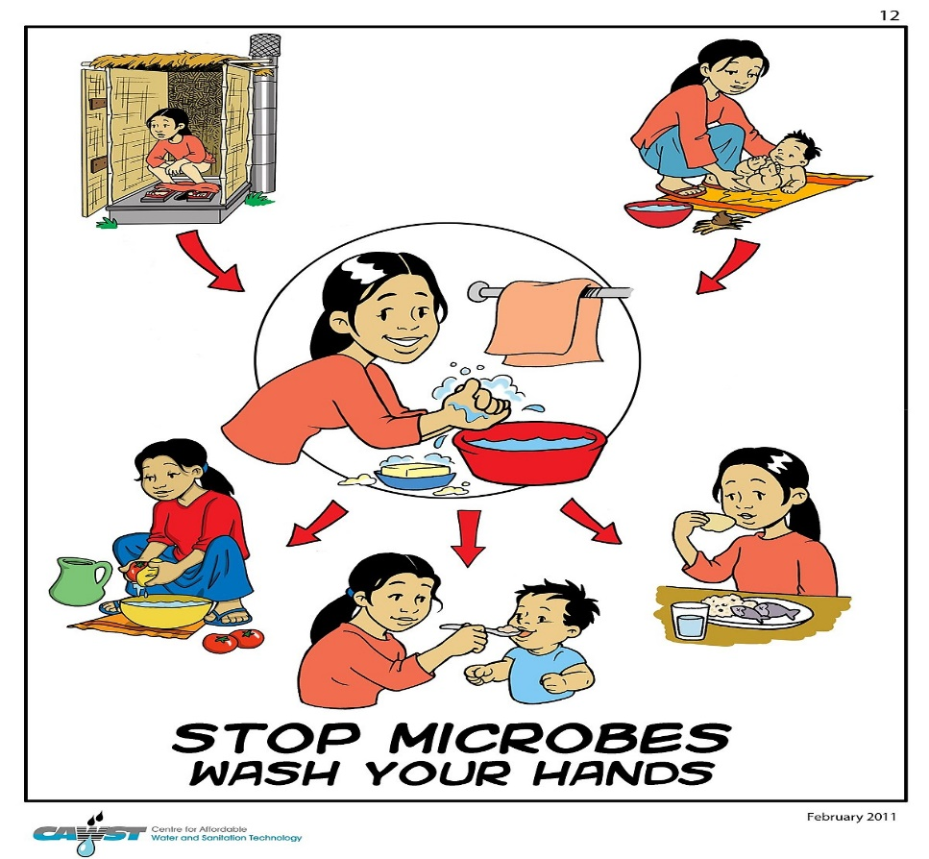
Key Words
Hygiene
Rules of health
Hygiene is important for our good health.

Slide 7
Key Words
Godliness
Supreme rule
Hygiene is thought to the next of godliness.

Slide 8
Key Words
Achieve
Obtain, acquire
We can not achieve anything without hygiene

Slide 9
Key Words
Spiritually
Divinely
We can not achieve anything spiritually without hygiene

Slide 10
Key Words
Soul
Spirit, Ego
Soul is the part of our body

Slide 11
Key Words
Smell
Oder, scent
Dirty clothes give off bad smell

Slide 12
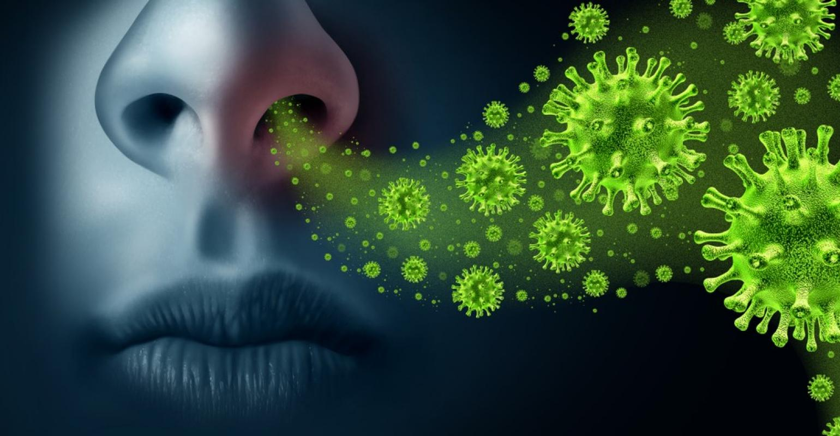
Key Words
Germ
Disease, Microbe
Bad smell invites germ

Slide 13
Key Words
Protect
Save, preserve
We should protect our environment

Slide 14
The word hygiene means the practice of keeping ourselves clean. It also means to keep our home and place clean. It is important for our good health. Hygiene is thought to be next to godliness. It is because we can not achieve anything physically, mentally or spiritually if we are unclear in our body, mina and soul. Nobody likes an unclear person either.

Slide 15
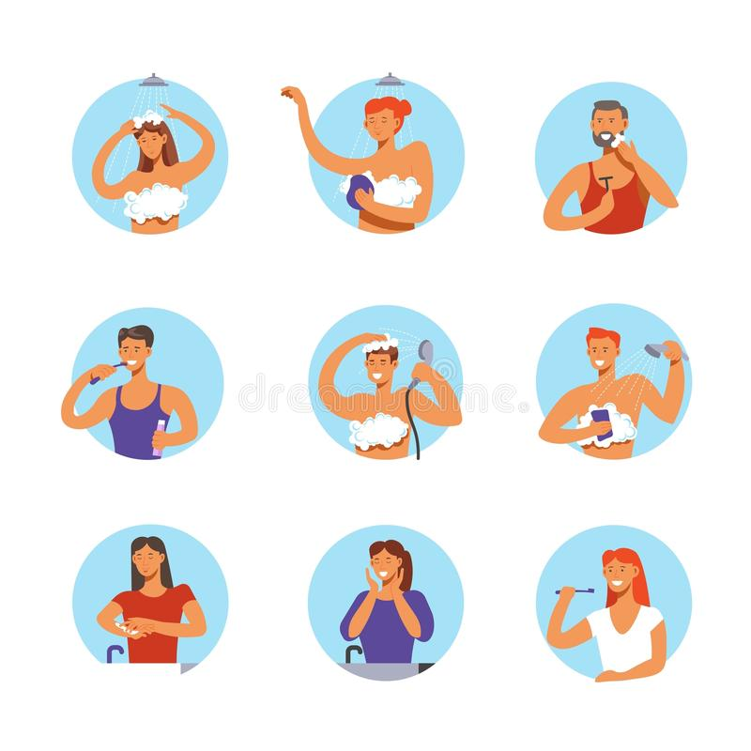
So we must follow the rules of hygiene
First, we must keep our body clean. We should have a bath every day and wash our hands regularly. This will keep the body and hair from dirt and bacteria.

Slide 16
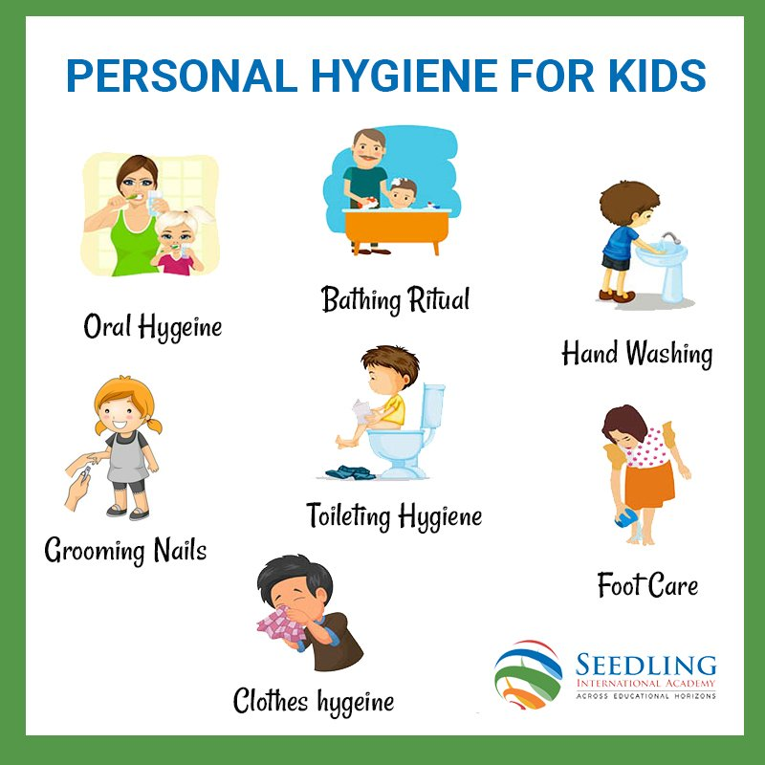
Secondly,we should wash our clothes regularly.Dirty clothes give off bad smell and invite grems.We should wear socks and shoes when we go out to protect our feet from dust and germs.It is also important to wash our hand before meal and after toilet.

Slide 17
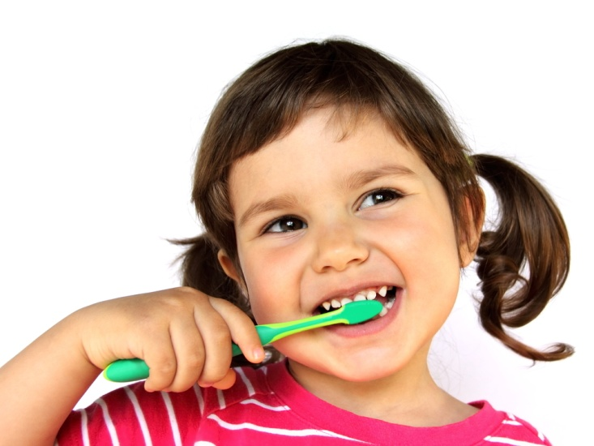
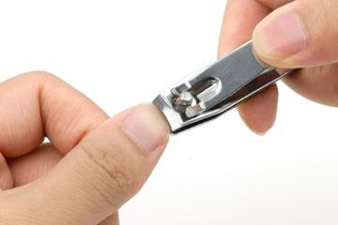
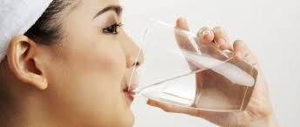
We should brush our teeth twice a day after breakfast before supper.We must also cut our nails regulary.Our drinking water must be safe.We can get safe water by boiling.

Slide 18
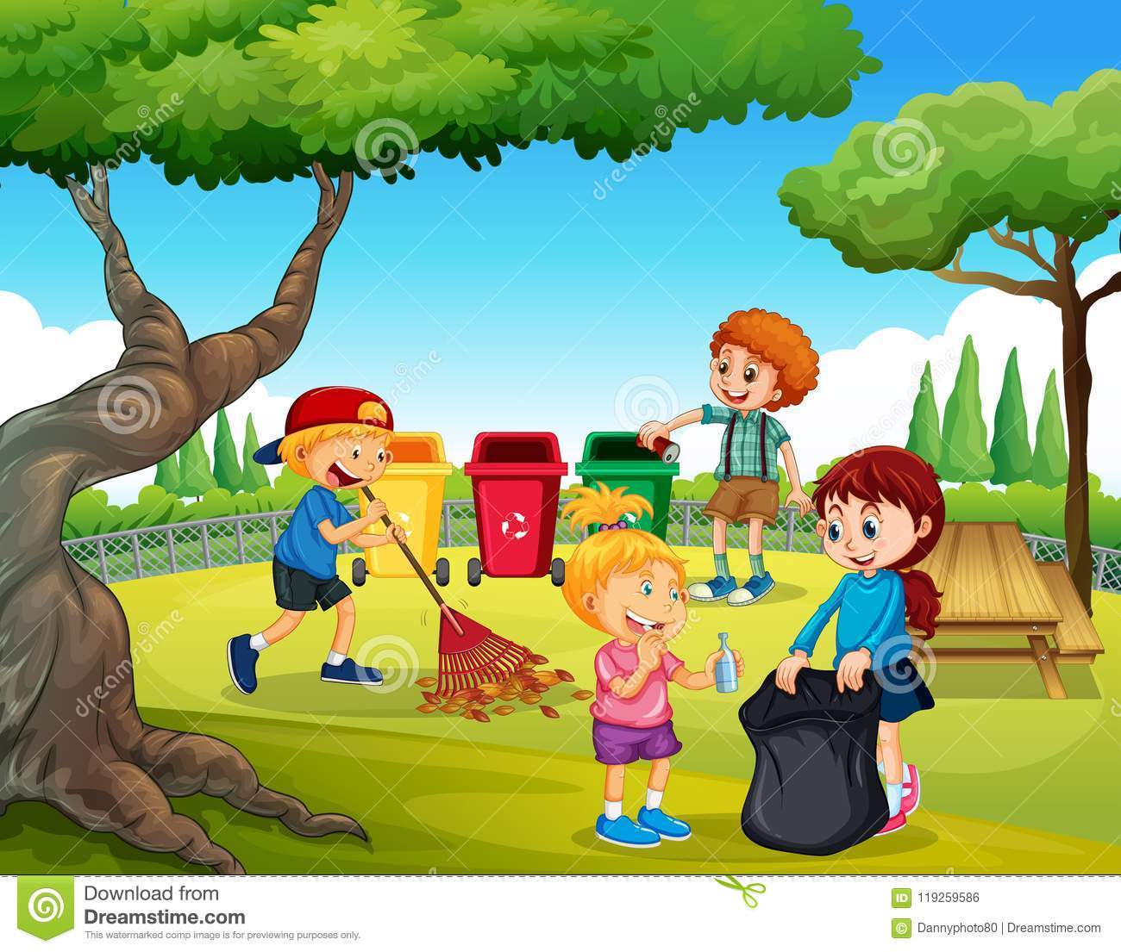
Finally, we should keep our surroundings environment clean. If we do and follow all the above things properly, we will be able to lead a healthy and happy life.

Slide 19
A.Read the questions first. Then read the text and answer them in short.
1.What can be a hotbed of germs?
Ans-Dirty clothes can be a hot bed germs.
2.How many times should we brush our teeth a day?
Ans-We should brush our teeth twice a day.
3.What kind of water should we drink?
Ans-We should drink pure water.
Individual work

Slide 20
B.True or false. If false, give the correct information.
Pair work
1.Cleanliness is part of our body.
True
2.Cleanliness is very important for mental health.
False.Cor.Inf-It is very important not only for mental health but also for our physical and spiritual health.
3.We need to wear socks and shoes to look smart.
False.Cor.Inf-We need to wear socks and shoes to keep us free from germs.
4.We need to brush our teeth before meals.
False.Cor.Inf-We need to brush our teeth after meals
5.We must keep ourselves clean.
True
6.We can have pure drinking water from tube wells.
False.Cor.Inf-We can have pure drinking water by boiling and filtering.

Slide 21
C. Complete the following sentences…………..
1.If we are healthy, ……………………………
1.If we are healthy, we shall be fit for work.
2.We must be clean so that we can be healthy.
2.We must be clean so that………………………..
3.You must exercise to keep ourselves disease free.
3.You must exercise to keep…………………………...
4.Nobody likes an unclean person.
4.Nobody likes an………………………………..........
5.If we obey the lows of hygiene we…………………..
5.If we obey the lows of hygiene, we shall be able to lead a happy life.

Slide 22
D.Work in groups. Make a list of five things that you do daily to maintain personal hygiene. Share with your with other groups make a poster and display it in the class.
Hygiene
Brush twice daily.
Take exercise to fit yourselves.
Wash your hand before eating.
Wear clean clothes.
Group work

Slide 23
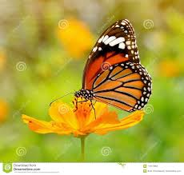
Evaluation
1.What do you mean by hygiene?
2.Why is hygiene important?
3.How can we get pure water?
4.How can we lead a happy life?

Slide 24
Home work
Write a paragraph on Hygiene

