Slide 1
Welcome

Slide 2
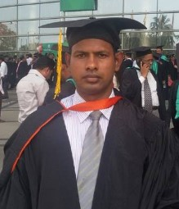
Presented by
Md. Ikramul Haque
B.Sc, M.A in English
Assistant Teacher( English)
Mirzapur Islamia Dakhil Madrasah
Dapunia, Pabna sadar, Pabna.
E-mail: h_ikramul22@yahoo.com
01716845666

Slide 3
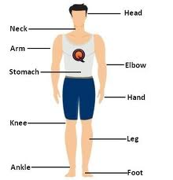
Look at the picture

Slide 4
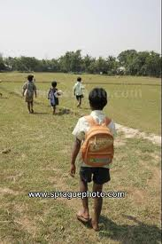
Rafin goes to school everyday with a bag. (Sentence/speech)
How many words are there in the sentence?
How are they different?
Parts of Speech

Slide 5
Our to day’s topic is
parts of speech

Slide 6
By the end of the lesson, students will be able to-
tell the names of parts of speech
give example of different parts of speech
categorize the words of a sentence in parts of speech

Slide 7
Do you know The defination of parts of speech?
Every meaningful words of a sentence is called parts of speech.
There are 8 kinds of parts of speech.

Slide 8
Noun
Interjection
Pronoun
Conjunction
Parts of speech
Adjective
Preposition
Verb
Adverb

Slide 9
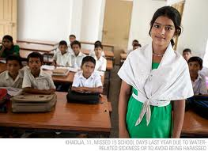
Noun
A noun is a name of any thing.
noun
Masum is a student
Here Masum Is ------
Sharmin reads in class eight.
noun
Here Sharmin is ---

Slide 10
Pronoun
A pronoun is used in place of a noun
Mamun reads in class eight. He is 12 years old.
Explain. in the 1st sentence Mamun is noun.but in the 2nd sentence “he” is used in place of Mamun.so here “he” is pronoun.
He,she,her,him,they,I,we ,us , our, my, mine, you, your, who, what, it myself, himself, herself, themelves, yourself, etc are used as pronoun.

Slide 11
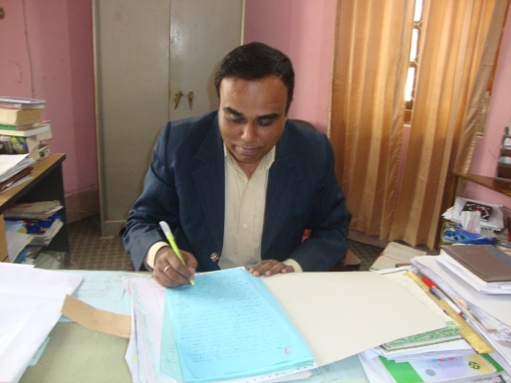
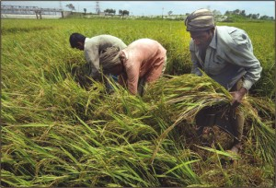
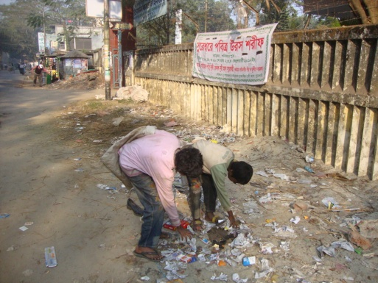
Verb
The man is writing a letter.
They are cutting paddy
They are picking something
Write
Cut
Pick
Verb is a doing word.

Slide 12
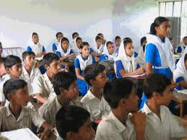
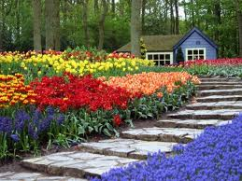
Adjective
There are forty students in the classroom
The garden is beautiful.
Adjective is a word which qualify noun or pronoun

Slide 13
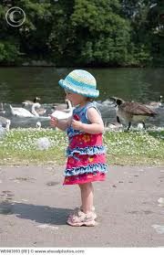
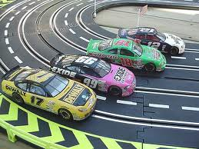
Adverb
The baby is walking slowly.
Cars are running fast.
Adverb is a word which qualify verb and Adjective.

Slide 14
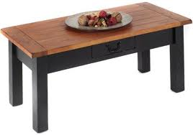
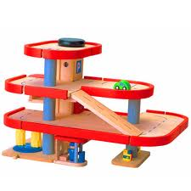
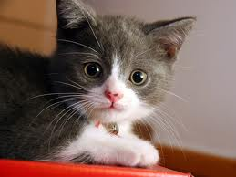
Preposition
There is some food on the table.
There is a cat under the table.
There is a toy behind the table.
Preposition sits before noun or pronoun and show the relationship between others words in the sentence.

Slide 15
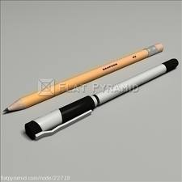
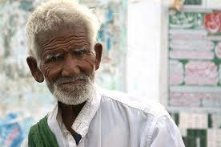
Conjunction
I bought a pen yesterday
I bought a pencil yesterday
I bought a pen and a pencil yesterday
The old man is poor
The old man is honest
The old man is poor but honest
Conjunction is a word which add two sentences and make a suitable scenes.
Some common conjunction: and, but,so, so that,because, because of, etc.

Slide 16
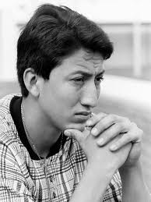
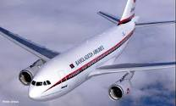
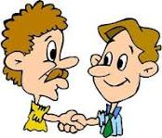
Interjection
Oh no, I forgot that the exam was today.
Wow! That airoplane ride was awesome!
Hi, this is Rony.
Interjection is a word which expresses sorrow, joy,delightfull,etc

Slide 17
Pair work
Write two examples of each parts of speech

Slide 18
Group work
Identify the parts of speech of each word of the following sentences
Mother cooks food for us.
I saw many animals in the zoo.

Slide 19
Answers
Mother: noun, cooks: verb
food: noun, for: preposition
us: pronoun, I: pronoun
saw: verb, many: adjective
animals: noun, in: preposition
the (Article): adjective,
zoo: noun

Slide 20
Home work
Find out the parts of speech of the underlined words:
The name of our country is Bangladesh. It is a small but overpopulated country. Dhaka is the capital of Bangladesh. About 15 crore people live in Bangladesh.

Slide 21
Thanks
Everybody

