Slide 1
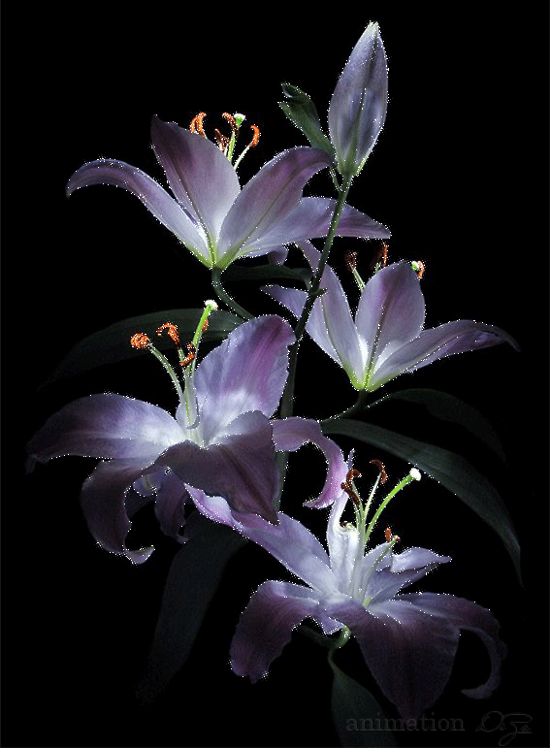
Welcome to multimedia class

Slide 2
Teacher’s Identity
Md. Arafat Hossain
Assistant Teacher (English)
Haripur High School
Joypurhat Sadar, Joypurhat-5900.
E-mail: arifjoy1991@gmail.com
Contact: 01747994114

Slide 3
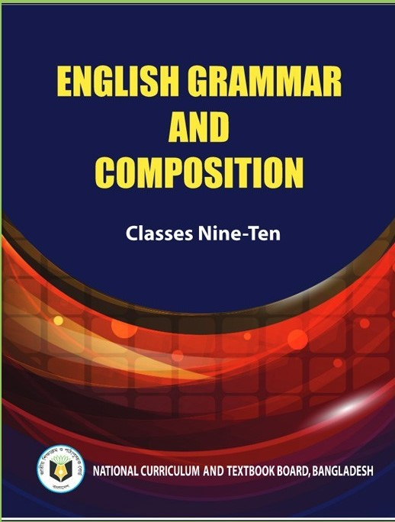
Class: Nine
Subject: English 2nd part
( English Grammar and Composition)
Time: 50 Minutes

Slide 4
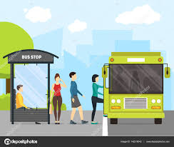
Look at the following pictures.
People get on the bus because there is a bus stop.
If there is no bus stoppage,
1) Where do you get down?
2) Where is your destination?

Slide 5
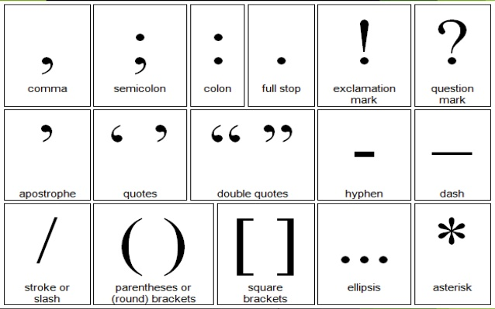
If there is no bus stop, you will not find any exact place. It will be very difficult for you to get down.
At the same way, if you have no stoppage in a sentence, it will be very difficult for you to understand the sentence appropriately.
These are the some stops in a sentenec.

Slide 6
Today We are going to discuss about-
The usage of punctuation marks.

Slide 7
Laerning Outcomes
After this lesson, students will be able to:
1. use punctuation marks correctly
2. identify and explain punctuation usage
3. understand sentence meaningfully.

Slide 8
Punctuation is the use of signs and symbols which make the text meaningful.
Here are some common punctuation marks:
Stops at the end of the sentence
. (Full Stop)
? (Note of Interrogation)
! (Note of Exclamation)
Brakes in the middle of the sentence
, (Comma)
; (Semi-colon)
: (Colon)
- (Hyphen) etc.

Slide 9
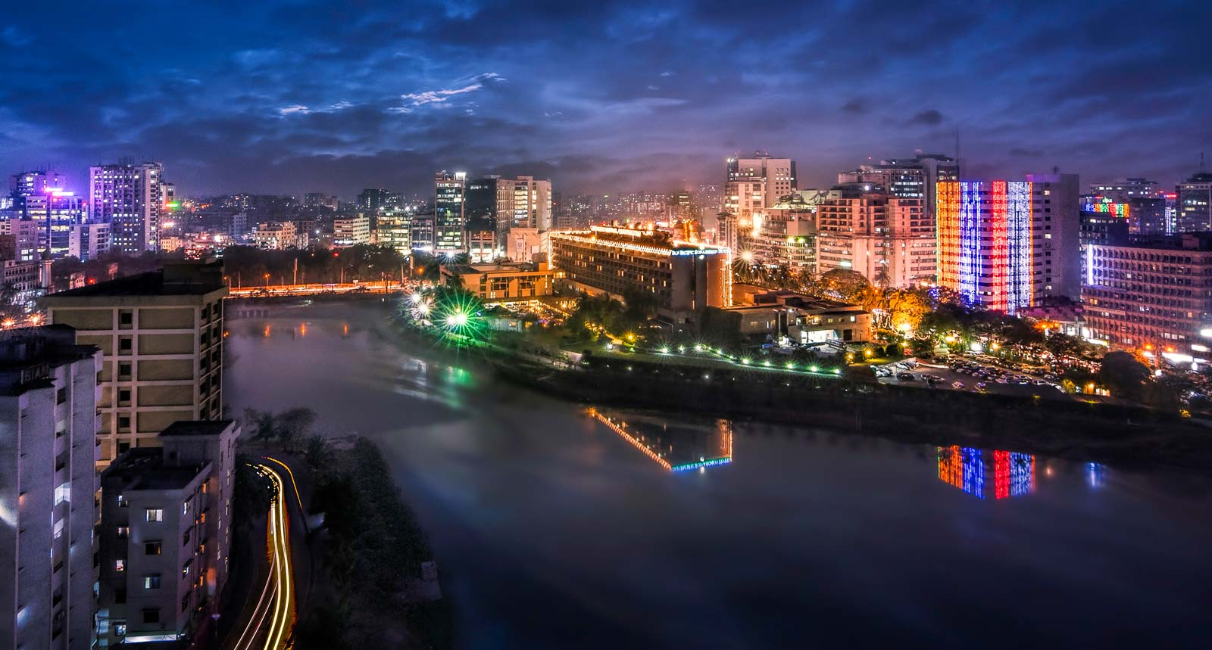
Full stop (.)
In written English, a sentence ends with a full stop or a question mark or an exclamation mark.
A full stop is used at the end of an assertive or an imperative or an optative sentence.
Dhaka is the capital of Bangladesh.

Slide 10
Note of interrogation (?)
An interrogative sentence ends with a question mark
or note of interrogation.

Slide 11
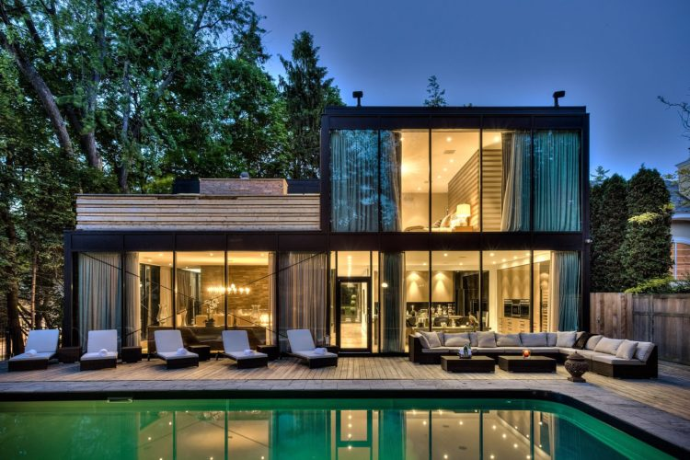
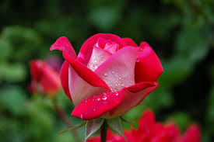
Note of exclamation (!)
The exclamation mark is used to express surprise, astonishment, excitement etc.
What a gorgeous house!
How beautiful
the flower is!

Slide 12
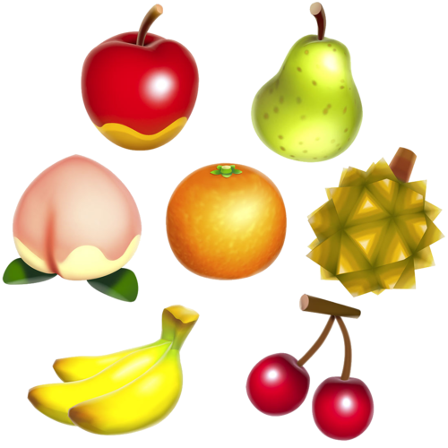
Comma (,)
It is the most useful common punctuation mark in English.
To separate words, phrases and sentences in a series:
apples, oranges, guavas, and bananas
They ate, they drank, and they danced.
To set off the name of a person you are addressing:
Kalam, what are you doing?
To use in titles, dates, addresses:
Farhan, M.D. April 06, 2020 Haripur, Joypurhat
To use before Noun/ Case in Apposition:
Mr. Khan, the headmaster of this school, is a learned man.

Slide 13
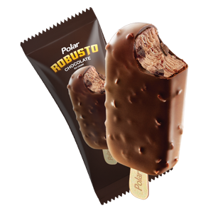
To use before a tag question.
They are ready to go, aren't they?
To set off the indirect speech from the direct speech.
I told him , “ Have you done the work?”
To differentiate subordinate clause from principle clause.
When I was going to school, I met with my friend.
Semicolon (;)
A semicolon is most commonly used to-
separate two sentences joined together without any linking words.
I love ice cream; it is my favorite food.

Slide 14
To separate two sentences joined by the linking words therefore, however, thus, moreover, yet, but or the linking phrases for example, in fact, in any case, on the other hand.
He had all the qualifications; yet he did not get the job.

Slide 15
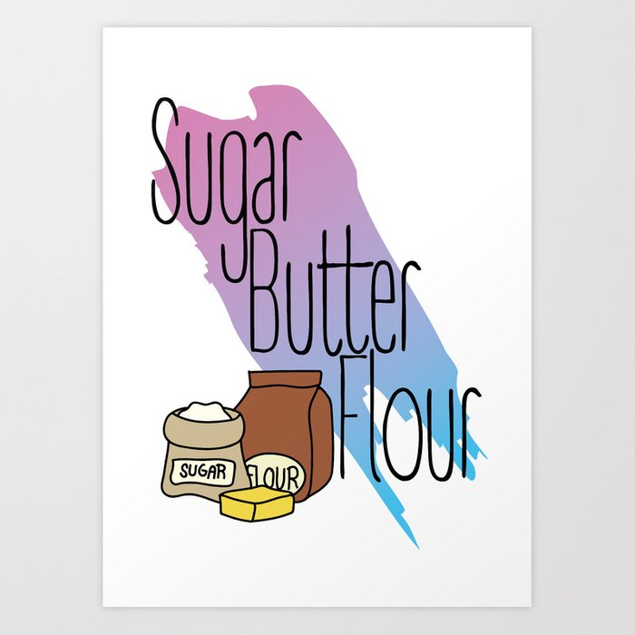
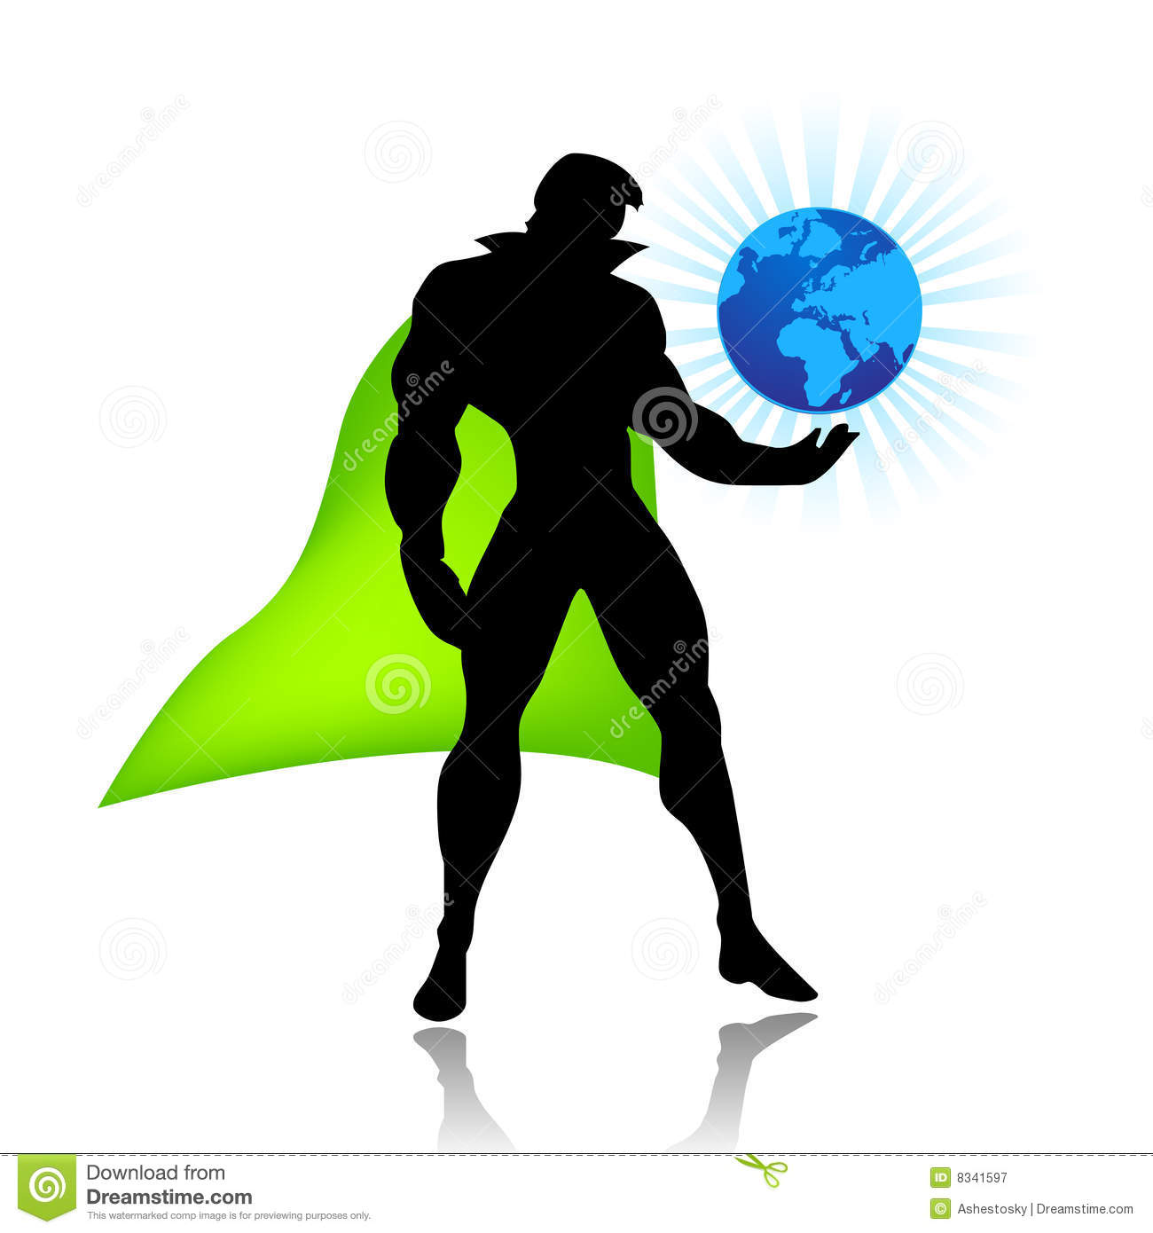
Colon (:)
The colon: means “as follows.” It is used-
To introduce a long list.
I want the following items: Butter, Sugar, and Flour.
to introduce a final word, phrases, or example that shows the meaning or result of the sentence.
Superheroes always manage to save themselves: all superheroes are immortal.

Slide 16
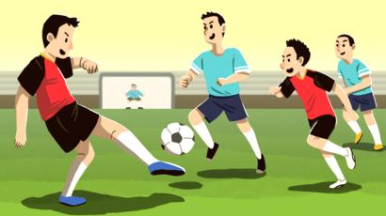
Quotation Mark/Inverted Commas (‘….’ “…..”)
Quotation mark is used to set off a direct quotation.
They said to me, “We are playing.”

Slide 17
Hyphen (-)
It is used-
To join some compound words together.
A three-month-old baby
To separate starting and ending numbers, dates, and scores.
Pages 35-52, 1974-1976

Slide 18
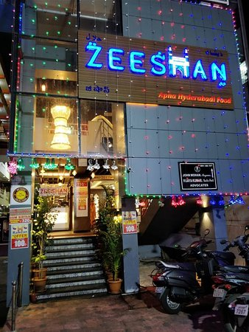
Apostrophe (’)
Apostrophe is used to-
Show ownership
Zeeshan’s house
Show contractions
Don’t

Slide 19
Dash (─)
A dash is longer than a hyphen. It is used-
to interrupt a sentence dramatically and to put stress on words you’ve added.
He fired the gun, and then ─
Afterward ─ yes, he was a real criminal.
Parentheses ( )
Parentheses provide a stronger break than commas, but not as strong as break as dashes. It is used to separate interrupting material.
Mount Robson (12972 feet) is the highest mountain in the Canadian Rockies.

Slide 20
Brackets [ ]
It is used-
to add your own words in a quotation.
“ Four Score [that means eighty] and seven years ago……..”

Slide 21
Individual Work
Use punctuation marks where necessary in the following text.
My name is Pollob I was born in Bangladesh I have completed my higher education from Dhaka University I love my country most It is a beautiful country
Answer: My name is Pollob. I was born in Bangladesh. I have completed my higher education from Dhaka University. I love my country most. It is a beautiful country.

Slide 22
Home Work
Will you come to my house tomorrow I asked the boy We can discuss the terms and conditions then I said I shall be very happy to meet you at your house Thank you so much he replied

Slide 23
Thank you all for your patience.

