Slide 1


Slide 2






Welcome
Stay home, Stay safe.

Slide 3

Presented by-
Mithu kumar Roy,
Assistant Teacher,
Tularampur Gov’t Primary School. Narail Sadar, Narail.
ICT4E District Ambassador.
Contact: 01714670007
E-mail: mithuroy0007@gmail.com .
Stay home, Stay safe.

Slide 4



Dear students,
How are you?
Do you want to listen to a rhyme?
PLEASE CLICK
First, Listen to the rhyme, then recite the rhyme with action.
Stay home, Stay safe.

Slide 5

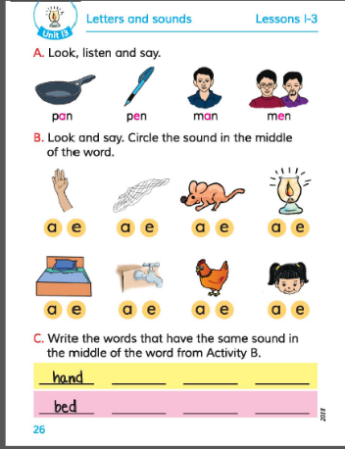
Today’s Lesson: Letters And Sounds.
English For Today
Class:3
Unit:13, Lesson: 1-3
Activity: B , Page: 26
Time: 50 minutes.
Stay home, Stay safe.

Slide 6
Learning Outcomes:
By the end of the lesson, Students will be able to -
Listening :
1.1.1 recognize English sound differences in the context of words.
Speaking :
1.1.1 repeat words, phrases and sentences after the teacher with proper sounds and stress.
1.1.2 say words, phrases and sentences with proper
sound and stress.

Slide 7

Look at the pictures and say the words.
Review the Previous Lesson
Stay home, Stay safe.

Slide 8



Dear students,
Can you find out the words which have a and e.
Yes..! Let us see.
Review the Previous Lesson

Slide 9




Let us see.
Now who can say the vowel sound of the words.
a
pan
pen
man
men
e
a
e
Stay home, Stay safe.

Slide 10
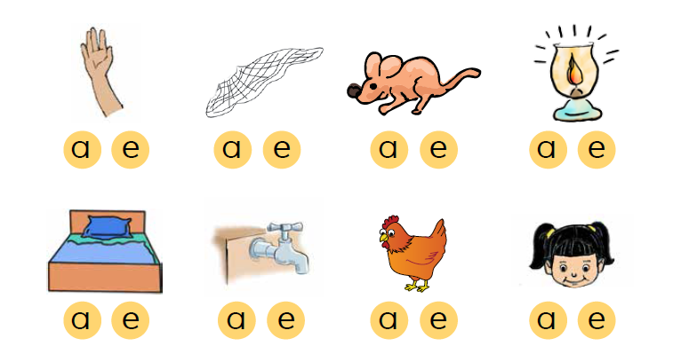
Now Look at the picture and listen to me.
Stay home, Stay safe.

Slide 11
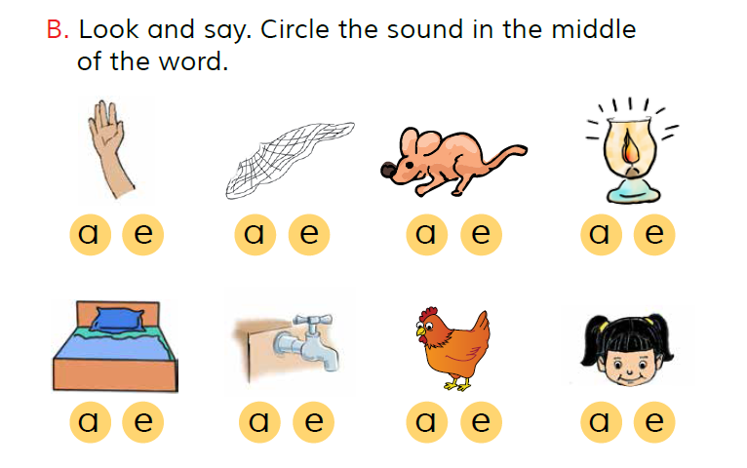
Now keep your finger on the picture and read after me.
Stay home, Stay safe.

Slide 12
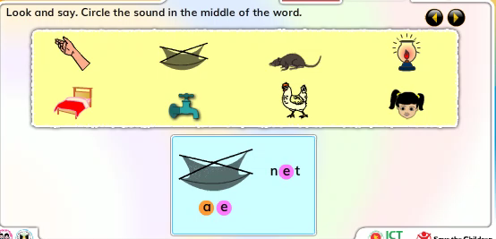
Now everybody, look attentively.

Slide 13

Do the Activity B
Circle the sound in the middle of the words..
Pair work
Stay home, Stay safe.

Slide 14
Now, Let us see.
Pair work
Stay home, Stay safe.

Slide 15




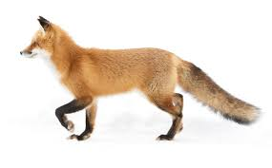

Look and Say the middle sound of the picture.
Evaluation
Stay home, Stay safe.

Slide 16






Let us see.
Hut
Mat
Evaluation
Bag
Fox
Box
Bat
Stay home, Stay safe.

Slide 17

Write down six words in your exercise book.
At least two will have the same middle sound
Stay home, Stay safe.

Slide 18

Thank you all.
Stay home, Stay safe.

