Slide 2
INTRODUCTION
Emdadul Haque Milon
B.A hons in English M.A,B.ed
Assistant Teacher( English)
Sonapur SESDP Model High School
Dowarabazar, Sunamganj
CLASS: NINE-TEN
SUBJECT: ENGLISH 1ST PAPER

Slide 3
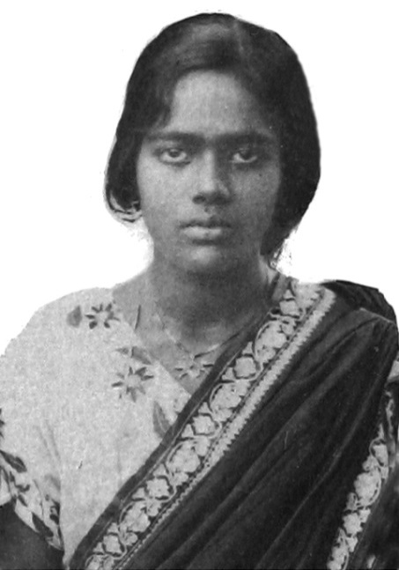
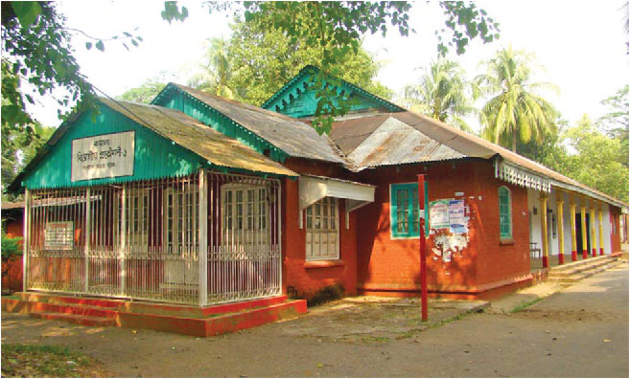
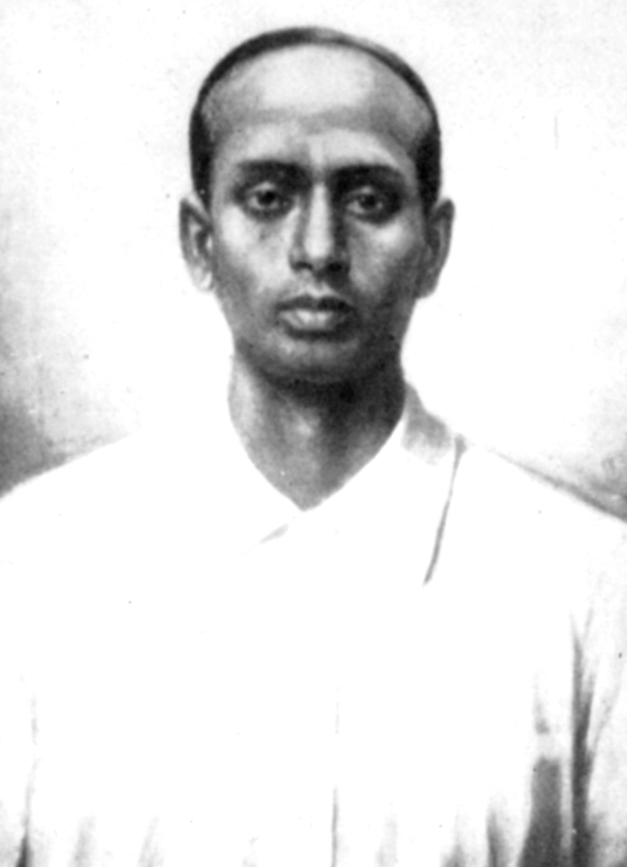
What do you know about them? Why are they well known?
Pritilota
Pahartali European Club
Surya Sen

Slide 4
Today our topic
They had dreams 1
Unit- 10
Lesson- 3

Slide 5
Learning Outcomes Of The Lesson
After this lesson the students will be able to-
1. talk about pictures.
2. listen for specific information.
3. read a text and find out information.
4. write about a person.
5. infer the word meaning from the text.

Slide 6
Listen the audio about Pritilata and choose the best answer.
1. Pritilota’s father was a ___________.
a) teacher b) doctor c) clerk d) engineer
$$$$
2. When did she pass her matriculation?
a) in 1921 b) in 1927 c) in 1929 d) in 1932
$$$$
3. The Chhatri Sangha was led by ____________ .
a) Lila Nag b) Pritilata c) Kalayani Das d) Lata Nag
$$$$
4. She became the headteacher of a local ________ .
a) Bangla medium high school b) primary school
c) English medium high school d) college
$$$$

Slide 7
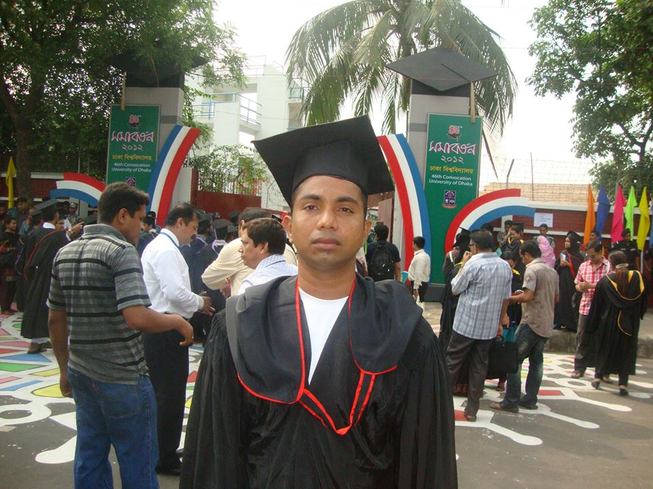
Graduate
Meaning
To achieve a university degree
Mr. Azim graduated from the University of Dhaka.

Slide 8
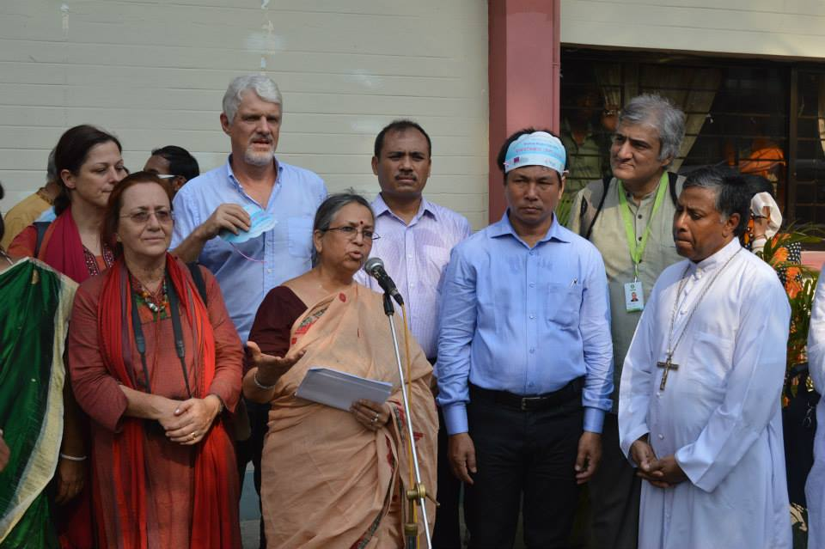
Activist
A member of a certain social or political group
Meaning
Mrs. Sultana Kamal is a human-rights activist.

Slide 9
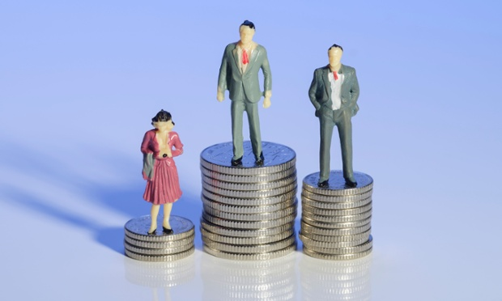
Discrimination
different attitude to people , especially on the grounds of race, age, or sex;
Meaning
Women should not have any discrimination. They should have equal rights as men have.

Slide 10
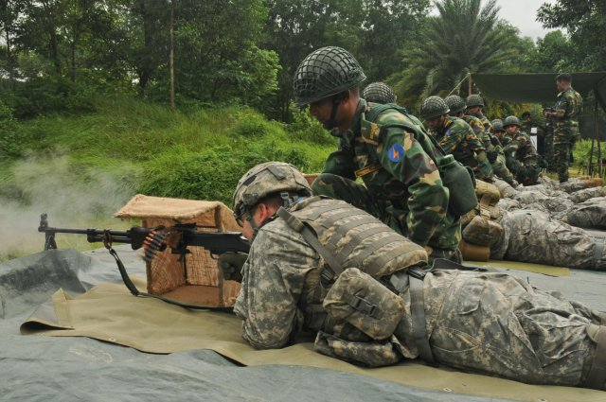
Combat
Meaning
fighting with arms/battle
The soldiers are having combat training.

Slide 11
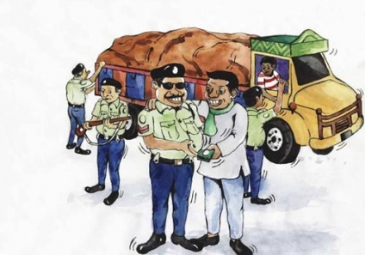
Notorious
Meaning
dishonourable
The police is taking bribe. It is a notorious deed.

Slide 12
Individual work
Read the text in the book and match the words in column A with the meanings in column B.

Slide 13
Read the text in the book and write the answers of the following questions.
Q 1. What did Pritilata dream for?
Q 2. Who was the mastermind of attacking of the Pahartali European Club?
Q 3. Why was the sign “Dogs and Indians not allowed” notorious?
Q 4. How did Pritilata prove that women can work like men?
Notes:
Answer may vary here.

Slide 14
Fill the gaps with suitable words from the box. Use right form of words if it is needed.
tell , name , injured, plan, commit, ideal, attack, found,
In 1932, Surya Sen a) __________ to attack the Pahartali European Club which had a signboard that read "Dogs and Indians not allowed” Pritilata was b) _______to lead the attack. Dressing herself as a Punjabi male, Pritilata with her team c) ___________ the club on September 23 at 10:45 pm. d)__________ and trapped by the British police, Pritilata swallowed cyanide and e) ___________ suicide to avoid arrest. Bangladeshi writer Selina Hossain calls Pritilata an f) _________for every woman. A trust named Birkannya Pritilata Trust has been g) _________ in her memory. A dormitory of Jahangirnagar University called Pritilata hall has been h) ________after Pritilata Waddedar.
planned
told
attacked
Injured
committed
ideal
founded
named

Slide 15
Homework
Mention the name of a man who is your ideal. Why is he your ideal? Write it in ten sentences.

Slide 16
Good Bye

