Slide 1
Good Morning my dear students.
Notes:
Welcome slide. Teacher may change according to his will.

Slide 2
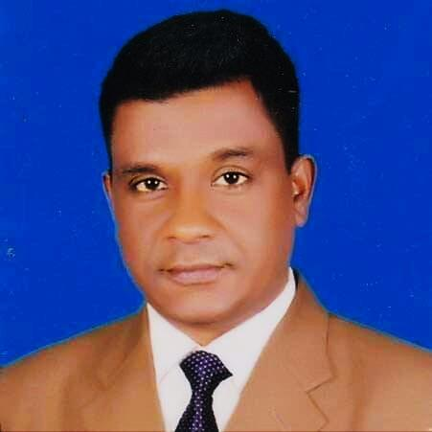
Introduction
Mohammad Azharul Islam
Assistant Teacher (English)
Hugra Habib Kader High School, Tamgail
English For Today
Class- IX - X

Slide 3
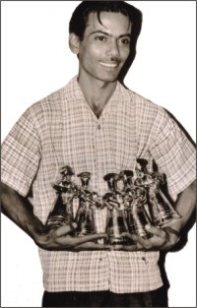
Do you know them?
Pritilata waddedar
Zahir Raihan
Notes:
Suspension to lesson declaration.

Slide 4
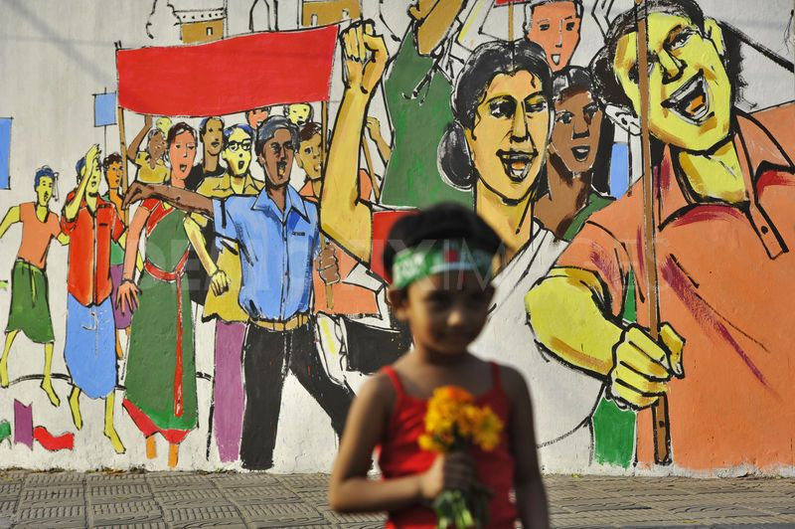
They had the dream of Freedom
Freedom of speech
Freedom of a country
Notes:
They had the dreams of the above.

Slide 5
Our Today’s lesson is-
They had dreams- 2
Unit-10, Lesson-4

Slide 6
Learning outcomes
After studied this lesson, learners will able to--
Ss will ask and answer questions.
Ss will read and understand text through silent reading
Ss will take and give interviews.
Ss will writing a paragraph.
Notes:
All the four skills will be focused in this lesson.

Slide 7
Zahir Raihan’s personnel.
Let’s have a look at --
Date of birth
19 August, 1935
Birth place
Village: Majupur
District: Feni
Breathed last
30 December,1971

Slide 8
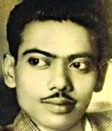
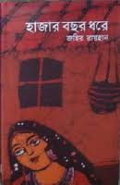
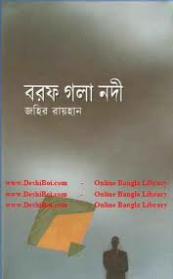
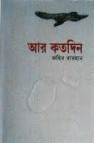
Some important writings of Zahir Raihan
Zahir Raihan

Slide 9
What was the legendary works of Zahir Raihan?
Jibon Theke Neya
(Bangla Movie)

Slide 10
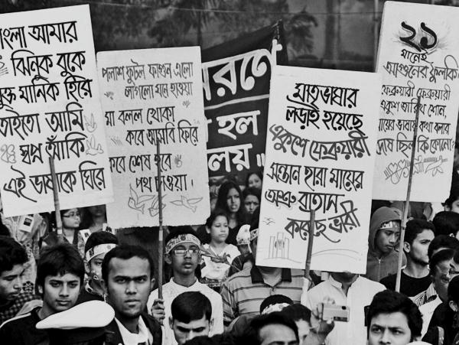
Key word/new words option
Word
Meaning
Procession
Parade, convoy, march past, gathering of people demanding right.
Zahir Raihan attended the procession of 21 February 1952.

Slide 11
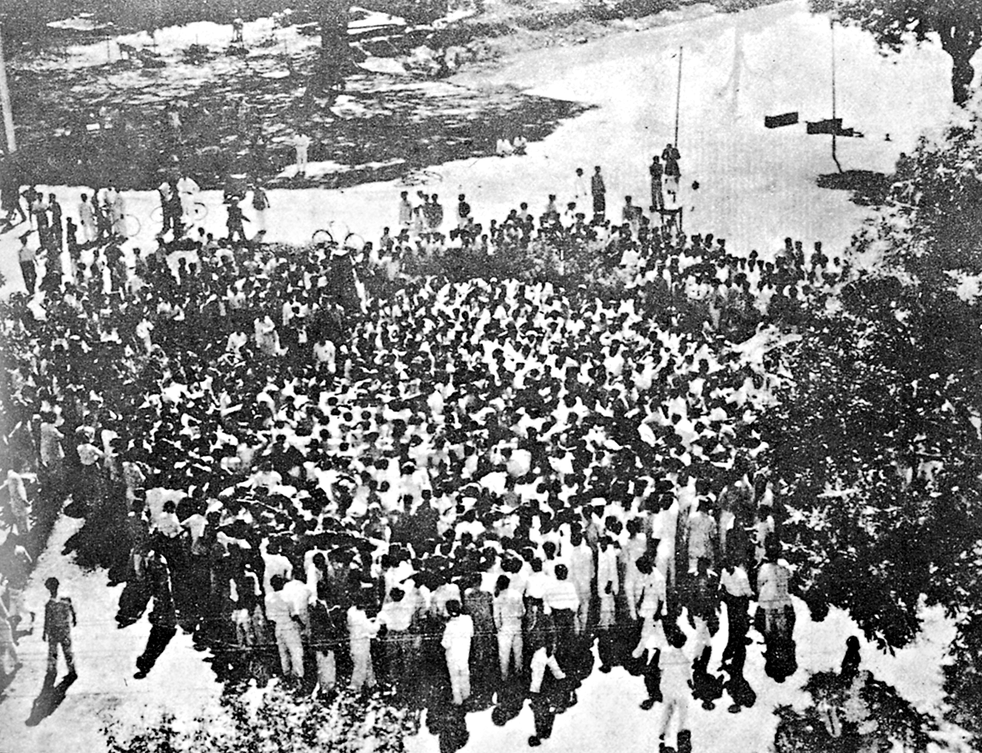
Word
Meaning
Historical meeting
Past ,old, ancient, meeting mentioned in the history
Zahir Raihan was present in the meeting of Amtala on 21 February, 1952.

Slide 12
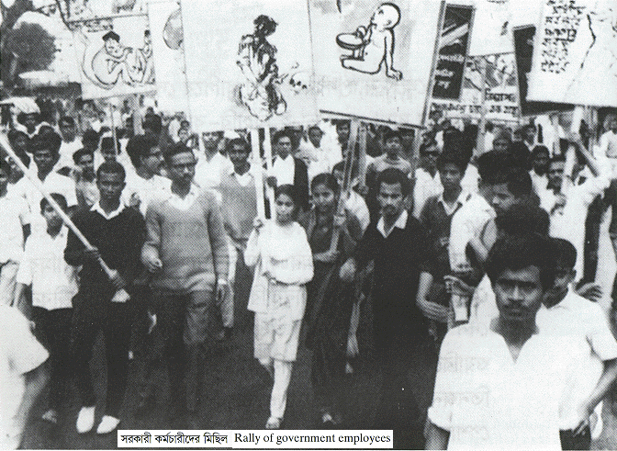
Word
Meaning
Mass movement
Movement participated by all classes of people
He also participated in the mass movement of 1969.

Slide 13
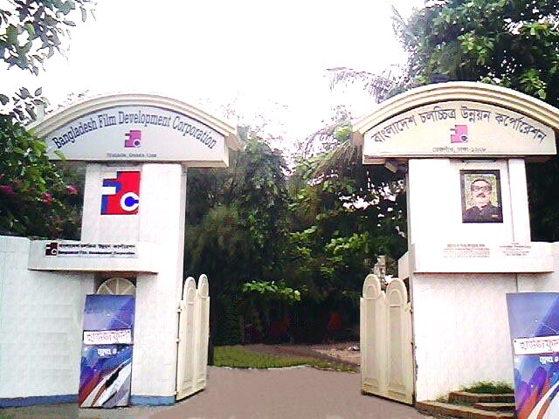
Word
Meaning
Film industry
Movie making industry, FDC
He had many dreams about our film industry.

Slide 14
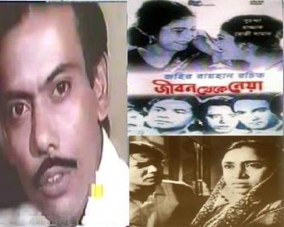
Word
Meaning
legendary
Fabulous, famous, well known
Zahir Raihan made a legendary film ’Jibon Theke Neya.’

Slide 15
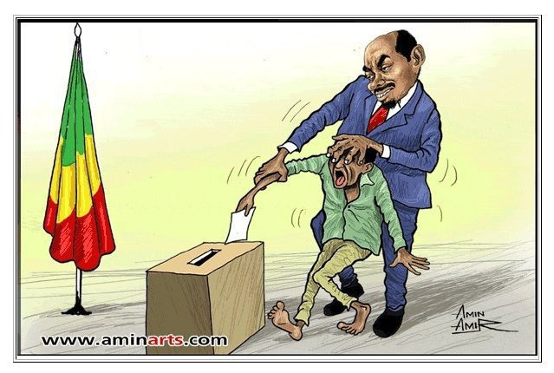
Word
Meaning
Autocratic
Despotic, repressive
Zahir Raihan was always against the autocratic government.

Slide 16
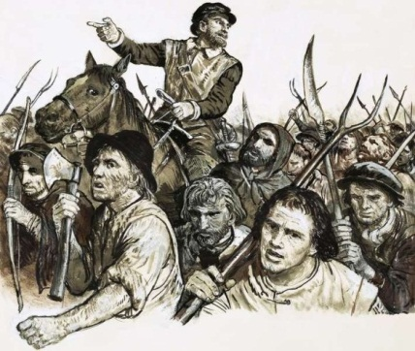
Word
Meaning
Revolt
Riot, mutiny
‘Jibon Theke Neya’ was a revolt against the autocratic government.

Slide 17
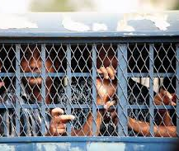
Word
Meaning
Prison
Jail , penal, punishment
The people in the picture are in prison.

Slide 18
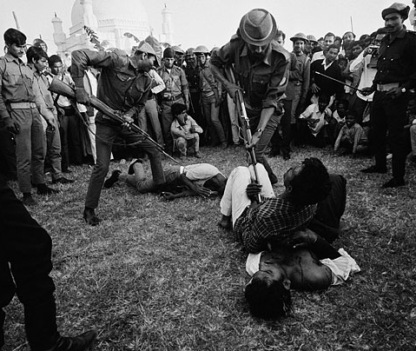
Word
Meaning
Atrocities
Cruelty,
killings, murder, violence
Zahir Raihan showed Pakistani atrocities by his film ‘Jibon Theke Neya’ very well.

Slide 19
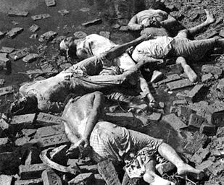
Word
Meaning
Genocide
Mass killing.
He also presented Pakistani genocide by his film ‘Jibon Theke Neya’ very clearly.

Slide 20
B Read the text.
Zahir Raihan was one of the most talented film makers in Bangladesh. He was bom on 19 August 1935 in the village Majupur, in Feni district. He was an active worker of the Language Movement. He was one of the ten students to go out in a procession on 21 February 1952 despite a ban on such activities. As a result, he and many others were arrested and taken to prison. Zahir was also present at the historical meeting of Amtala on February 21, 1952. He also took part in the mass movement in 1969. In 1971, he joined the Liberation War. All through his life, Zahir dreamt for a democratic society, a society that will ensure freedom of speech and will. He had many dreams about our film industry too. He made a legendary film Jibon Theke Neya based on the Language Movement of 1952. It was a revolt against the then autocratic government. The family presented in that film was a miniature East Pakistan ruled by an autocrat who had to go to the prison for her conspiracy.

Slide 21
During the liberation war this film was shown outside Bangladesh. Critics like Satyajit Ray, Mrinal Sen, and Ritwik Ghatak appreciated this film. Zahir gave all his money to the Freedom Fighters' trust that he got from his film shows. Besides, his great documentary on Pakistani atrocities, Stop Genocide, helped create world sentiment in favour of our liberation war. On 30 December 1971, someone informed Zahir about an address somewhere at Mirpur, where he might find his brother, the famous writer Shahidullah Kaiser. Shahidulla was captured and killed by the Pakistani army and the local collaborators during the last days of the war. Accordingly Zahir left home to get his brother back and he never returned. Zahir's dream was fulfilled. He could see the inception of a free independent Bangladesh though he did not get back his brother. And it's a pity that this dreamer was missing at such a time when his dream came true.

Slide 22
C Use appropriate information from the text above to complete the grid.
Evaluation
Zahir Raihan
participated in | famous as | best documentary | movie based on language movement | missing since | his dream
 |  | .

Slide 23
Evaluation through completing sentences & pair works.
D Read the following sentences and complete them.
1 Zahir Raihan is famous as …………………………………………….
2 Zahir was imprisoned because ……………………………………….
3 He participated in ………………………………….. and …………….
4 Jibon Theke Neya symbolizes………………………………………….
5 He donated ………………………………………………………………
6 He worked to organize ………………………………………………… by his
great documentary Stop Genocide.
7 His disappearance is a great…………………………………………..
E Work in pairs. Discuss
1 Why is Zahir Raihan considered a freedom fighter though he was a film
maker?
2 How does the title of the lesson fit to the story of Zahir Raihan?

Slide 24
See you again.
Notes:
Last greetings.

Slide 25
