Slide 2
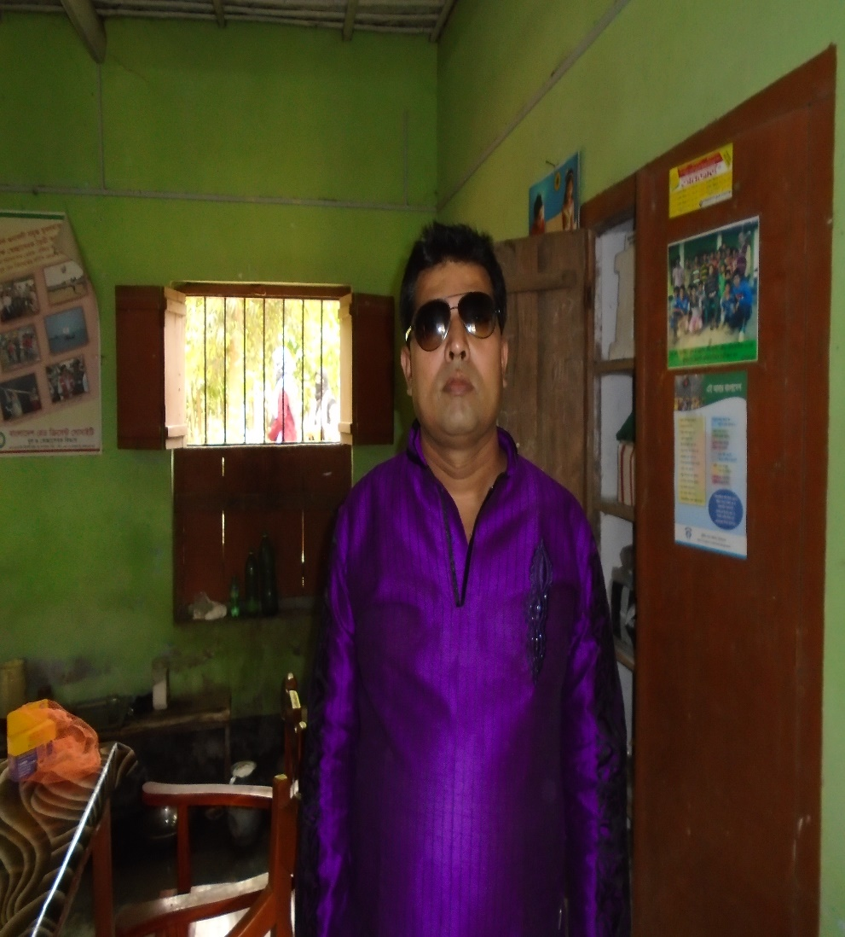
TEACHER’S IDENTITY
ASHUTOSH KUMAR BOSU
ASSISTANT HEADTEACHER
DHULJORA CHURARGATI P,C HIGH SCHOOL
MOHAMMADPUR, MAGURA.
Email-ashutoshbosu1971@gmail.com
-01718322787

Slide 3
LESSON IDENTITY
CLASS- NINE
SUBJECT- ENGLISH GRAMMAR
LESSON- CONNECTORS

Slide 4
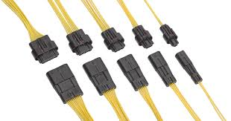
Look at the pictures
What are they?

Slide 5
Declaration of Lesson
Connectors

Slide 6
OBJECTIVES
After the lesson, the students will be able to
tell the definition of connectors
tell the classification of connectors
fill up gaps with appropriate connectors

Slide 7
Look at the following sentences
He is poor but he is honest.
Wait until the rain stops.
Ratan is absent in the class because he could not prepare his lesson.
Kamal and Jamal are brothers.
While taking food, we should bear in mind that we do not eat just to satisfy hunger or to fill the body.

Slide 8
Do you know the underlined red words?
Connectors
What is connector?
Connectors are those words which connect two or more words, phrases or clauses.

Slide 9
Classification of Connectors
Connectors
Primary
Connectors
Other
Connectors
Secondary
Connectors
For,and,but,since,though,
when,unless,as,till etc.
Because of, in spite of, so that, beside etc.
Moreover,therefore,on the other hand, thus etc.

Slide 10
List of Connectors
Meaning | Sentence Connectors | Subordinates | Phrase Linkers
Cause and effect | Therefore,as a result, consequently,hence, thus | Because,since,as | Because of, as a result,due to, owing to
Comparison | Similarly,in the same way | As | Like, similar to
Contrast in expection | However, nevertheless,yet,on the contrary,unfortunately | Though, although, but | Despite of, in spite of
Contrast in comparison | On the other hand | While, whereas | Unlike
Contrast in action | Instead |  | Instead of
Emphasis | In fact, in deed
Main reason | Primarily
confirmation | Usually, normally naturally | In accordance with

Slide 11
Fill in the gap with appropriate sentence connectors
Every citizen has some duties and responsibilities for his nation.(a)-------- most of the people are careless in this respect. People of this country have achieved national identity at the cost of a great sacrifice(b)----------- is still evaluated nationally. (c) ----- some selfish people never want to give them recognition. (d)------ we all should do some benevolent activities. (e)----- we will be guilty to the nation.
But
which
Though
However
Otherwise

Slide 12
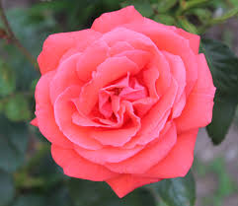
Thank you all

