Slide 2
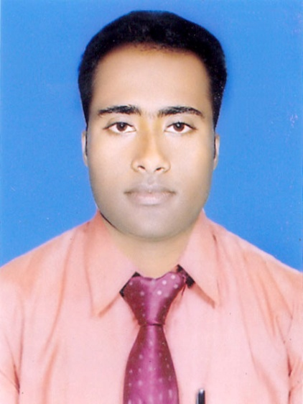
Teacher ‘s Identity
CHANDAN BISWAS
ASSISTANT TEACHER
ANDHA HIGH SCHOOL
E-mail: chandanb13@gmail.com

Slide 4
Class Identity
English-1st Paper
Class-Six
Lesson-1
Going to a new School

Slide 5
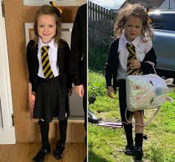
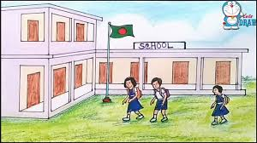
Look at the picture

Slide 6
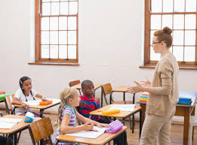
Say something about the picture.

Slide 7
Learning outcomes
After completing the lesson students will be able to
*Read and understand the texts.
*Write a paragraph about first day at school.
*Answer the questions.

Slide 8
Vocabulary
Interesting
Rickshaw
Reached
Gate
found
Everyone
Class
– মজাদার
- রিক্সা
- পৌঁছে
- গেট / ফটক
- পাওয়া
ভাঙ্গা
- শ্রেণি

Slide 9
Walked
Classroom
Seat
Warmly
Greeted
Friendly
Good bye
হেঁটেছিল
-শ্রেণীকক্ষ
- বসার আসন
- উষ্ণভাবে
- অভিবাদন জানান
- বন্ধুত্ব পুর্ণ
- বিদায়

Slide 10
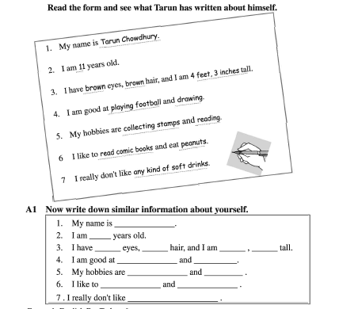
Read & Fill in the gap

Slide 11
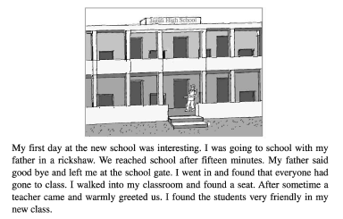
Read the story

Slide 12
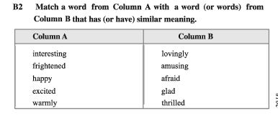
EVALUATION

Slide 13
EVALUATION
1* Who took Tarun to school the first day ?
2* How Tarun felt on first day in the school and why he felt so ?
3* What happened in the school on the first day ?

Slide 14
Home work
* Write paragraph on first day at your school and why you felt so ?

Slide 15
Thank you everybody

