Slide 1
Welcome

Slide 2
Presented by
Mst. Sahida Banu
Asssistant Teacher,
Hoza Government Primary School.
Durgapur, Rajshahi.
Phone No.01717905032

Slide 3
Lesson Introduction
Class: Four
Subject: English
Unit:17
Lesson:1-2
Title:In the park
Page No:34
Time:40 mins
Date:31.03.2020

Slide 4
Speaking:
6.1.1 say what the speaker is doing.
6.1.2 say others are doing.
6.2.1 say what the speaker is doing.
8.1.1 take part in conversations on simple topics (likes/dislikes, hobbies ,holidays, family, friends, etc.)
Reading:
1.4.1 read words, phrases and sentences in the text.
1.5.1 read words, phrases and sentences in the text with proper pronunciation, stress and intonation.
1.7.1 read short paragraphs, dialogues and simple letters.

Slide 5
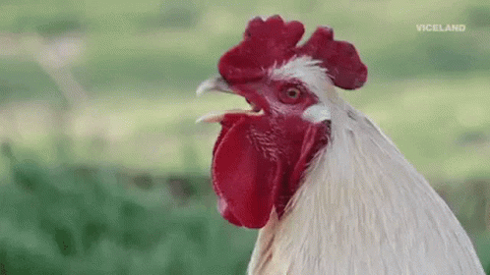
Warmup:
Lets listen a audio.

Slide 6
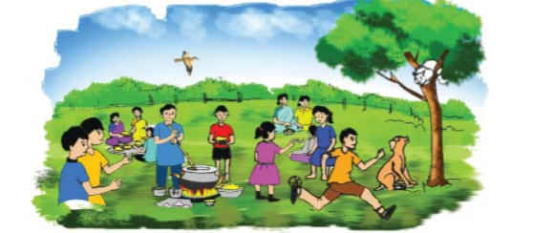
Todays Lesson :
Look at the picture.
Where they are staying ?
Write down on your notebook ‘In the park’.
“In the park”

Slide 7
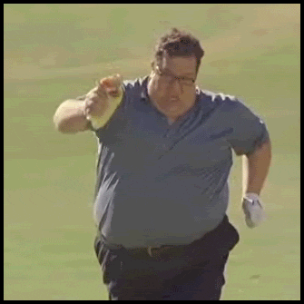
What is the man doing ?
Look at the picture
The man is running very fast.

Slide 8
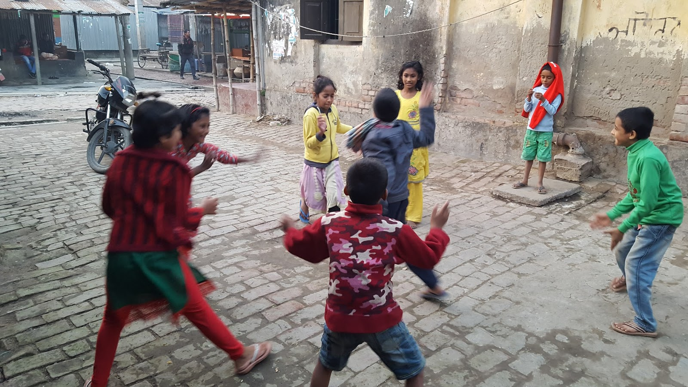
What are they doing?
Look at the picture
They are playing.

Slide 9
Pairwork:
Make sentences
Look at the table
Language Focus
B. Statement in the present continuous
We use the present continuous to talk about things happening now.
I You He/She/It We You They | am are is are are are | playing | with Mehnaz.
Subject+am/is/are+principle verb+ing+object

Slide 10
Ans:
I am playing with Mehnaz.
You are playing with Mehnaz.
He/She/It is playing with Mehnaz.
We are playingwith Mehnaz
You are playing with Mehnaz.
They are playing with Mehnaz.

Slide 11
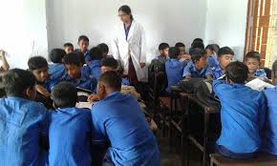
Groupwork:
Open your book at page 34 and read it and act each other in 5 groups.

Slide 12
Indivisual work:
Look at the picture of activityA. Then write any five present continuous sentences. Use the verb bellow.
eat
cook
sit
look at
fly
stand
Ans:
1 . Some children are eating something.
2 . A man is cooking.
3 . A cat is sitting on the tree.
4 . A dog is looking at the cat.
5 . There is abird flying in the sky.

Slide 13
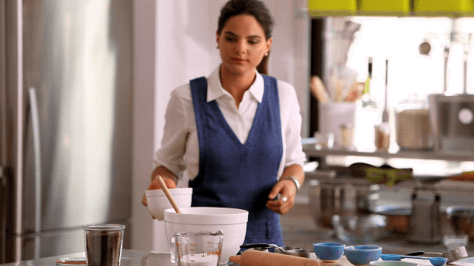
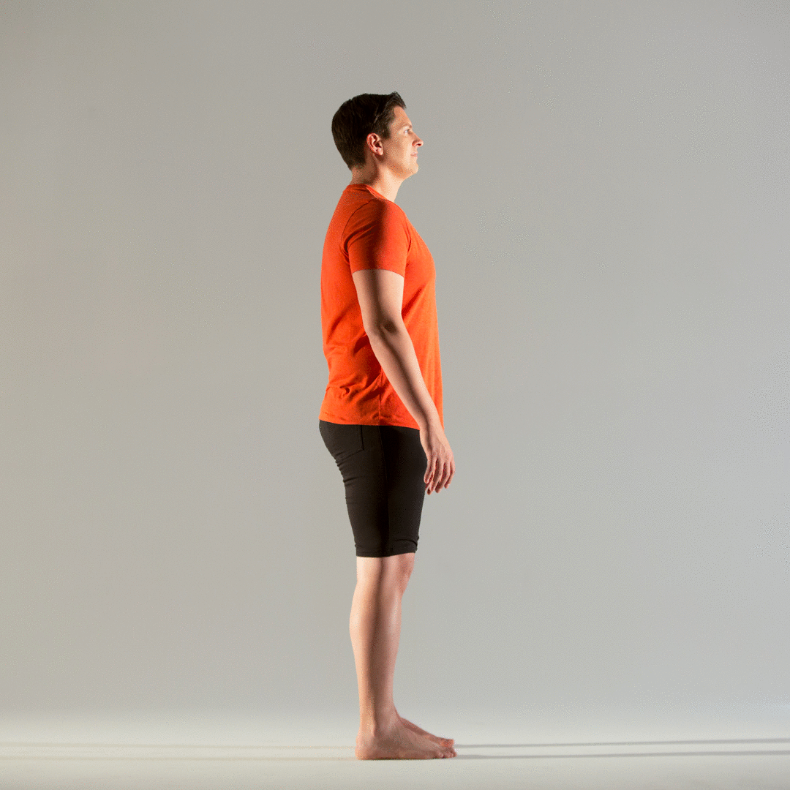
Evaluation:
Look at the picture.
1.What does she doing?
Ans. She is cooking.
2.What the man is doing?
Ans. The man is standing.

Slide 14
One day one word
# Write down on your note book.
Date:31.03.2020
Word Meaning(অর্থ) Antonym Sentence
Fast
Quick(দ্রুত)
Slow
The horse is running fast.

Slide 15
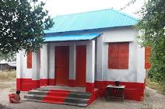
Homework:
Q . Write 5 sentences in present continuous.

Slide 16
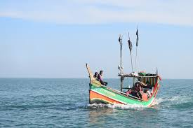
Thanks to all

